Slide 1
Warm Up
Video Link- https://www.youtube.com/watch?v=EGgaXXBkE8A&t=1s&index=7&list=PLT7ZYdeufVdtesTphFnf-dHUQcV6pjB-g
If you were a colonist which side of this conversation would you choose and why?

Slide 2
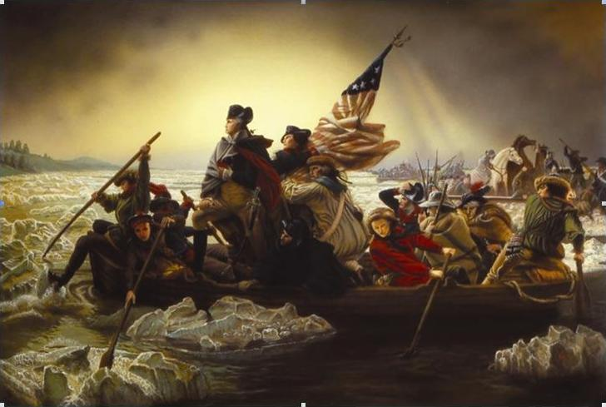
The American Revolution
LG 2: Compare the causes, characteristics, and consequences of the American Revolution and French Revolution.

Slide 3
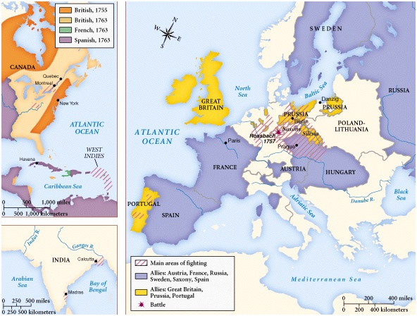
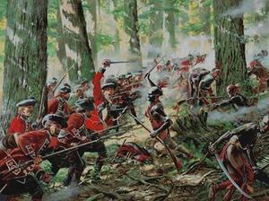
Tensions Between Britain and Its Colonists
Pontiac’s Rebellion
Seven Years’ War (French & Indian War)

Slide 4
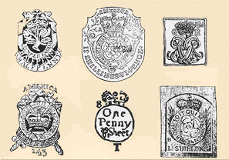
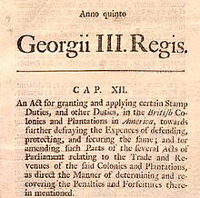
Stamp Act, Sugar Act, Townshend Act
Required colonists to pay a tax on everyday goods
Meant to raise money for British war expenses
Protests began – led by Sons of Liberty
Opposition to Stamp Act began to unite the colonies

Slide 5
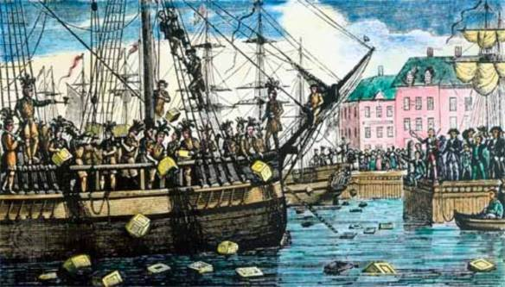
Boston Tea Party
1773: British Parliament gave the British East India Company a monopoly on tea sales in the colonies
Colonists saw this as a scheme to hide the tea tax
Colonists disguised as Mohawk Indians climbed onto BEIC ships and dumped the tea into the harbor

Slide 6
Coercive Acts
British reaction to Boston Tea Party
Coercive Acts - England
Intolerable Acts – Colonies
Quartering Act
Massachusetts Govt. Act
Boston Harbor Blockade

Slide 7
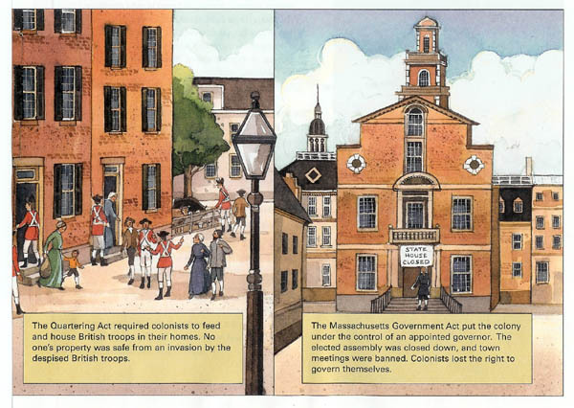

Slide 8
First Continental Congress
1774: delegates from 12 colonies met in Philadelphia
Colonists upset about paying taxes but not being represented in Parliament
“No taxation without representation”- battle cry of the American Revolution

Slide 9
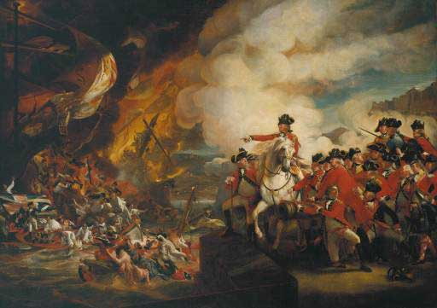
Lexington & Concord
British government declared Massachusetts to be in a state of rebellion
1775: British troops sent to confiscate weapons
No one is sure who fired the first shot, but this started the Revolution
“shot heard ‘round the world”

Slide 10
Revolutionaries
Thomas Paine: Common Sense
Thomas Jefferson: Summary View of the Rights of British America
Benjamin Franklin
John Adams
“Why is it that we hesitate? From Britain we can expect nothing but ruin. If she is admitted to the government of America again, this continent will not be worth living in.”

Slide 11
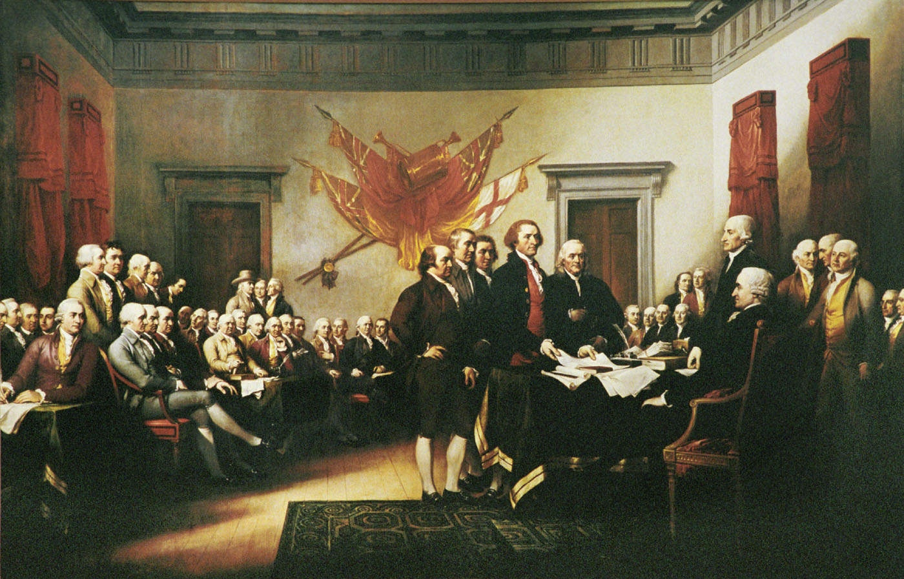
Second Continental Congress
Created a continental army
July 1776: Congress issued Declaration of Independence and renamed the 13 colonies as the United States of America
Colonies break
from England

Slide 12
Declaration of Independence
“We hold these truths to be self-evident, that all Men are created equal, that they are endowed by their Creator with certain unalienable Rights, that among these are Life, Liberty, and the Pursuit of Happiness – That to secure these Rights, Governments are instituted among Men, deriving their Powers from the Consent of the Governed, that whenever any Form of Government becomes destructive of these Ends, it is the Right of the People to alter or abolish it….”

Slide 13
Loyalists vs. Patriots
OR: Tories vs. Rebels
Tories/Loyalists: colonists who opposed the revolt against their mother country (Britain)
Rebels/Patriots: colonists who supported independence from Britain

Slide 14
Revolutionary War
1776: British forces capture NYC and attack Philadelphia
1777: British army coming from Canada is defeated at Battle of Saratoga (changed momentum)
1778: France joins
1778 – 1781: Stalemate
1781: Washington forced the surrender of Cornwallis at Yorktown, Virginia
1783: Treaty of Paris
France agreed to recognize the U.S. as an independent nation
Major game changer in the war

Slide 15
Results of the War
Constitution: based on Enlightenment ideas and Montesquieu’s separation of powers
Citizens gained more political rights
Relocation of Loyalists: 60,000 moved to Canada
Trade: increased between American and Britain
Expansion: Americans move west of the Appalachians – relocate Native Americans
French debt: bankrupt → French Revolution

