Slide 1
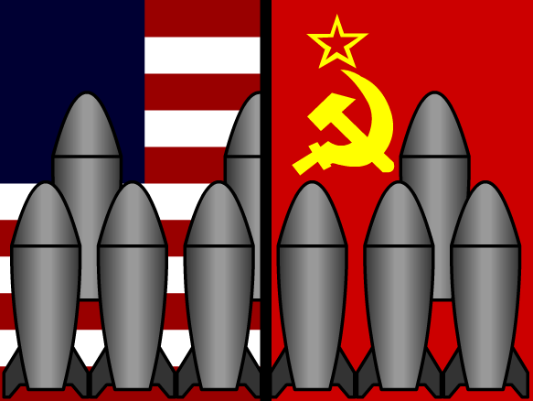
THE COLD WAR
Learning Goal 1: Describe the causes and effects of the Cold War and explain how the Korean War, Vietnam War and the arms race were associated with the Cold War.

Slide 2
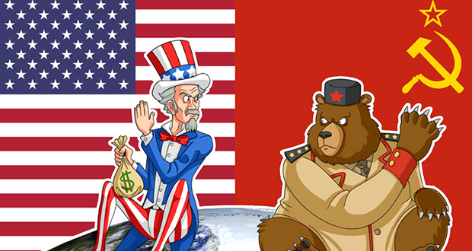
What was the cold war?
1945-1990
Political hostility between the (communist) Soviet Union and (capitalist, democratic) United States
Characterized by threats, propaganda, and proxy wars
Not actual physical fighting or warfare

Slide 3
Significant events of the cold war
Division of Germany
Building of Berlin Wall
Korean War
Arms War
Vietnam War
Space Race
Period of detente
Soviet Invasion of Afghanistan
Glasnost & perestroika

Slide 4
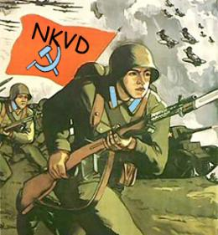
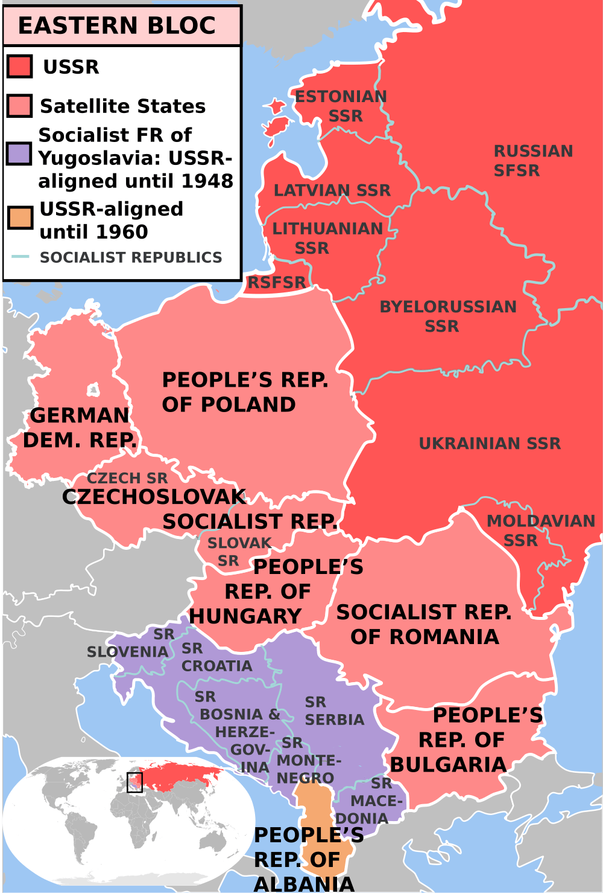
1945: USSR
Stalin in power
Estimated 26 million Soviet citizens died in WWII
  11 million soldiers; 15 million civilians
Stalin imprisoning & executing enemies or suspected enemies
  Secret police everywhere
Forced industrialization, collectivization, etc.
Citizens unable to travel the West
Forcing small ethnic groups to Siberia & exile
Daily life difficult & dangerous for many
Taking over parts of Eastern Europe & spreading communism, setting up satellite states
Notes:
Germany suffered ¾ of their losses fighting the Red Army

Slide 5

USSR Goals: The Cold WAr
Spread communism in other countries to lead a worldwide proletariat revolution
Control Eastern Europe
  Control (politically and economically) Eastern Europe to keep the US/capitalists from gaining too much power in Europe
Defeat the US in an arms & space race
Keep Germany divided
    Wants a buffer zone as protection against aggression from the west (buffer = Germany)

Slide 6
1945: USA
Many soldiers returning home from both fronts of WWII
Baby boom
Creates the Marshall Plan: plan to loan money to Europe to help it quickly rebuild
Concerned about communism spreading beyond the USSR
Economy transitioning away from wartime back to normal
Notes:
Germany suffered ¾ of their losses fighting the Red Army

Slide 7
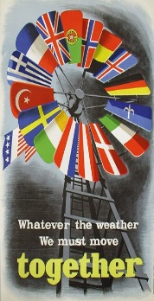
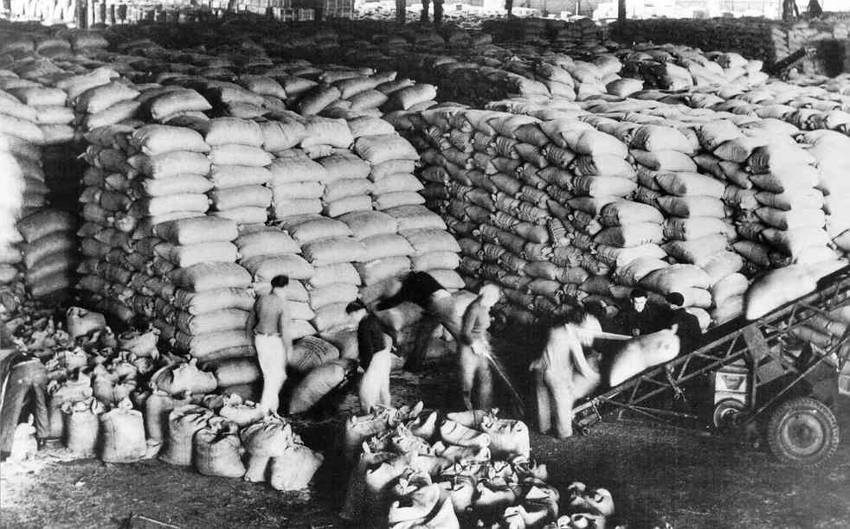
The cold war:
USA GOALS
Containment: plan to stop the spread of communism
Marshall Plan: US gave $$ billions to rebuild economies of Western European nations
    Build trade partnerships for US
    Gain access to raw materials available in eastern markets
Defeat the USSR in the arms & space races
  Win proxy wars against the USSR
Encourage democracy in other countries to prevent the spread of communism

Slide 8
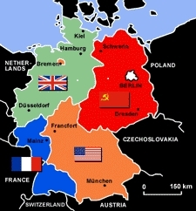
1945: GERMANY
Notes:
Germany suffered ¾ of their losses fighting the Red Army

Slide 9
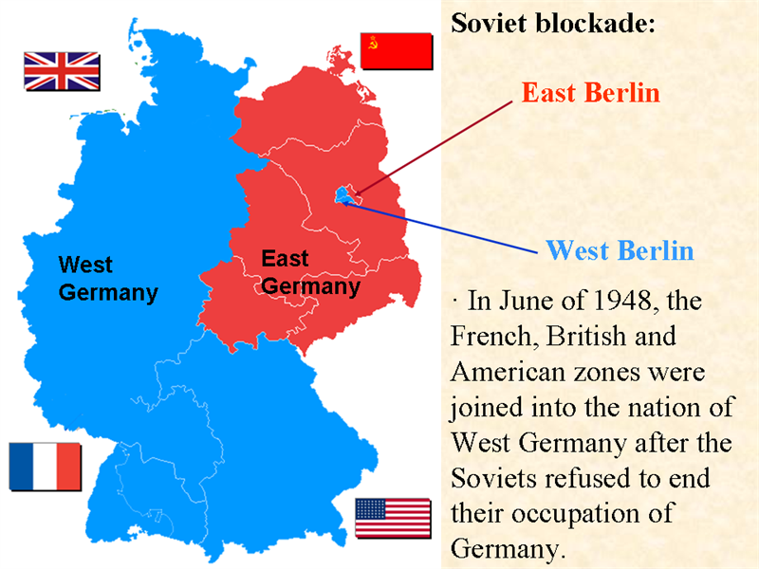
1945: GERMANY
Devastated by fighting
Nazi leaders put on trial at Nuremburg
Both Germany and Berlin (capital city) were split up between the Allies: first in 4, then in two-
West Germany | East Germany
Run by the US/France/GB Capitalist | Run by the Soviet Union Communist

Slide 10
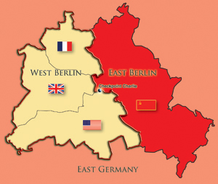

Which country does the pink territory belong to?

Slide 11
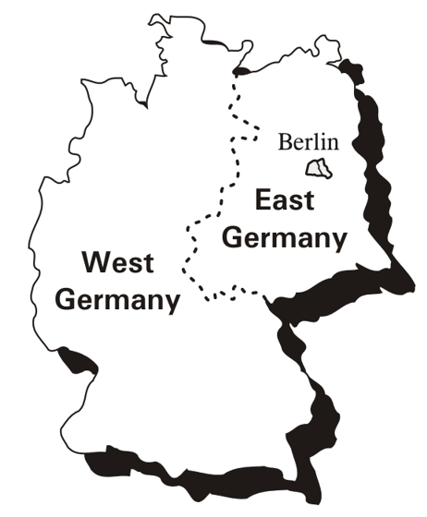
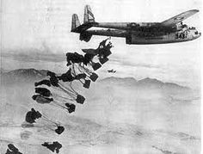
The first confrontation of the cold waR: THE BERLIN blockade & AIRLIFT
  Berlin Blockade: Soviets cut off land access to Berlin from the west
  Berlin Airlift: Western allies began flying in supplies to West Berlin around the clock for 11 months
    Kept West Berliners supplied, avoided another actual war
  Stalin lifted the blockade
First major confrontation of the Cold War

Slide 12
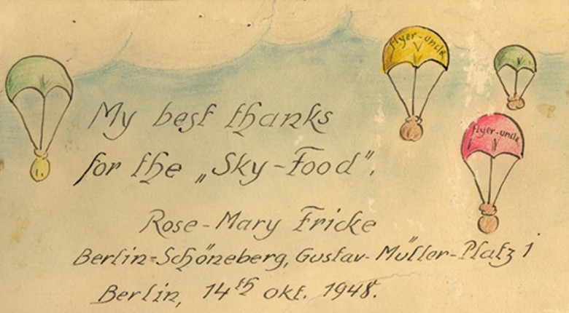
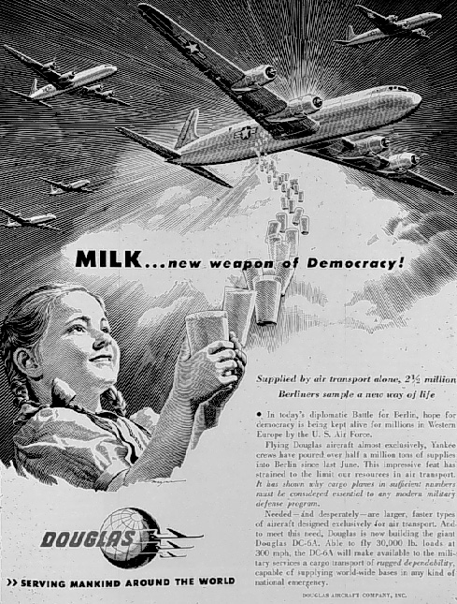
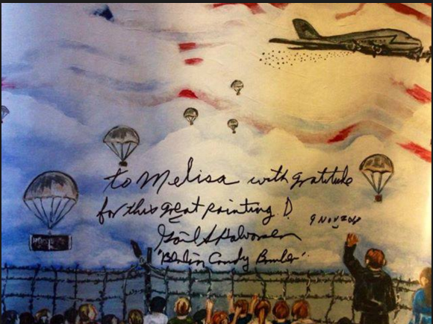
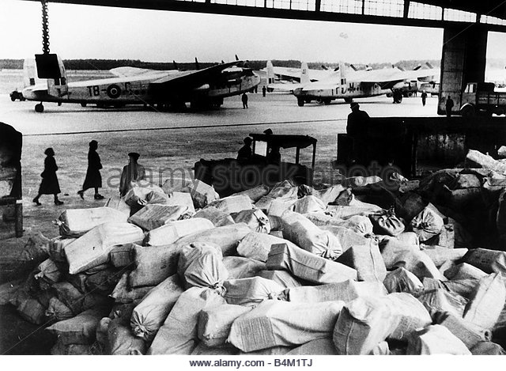
Notes:
Candy Bombers

Slide 13
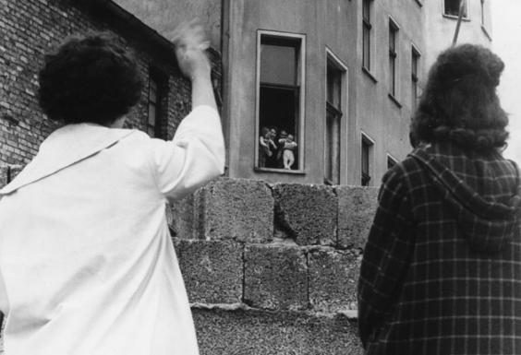
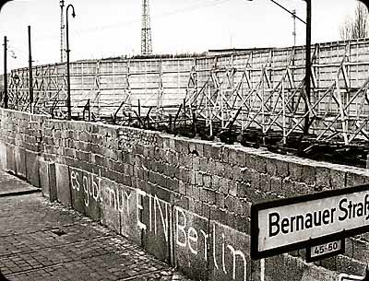
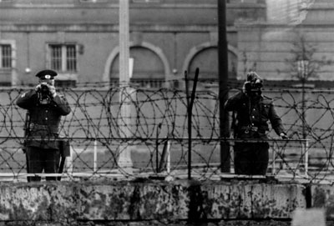
THE BERLIN WALL
Many people in East Germany wanted to escape to the democratic, capitalist West
Soviets in East Germany built the Berlin Wall in 1961 to stop people from fleeing to West Berlin
  Many killed trying to flee
Became a universal symbol of the Cold War
  Video link

Slide 14
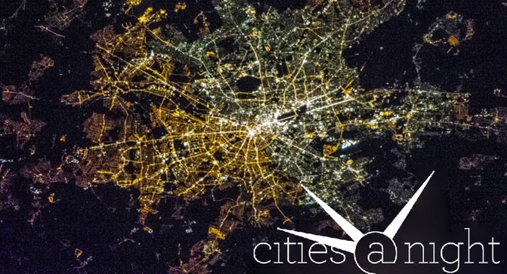
Berlin by satellite - 2013
Notes:
A satellite image has revealed enduring divisions between the east and west of Berlin, with the eastern half of the city much less brightly illuminated at night.

Slide 15
The Cold War
Communism (USSR) vs. Democracy (USA)
Competing Ideologies
A major cause of Cold War!
 | Western Democracies | Soviet Communism
Political System | Citizens elect leaders Citizens have the right to form political parties | USSR – dictatorship controlled by Communist Party The only political party allowed
Individual Rights | Basic civil rights Free speech Freedom of press Freedom of religion | Citizens had few rights Censorship Secret police Religion discouraged
Economic System | Economic freedom People & corporations can own land & businesses Goods & services provided for a profit | No private property Govt. controls economy State-owned collective farms

Slide 16
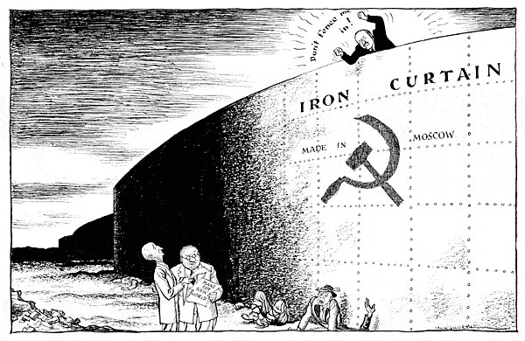
THE IRON CURTAIN
Imaginary division between democratic Western Europe, and the communist-controlled East.
  To the right of this line = Communism
  To the left = democracy
Life behind the iron curtain:
  Very limited rights
  No free press
  Constant threat of arrest
  Paranoia (esp. during Stalin’s reign until 1953)
  Gulag prison camps

Slide 18

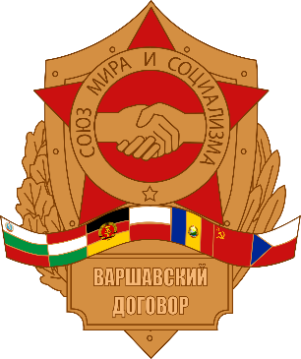
Trying avoid another war…
Many new organizations and alliances were created
United Nations: replaces the League of Nations; promotes diplomacy & intervention to avoid war
  Creates the state of Israel (1947), starting an ongoing conflict between Arab Palestinians & Israeli Jews
NATO: North Atlantic Treaty Organization
A defensive military alliance of 10 Western European nations, Canada, and the US
  Formed in 1955
  Not communist
  Other countries joined later
Warsaw Pact
A defensive military alliance formed by the Soviet Union & 7 Eastern European countries
  Formed in 1955
  Communist
Notes:
193 nations in UN as of 17
Vatican City - Because of its tiny population and unique status, the Vatican City is a permanent observer state, but not a full member. (Holy See and the United Nations)
Palestine - Attempted to gain membership in 2011/2012, but failed due to lack of support from the Security Council. The US would have likely vetoed membership. It is currently recognized as a non-member observer state. (Palestine 194)
Taiwan - The UN considers the People's Republic of China and the Republic of China to be a single state, therefore Taiwan is not a member.
There are several partially recognized states like Kosovo, Abkhazia, South Ossetia, and the Sahrawi Arab Democratic Republic,
W. Germany joined NATO 1955

Slide 19
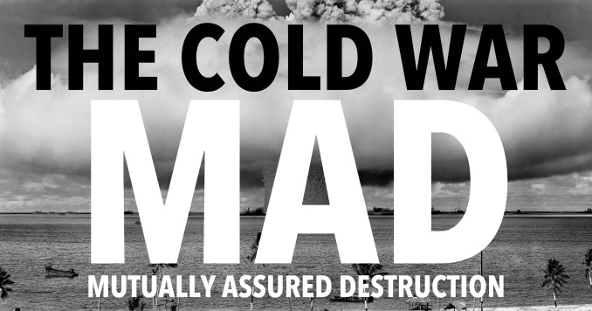
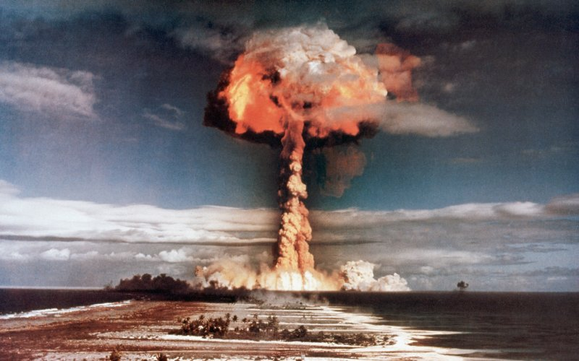
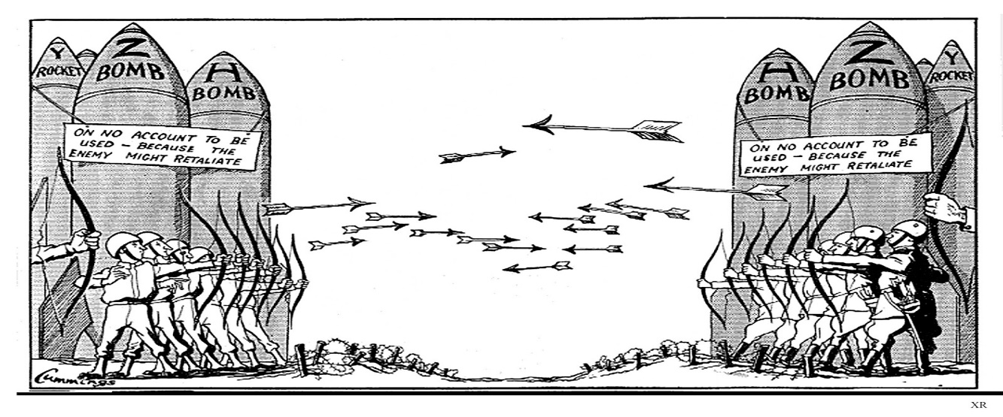
ARMS RACE
USA & USSR each develop more destructive weapons, like ICBMs
  ICBMs =intercontinental ballistic missiles
  Nuclear proliferation → spread of nuclear weapons (tech/info/materials) to nations not recognized as a weapon state
    Deterrents
    MAD: Mutually Assured Destruction
      Link: all nuclear explosions
Notes:
An intercontinental ballistic missile (ICBM) is a guided ballistic missile with a minimum range of 5,500 kilometres (3,400 mi)^{[1]} primarily designed for nuclear weapons delivery

Slide 20

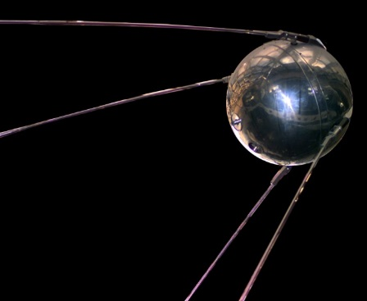
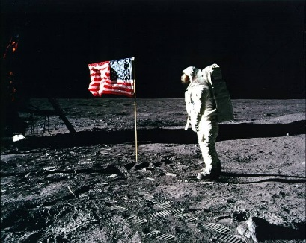
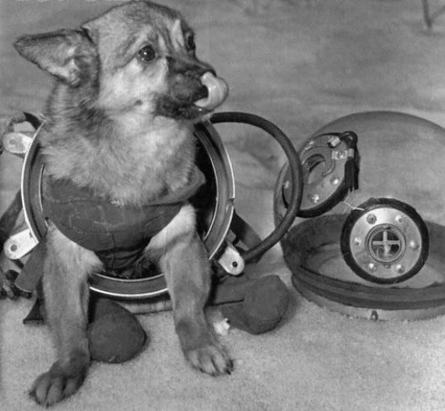
SPACE RACE
Who will be the first to reach the moon?
  Sputnik – USSR (1957)
  Apollo moon landing – USA (1969)
    Video clip: Space Race
Nuclear Non-Proliferation Treaty – 1968
  Objective: prevent the spread of nuclear weapons and weapons technology
  Limits nuclear capabilities to China, Russia, US
Notes:
Sputnik- 1st satellite During the 1950s and 1960s the USSR used dogs for sub-orbital and orbital space flights to determine whether human spaceflight was feasible. In this period, the Soviet Union launched missions with passenger slots for at least 57 dogs. The number of dogs in space is smaller, as some dogs flew more than once. Most survived; the few that died were lost mostly through technical failures, according to the parameters of the test. A notable exception is Laika, the first dog to be sent into orbit, whose death was expected from the outset.

Slide 21
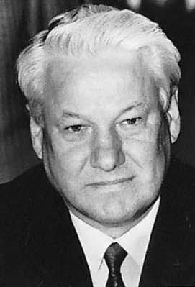
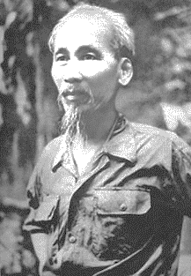
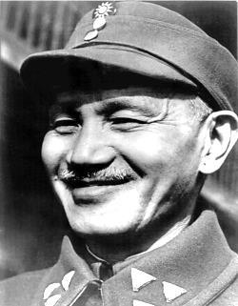
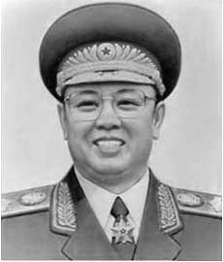
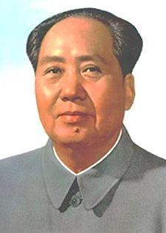
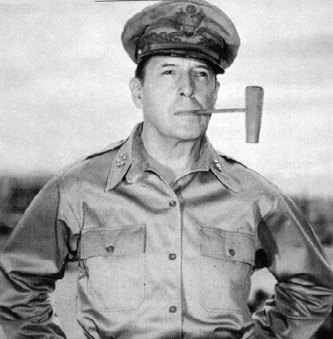
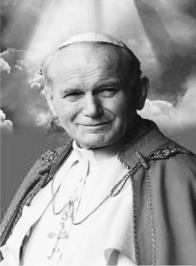
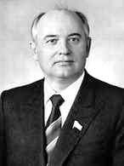
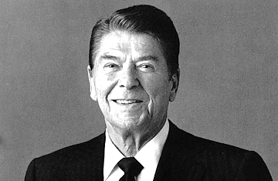
Unit 10 – key People

Slide 22
On your IDs
Who: what is their role & where are they from?
Significance: what are 2+ things of importance that they did?
  Do not repeat who

Slide 23
Non-EXAMPLES
Who? 32nd president
Significance: Successor of Roosevelt
Who? Journalist and statesman
Significance: helped fascist Germany

Slide 24
Mao Zedong
Who?
Chinese Communist leader
Significance?
Led China’s communist revolution, oversaw the Great Leap Forward & Cultural Revolution
Chairman (chief of state) of the People’s Republic of China from 1949 to 1959.

Slide 25
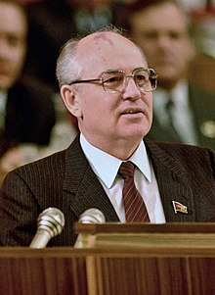
Mikhail Gorbachev
Who:
Appointed General Secretary of the Communist Party in 1985, became the President of the Soviet Union in 1990
Significance:
Attempted to reform the USSR
Worked for détente- a better relationships between USSR & the West
Helped bring an end to the Cold War.

Slide 26
Next Up: Containment Mini-q
Turn in when completed! Work on your IDs after
MINI Q TIPS:
Read ALL the information provided for each & the blue paper
Containment: It tells you what Containment is on your blue reading!
Quarantine: isolation of people, animals, or things out of a certain area to prevent the spread of something

Slide 27
Exit Ticket
What caused the Berlin Airlift?
Explain the policy of containment.
What are 2 effects of the Cold War that impact us today?
  Think about what is happening in today’s world, how we interact with countries that were involved in the Cold War, weapons, etc…

