Slide 1
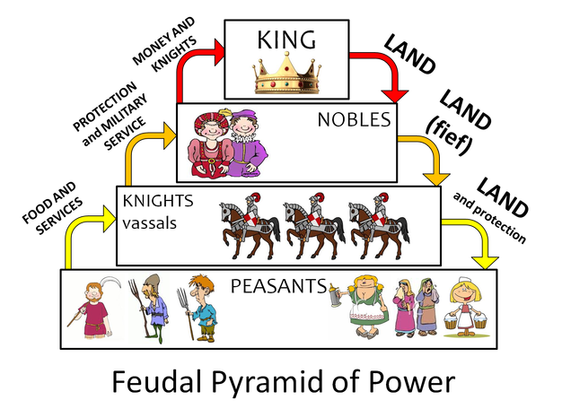
Decline of Feudalism
In the late middle ages, Feudalism started to collapse.
This eventually led to the Renaissance (time of culture in Europe), but first we must talk about the decline.
Why did feudalism collapse?

Slide 2
Why did Feudalism Collapse?
4 chief causes: The Crusades, Black Death, Hundred Years’ War, and The Great Schism
Assignment:
Left side: describe the event
Right side: what effect did this have on Medieval Europe/how did it cause Feudalism to end?
We will do the Black Plague & Great Schism together & use readings for the remaining 2

Slide 3
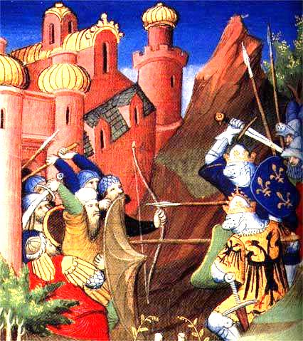
Cause 1: The Crusades
Video clip (5 min Crusades)
1096 – “Holy Wars”
Pope Urban II called on Christian knights to take back the Holy Land (Jerusalem) from Muslims (controlled since 1071)
Also…. Bring prestige to the Church, wealth, population control, and TRADE!
LED TO: Crusades increased power for European kings, creating nation-states in Europe (end of Feudalism & Manorialism)

Slide 4
Who were the Crusaders going to fight?
What major city did many of the Crusaders pass through on the way from Europe into Asia?

Slide 5
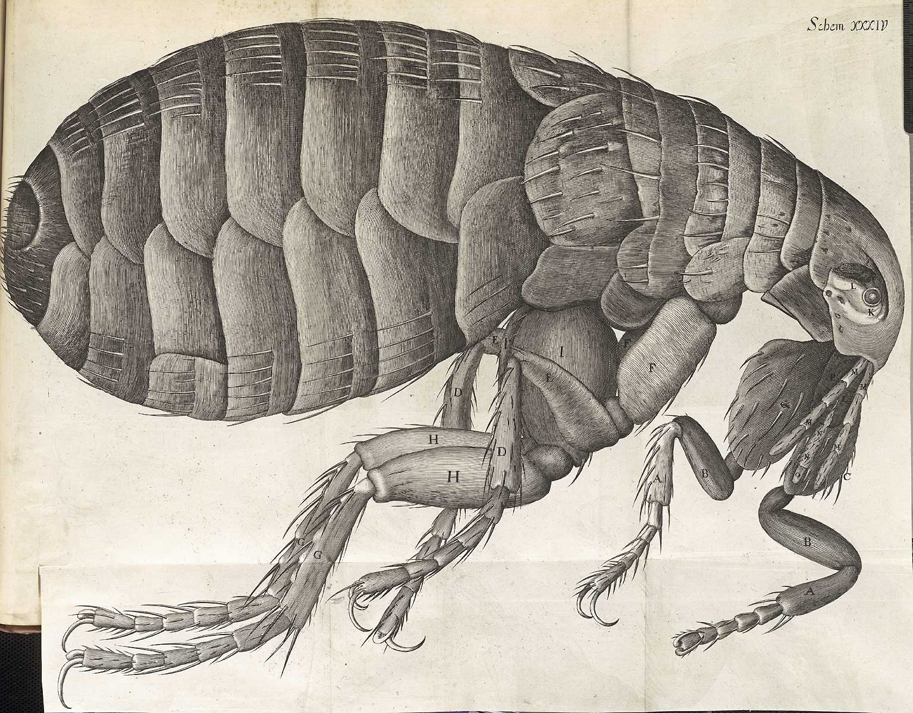
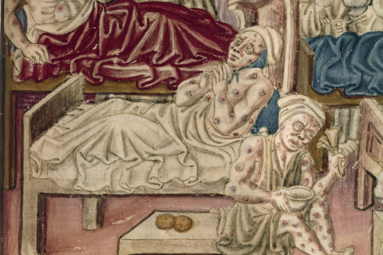
Cause 2: The Black Death
As you watch the video clips, take notes describing the Black Plague & its effects on people
Video Clips
TED
The Plague- Coroners’ Report
Youtube version
The Plague in Europe
Notes:
Hollaback Gwen Stefani

Slide 6
Cause 2: The Black Death
Epidemic that originated in Asia – 1300s -spread via trade routes by fleas!
Characterized by fever, vomiting, boils, internal bleeding leading to death
LED TO:
Responsible for the deaths of over 1/3 of the population
Social upheaval (disorder) resulted and many blamed Jews for the issues
Accused Jews of contaminating water wells & spreading the disease.
Peasants left manors to look for jobs
Smaller population meant less competition for jobs

Slide 7
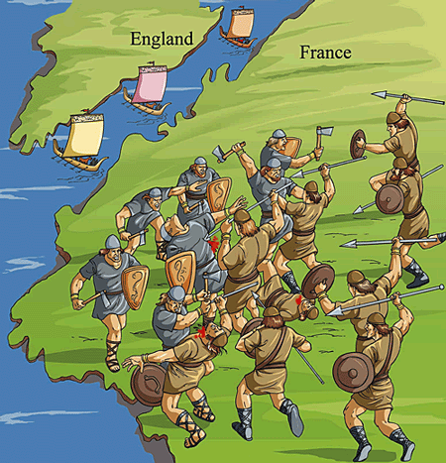
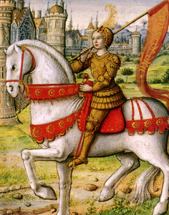
Cause 3: The Hundred Years’ War
1337 – 1453 & England vs. France
Fought over land
English kings once had feudal manors on French lands and French kings started to dispute the claims
French King Philip VI claimed lands and England’s King Edward III declared war!
England had new weapon: longbow which could pierce armor & enabled fighting from long distances
France ultimately won
French were outnumbered by English in most of the battles and the English won most of the battles.
French ultimately won the war
Joan of Arc: French teenager who rallied the French & led them to victory in battle
Notes:
Joan of Arc, a peasant girl living in medieval France, believed that God had chosen her to lead France to victory in its long-running war with England. With no military training, Joan convinced the embattled crown prince Charles of Valois to allow her to lead a French army to the besieged city of Orléans, where it achieved a momentous victory over the English and their French allies, the Burgundians. After seeing the prince crowned King Charles VII, Joan was captured by Anglo-Burgundian forces, tried for witchcraft and heresy and burned at the stake in 1431, at the age of 19

Slide 8
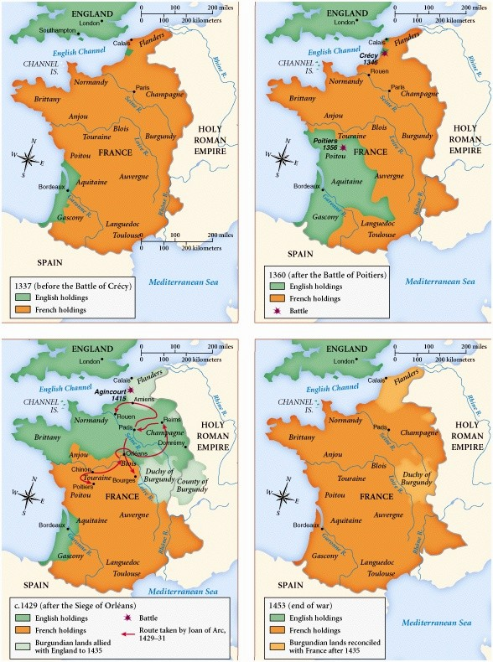
Cause 3: The Hundred Years’ War
LED TO
France’s royal power is centralized
Powerful monarchies consolidate their power
France became a major European power, army loyal to French king
Contributed to a creation of a system of government taxation and paid military service
(no need for knights/vassals) = end of feudalism

Slide 9
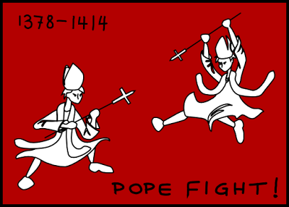
Cause 4: The Great Schism
1305– Frenchman is elected Pope and the papacy moved to Avignon, France (French have great influence over pope)
1378: Italian elected pope – Pope Urban VI. Papacy moved back to Rome.
EFFECTS/LED TO
The French cardinals upset and elected another person – Clement VII – as pope to keep papacy in France
TWO POPES!?

Slide 10
Cause 4: The Great Schism
People couldn’t decide who was the true pope and this lasted 40 years!
1409- a third pope is elected
Effects→
Corruption in church
No focus on religious matters
Power of church declines in Europe (*end of feudalism)

Slide 11
Decline of Feudalism Assignment

Slide 12
Next up: Notebook (or binder!) Test
Use only YOUR notebook
Everything must be glued in/hole-punched in OR IT CANNOT BE USED!
Turn in your Notebook Test when done & get the reading
Then complete the Crusades section
Turn the paper over & complete the Decline of Feudalism assignment
Spiral Test notes: #12 can also be found on p.8
#21 is p. 24 (today!)
#22 is p. 24 (today!)

Slide 13
Exit Ticket
Estimated Long-term Impact on Population of Europe (AD 1000 - 1600)
Year | Population in Millions | Year | Population in Millions
1000 | 36 | 1300 | 78
1050 | 40 | 1350 | 83
1100 | 44 | 1400 | 60
1150 | 51 | 1450 | 71
1200 | 58 | 1500 | 80
1250 | 68
CHART: What was happening to Europe’s population prior to the Plague?
CHART: How long did it take for Europe’s population to recover from the Plague?
What’s another name for the Plague?
What was the main cause of the Crusades?

Slide 14
Exit Ticket
What 4 events led to the end of Feudalism in Europe?
Which 1 of these 4 events seem to have the most impact on people at this time, in your opinion? Give evidence to support your answer.

Slide 15
Exit Ticket
What 4 events led to the end of Feudalism in Europe?
Which 1 of these 4 events seem to have the most impact on people at this time, in your opinion? Give evidence to support your answer.

