Slide 1
Consider…
How do you feel about your country?
What changes do you want to see happen? Why?
3. What are you willing to risk for these changes to happen?
4. What do you want to keep the same?

Slide 2
The FRENCH REVOLUTION
Notes:
2

Slide 3
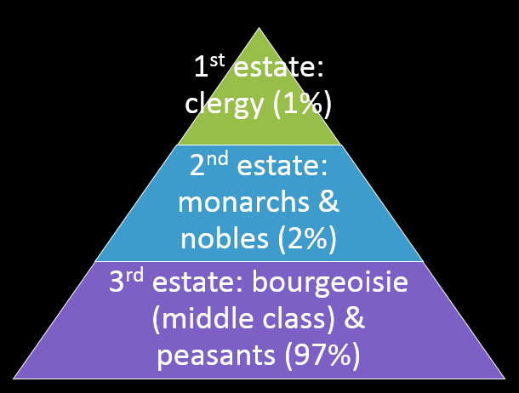
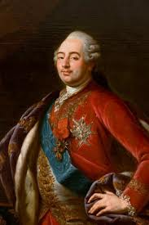
Causes of the French Revolution
France’s gov. in debt
Food shortages
Severe social inequality among estates
even more than in the US at that time
High taxes on the 3rd estate
but not on the 1st or 2nd…
3rd estate felt the social contract was broken
American Revolution = inspiration
King Louis XVI = well-intentioned but unprepared & unskilled leader
Marie Antoinette, his wife, spent extravagantly
Notes:
Marie spent 1.5million gambling card games; rejected tight silk dresses (angered fashion industry)
3

Slide 4
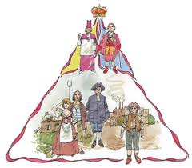
1st estate: clergy (1%)
2nd estate: monarchs & nobles (2%)
3rd estate: bourgeoisie (middle class) & peasants (97%)

Slide 5
While much of the 3rd estate was struggling to survive…

Slide 6
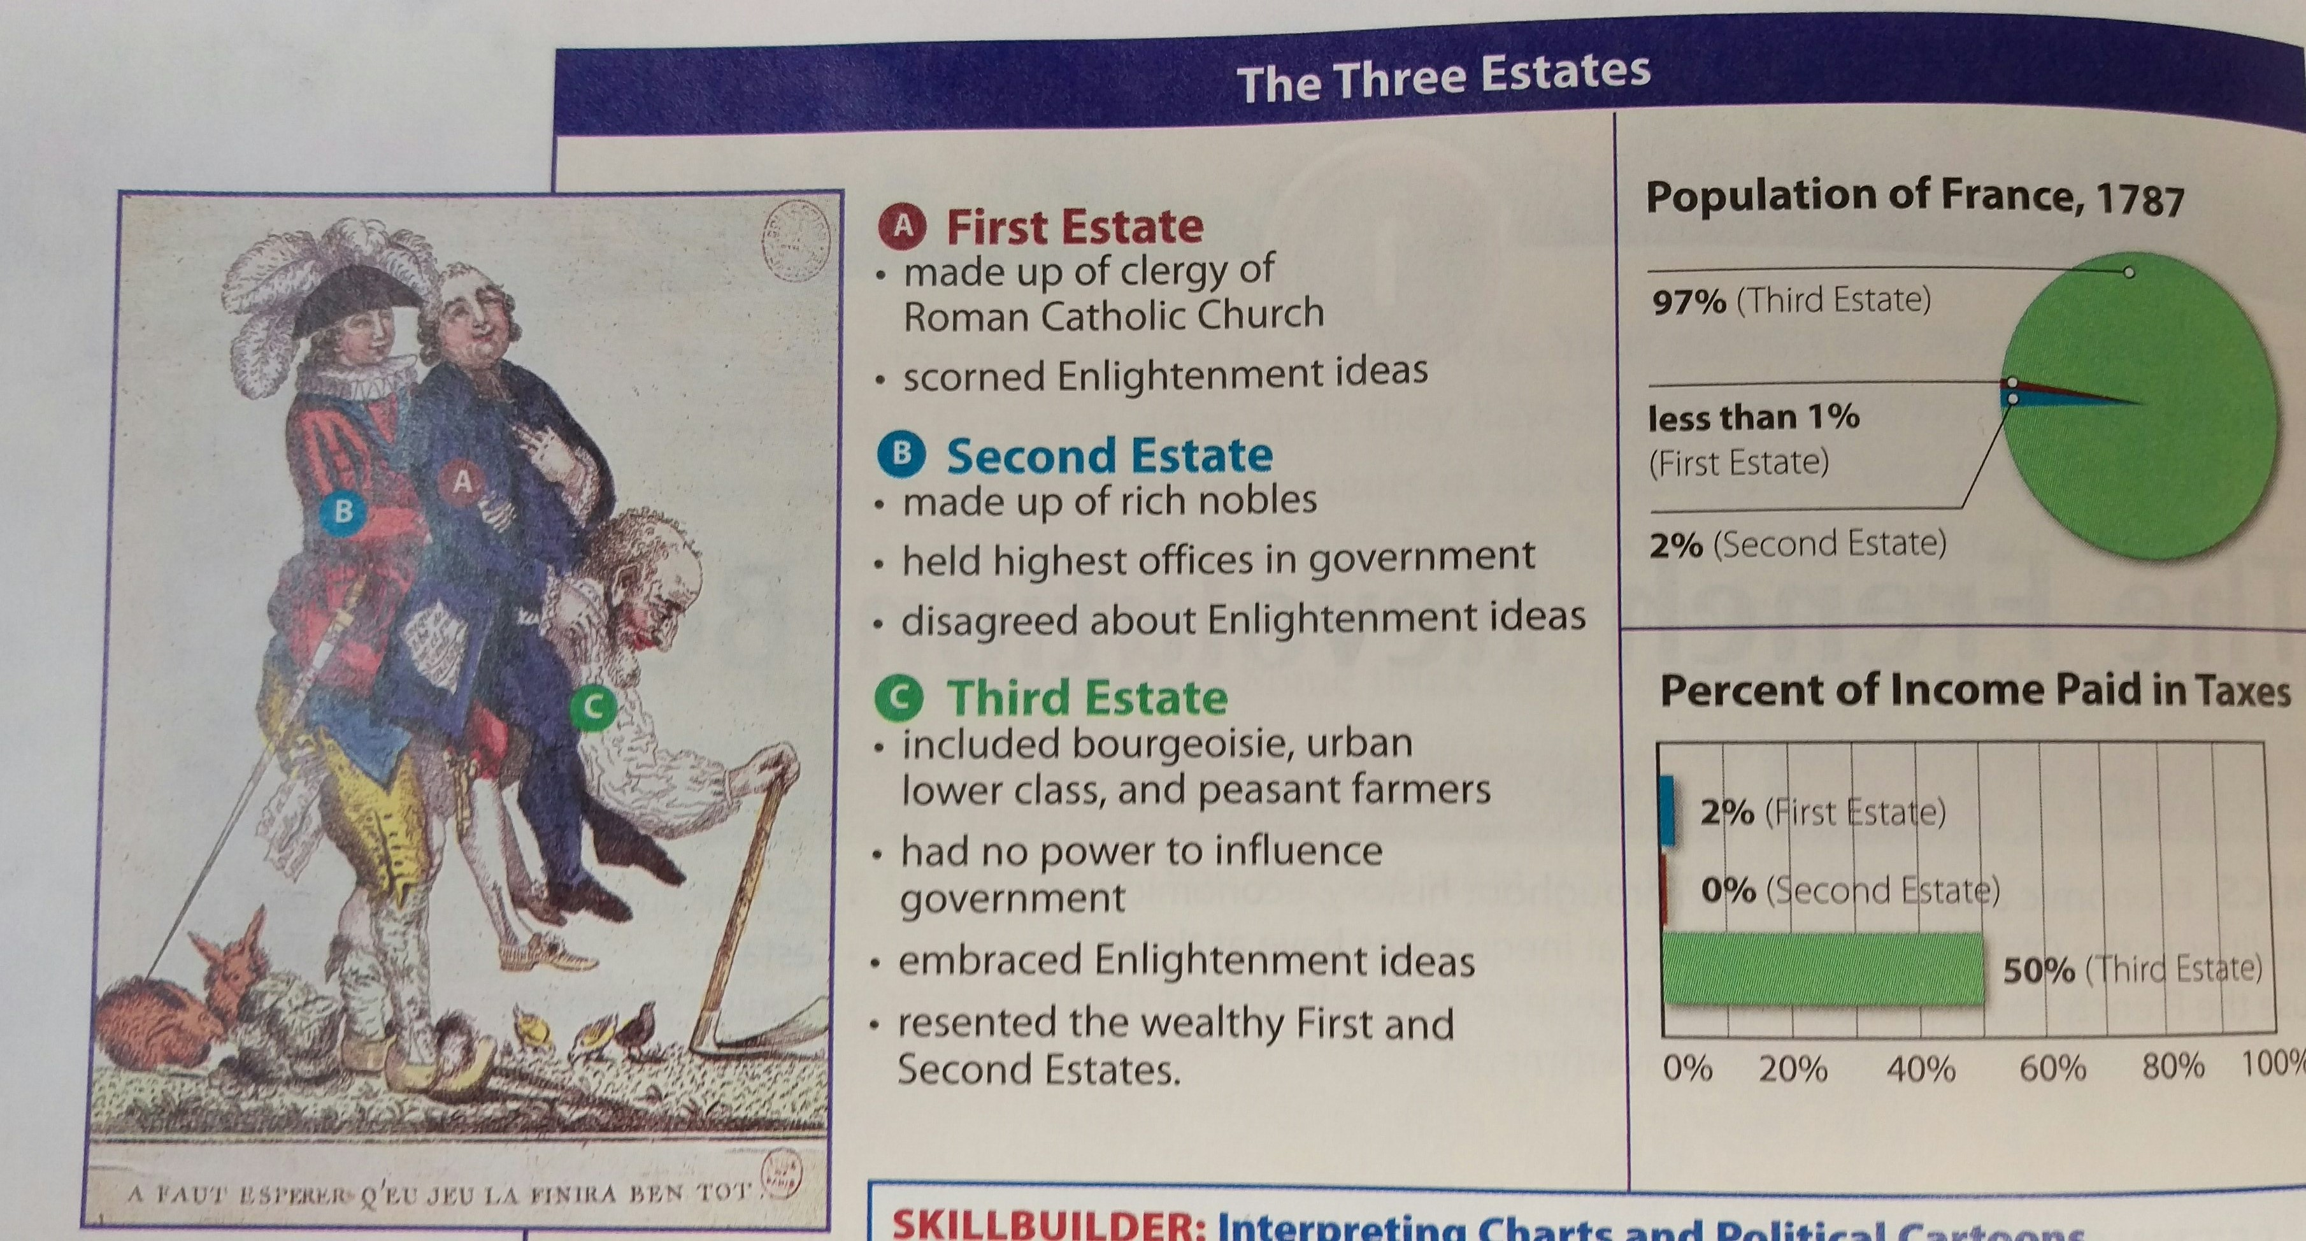

Slide 7
May 1789: Estates General
What was it? Meeting of leaders from all 3 estates
Purpose? Solve France’s bankruptcy & debt caused by overspending
Effects?
June 1789: National Assembly
What was it? New government of 3rd estate (an Enlightenment-style representative government!)
Purpose? new constitution & laws
Effects? Revolution brewing…
Notes:
Estates Gen: each estate had 1 vote, resulting in 3rd always losing
7

Slide 8
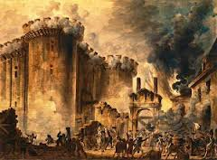
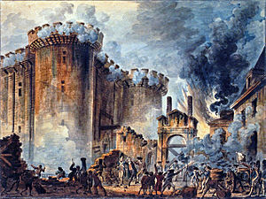
Storming of the Bastille (July 14, 1789)
What was it? 3rd estate of Paris attacked the Bastille prison , freed prisoners, and stole the weaponry
Purpose? Gain weapons
Effects? Start of the Revolution! Armed 3rd estate
“Liberty, Equality, Fraternity!”
-The famous slogan of the revolution
Notes:
Paraded around with guards heads on pikes (textbook)
8

Slide 9
Fall 1789: The Great Fear
What was it? Rebellion & chaos across the country as famine spread; 3rd estate fought the 1st & 2nd estate across France
Attacked the 1st & 2nd estates homes, stole their goods, etc.
What was it? French women led a protest march over the price of bread to the Palace at Versailles
Broke into the palace searching for the king & queen
Killed guards as it turned into a riot
Monarchs fled to Paris
Oct.1789:The Women’s March on Versailles
Notes:
9

Slide 10
The Revolution Reforms France (1789)
Rights of Man & Citizen: A new constitution gave everyone equal rights
Based on Egalite, liberte & fraternite
King Louis XVI & wife Marie Antoinette killed by guillotine
Gov. took control of Catholic Church
Notes:
Taking control of church = gaining church wealth. Sold church lands, helped pay off debt. Alarmed the French peasants. Rights only applied to white men.
10

Slide 11
Effects of the Revolution
War in France
Other European kings were afraid of losing power like King Louis XVI had
The kings formed an alliance and invaded France
France was fighting Austria, Prussia, Great Britain, and Netherlands, Spain…
Continued food shortages & gov. debt
Divisions in France about the new gov.
Notes:
11

Slide 12
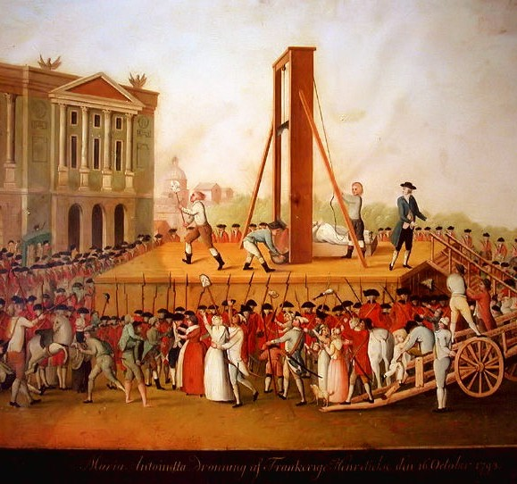
Notes:
12

Slide 13
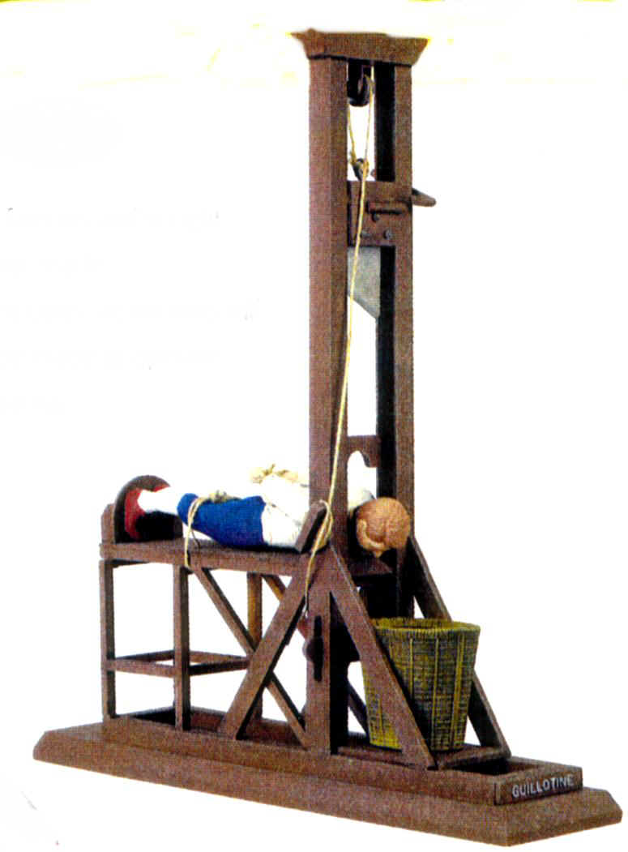
Reign of Terror
A radical political organization, the Jacobins, took power
The leaders of France were afraid of losing power
Led by Maximilian Robespierre & the Jacobins, the gov. stopped using the Constitution
Became a lawless society
French leaders murdered many innocents (guillotine)
No one was safe

Slide 14
Next up: The Reign of Terror

Slide 15
French Rev. Part 1
https://www.youtube.com/watch?v=KDzEc5Ec5sE

