Slide 1
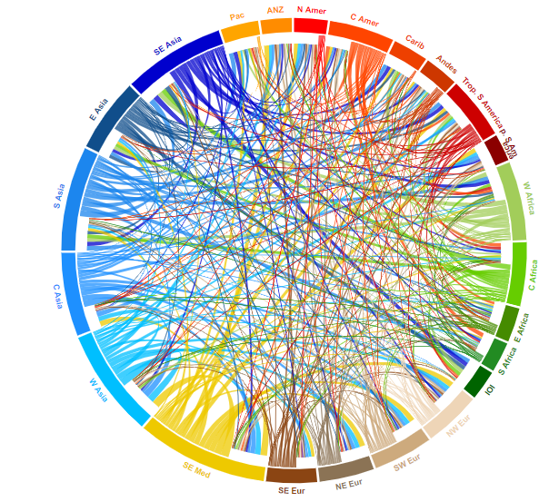
What do you think this is showing?

Slide 2
Globalization
LG2: Describe the economic and social impact of 20th century globalization and describe the role technology played in developing the modern global economy and society.

Slide 3
Calories

Slide 4
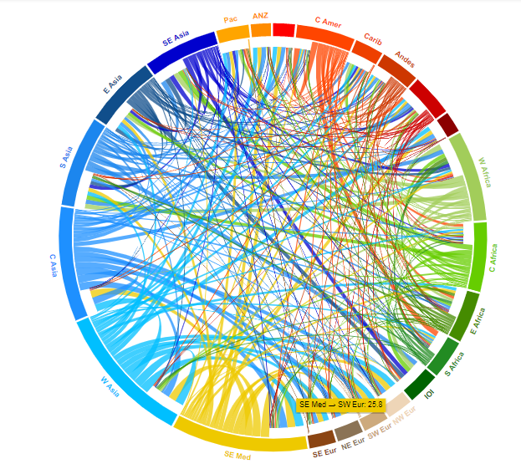
Protein

Slide 5
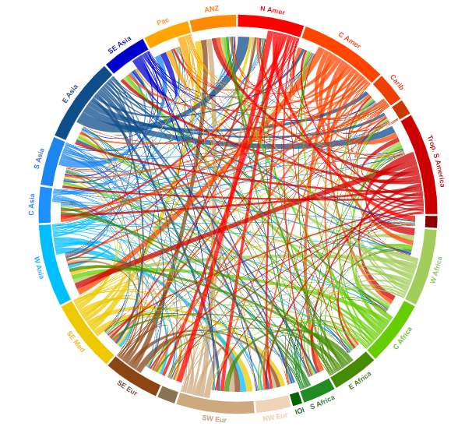
Fats

Slide 6
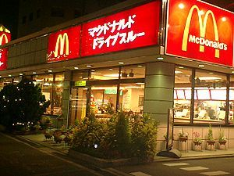
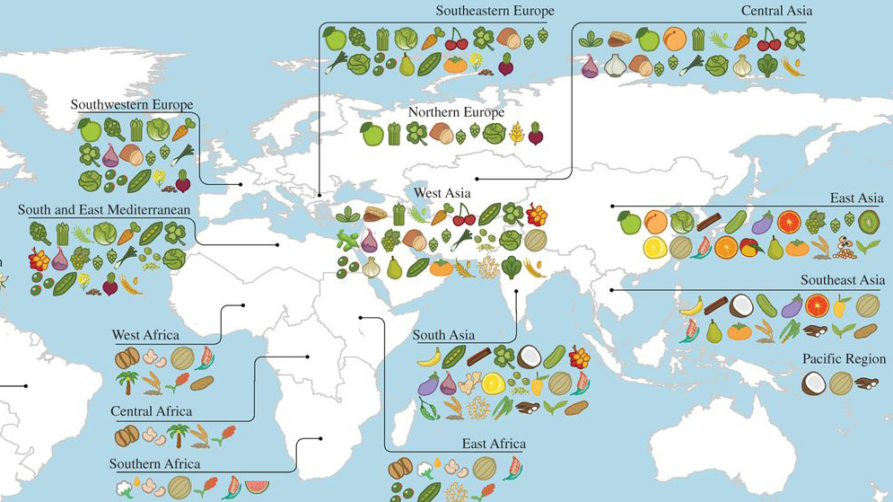

Slide 7
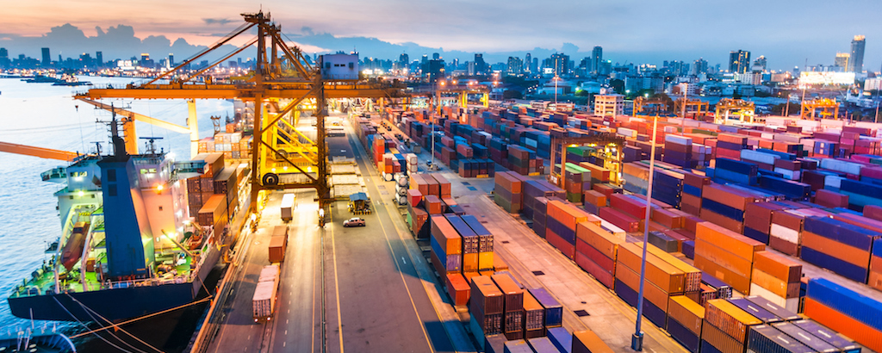
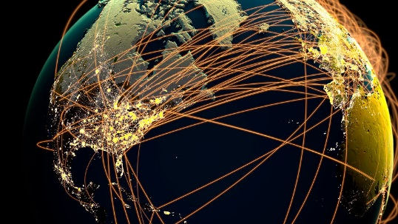
What IS globalization?
Globalization = the global integration of international trade, investment, information technology and cultures.
Places around the world become interconnected
International connections become more common

Slide 8
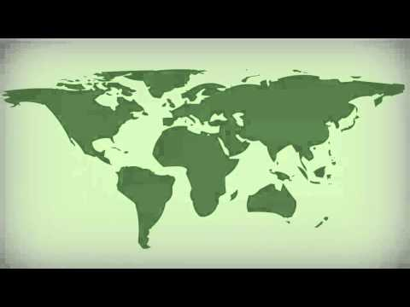
Clip: What is Globalization?

Slide 9
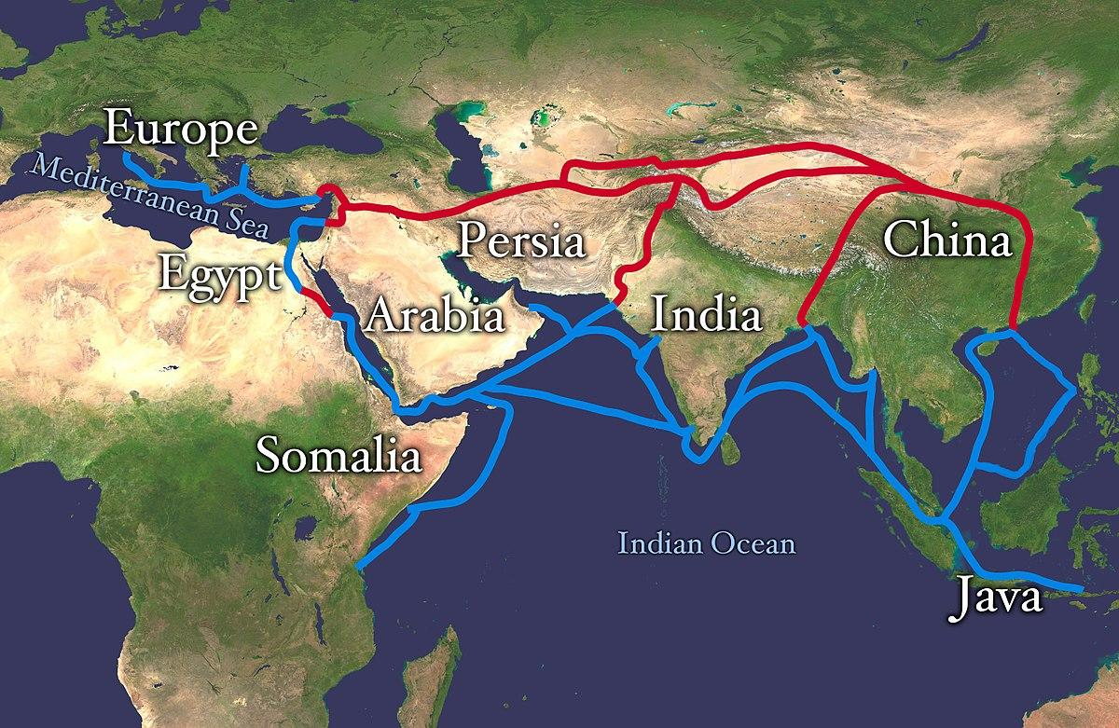
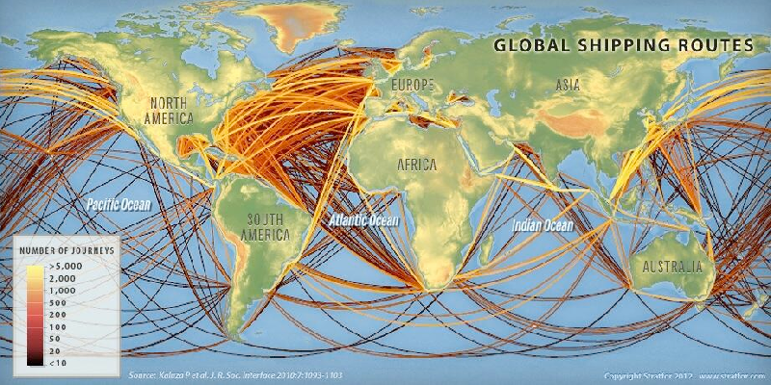
From To

Slide 10
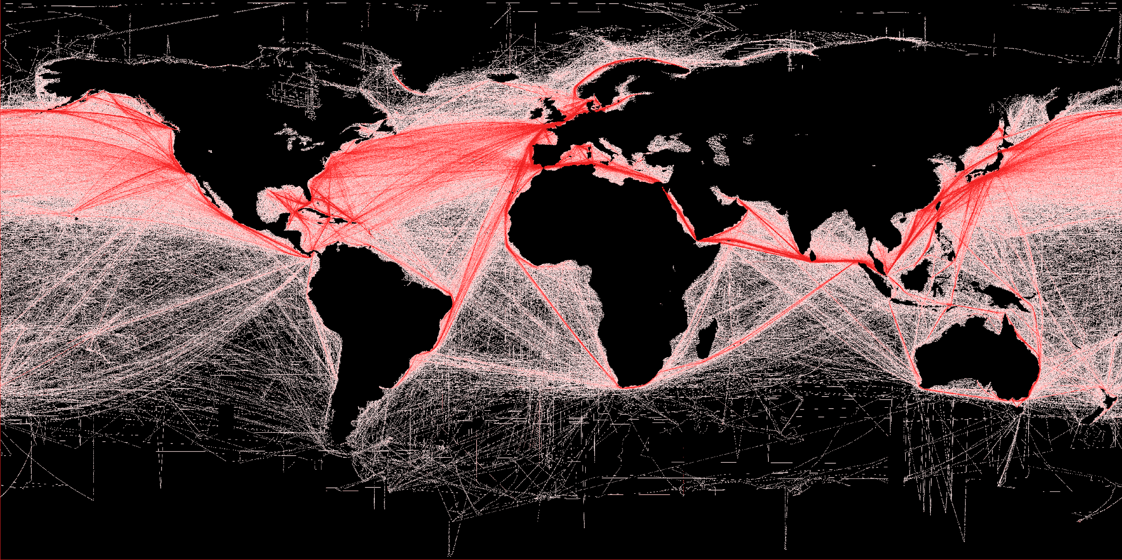
Shipping Map

Slide 11
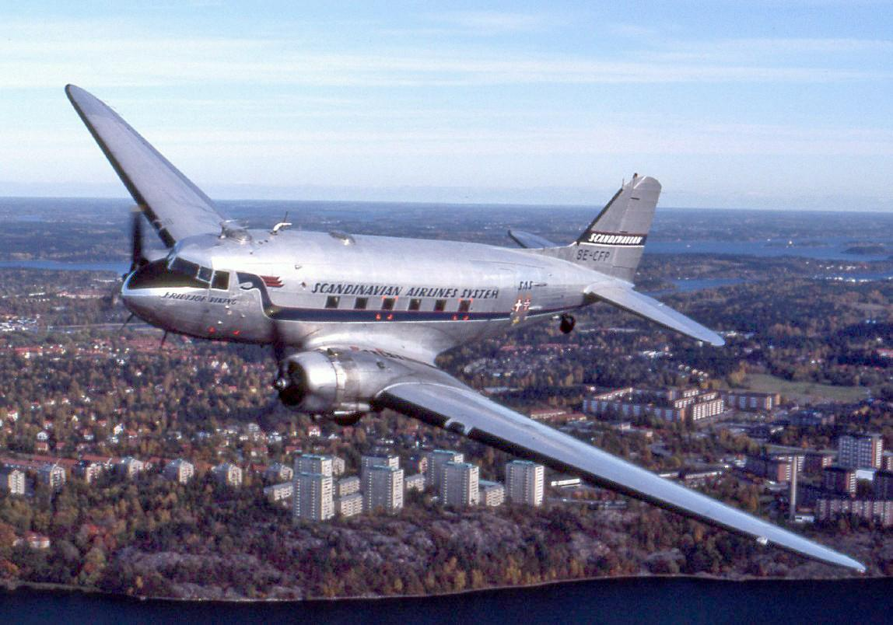
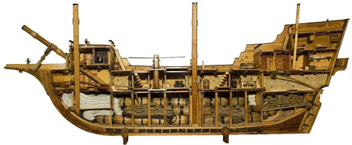
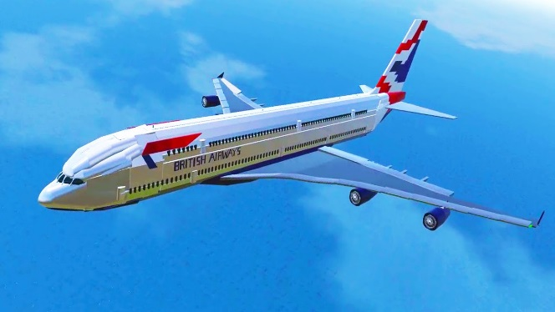
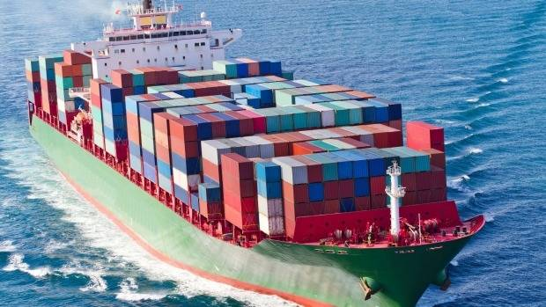
Technology & Innovation
allow for Globalization
Faster, more efficient means of transport
Larger volume of goods traded
Increased access to information

Slide 12
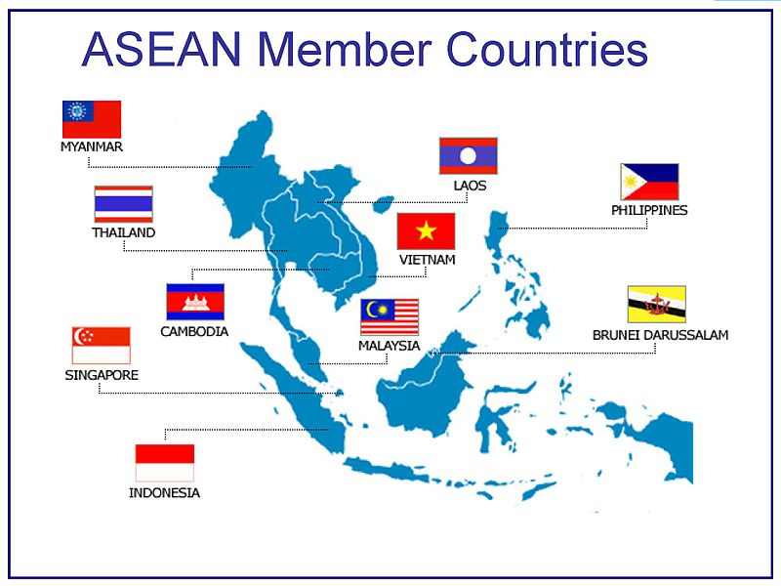
Major Trading Agreements & Groups
EU (European Union)*
European nations cooperating politically &
economically without trade barriers
ASEAN (Association of Southeast Asian Nations)*
10 Southeast Asian nations cooperating economically with the goal of peace, stability & prosperity in the region

Slide 13
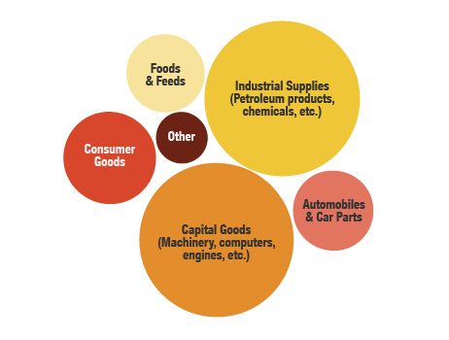
2011 US exports

Slide 14
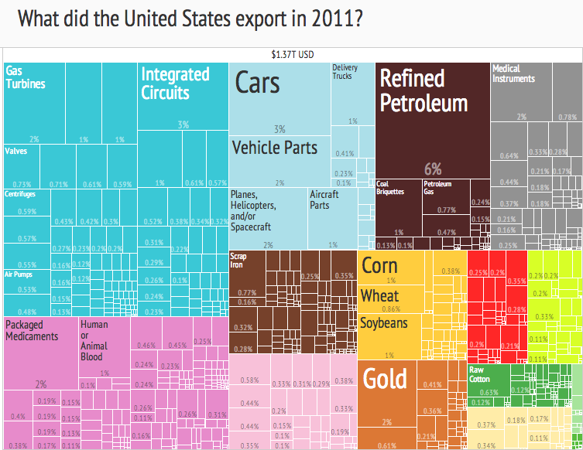

Slide 15
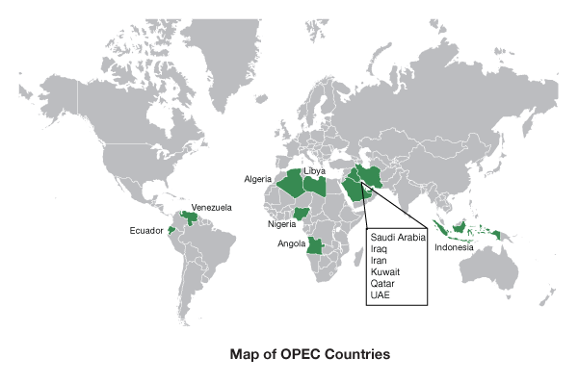
NAFTA (North American Free Trade Agreement)*
Eliminated tariffs on trade in North America
May be renegotiated in the future
OPEC (Org. of Petroleum Exporting Countries)*
Sets the price of a barrel of oil
Acts as a “cartel” (keeps price as high as possible)

Slide 16
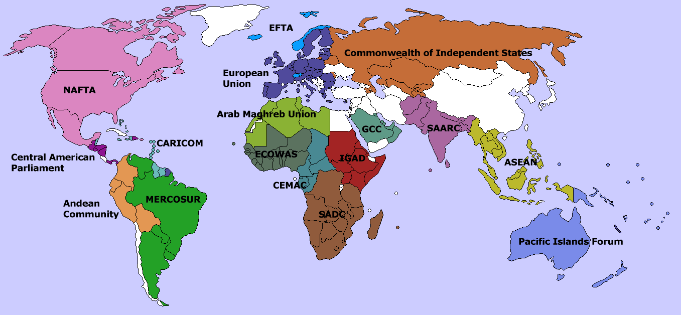
Trade Agreements

Slide 17
Multinational Corporations*
MNC: Company that operates in multiple countries
Exxon Mobil, General Motors, Toyota, etc.
Factories and centers are located all around the world allowing companies to locate near raw materials, cheaper labor, and consumer markets

Slide 18
Outsourcing
Using foreign labor instead of domestic labor because it is cheaper
Examples- car manufacturing abroad instead of in the US because of cheaper labor costs

Slide 19
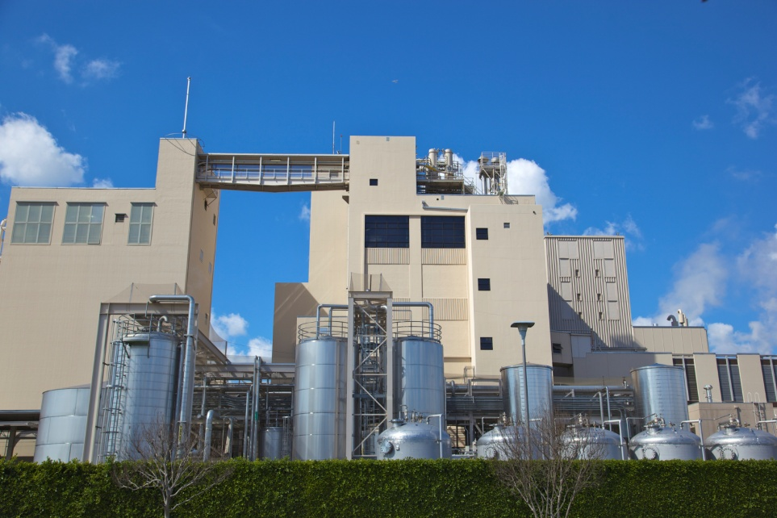
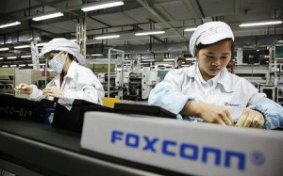
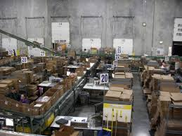
Manufacturing Plant
Assembly Factory
Stages of Production Process
Common Market/Consumer
Distribution Center

Slide 20
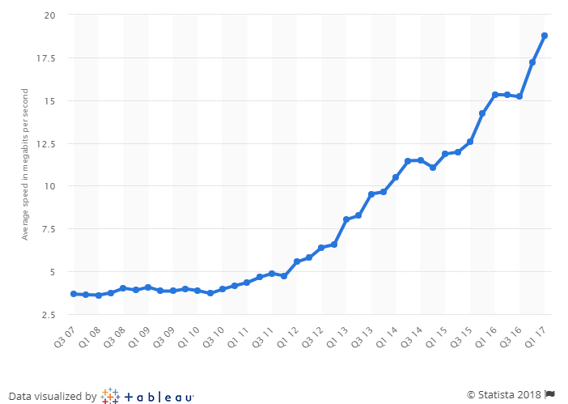
Average US Internet Speed, 2007-2017 (mps)

Slide 21
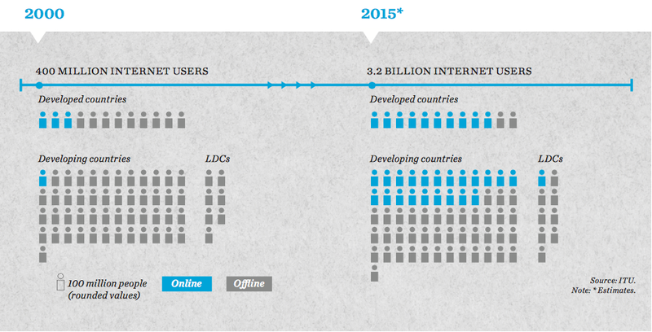
On Dec. 31, 2017 an estimated 47% of the world used the internet

Slide 22
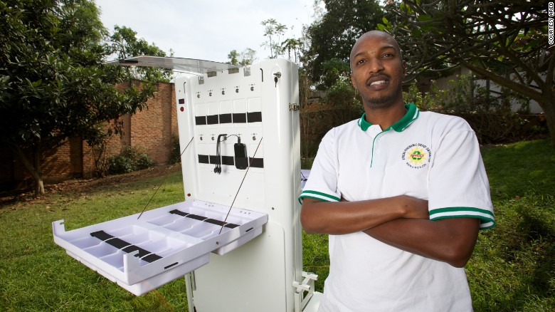
Solar-powered station can charge 80 phones at once (Rwanda)

Slide 23
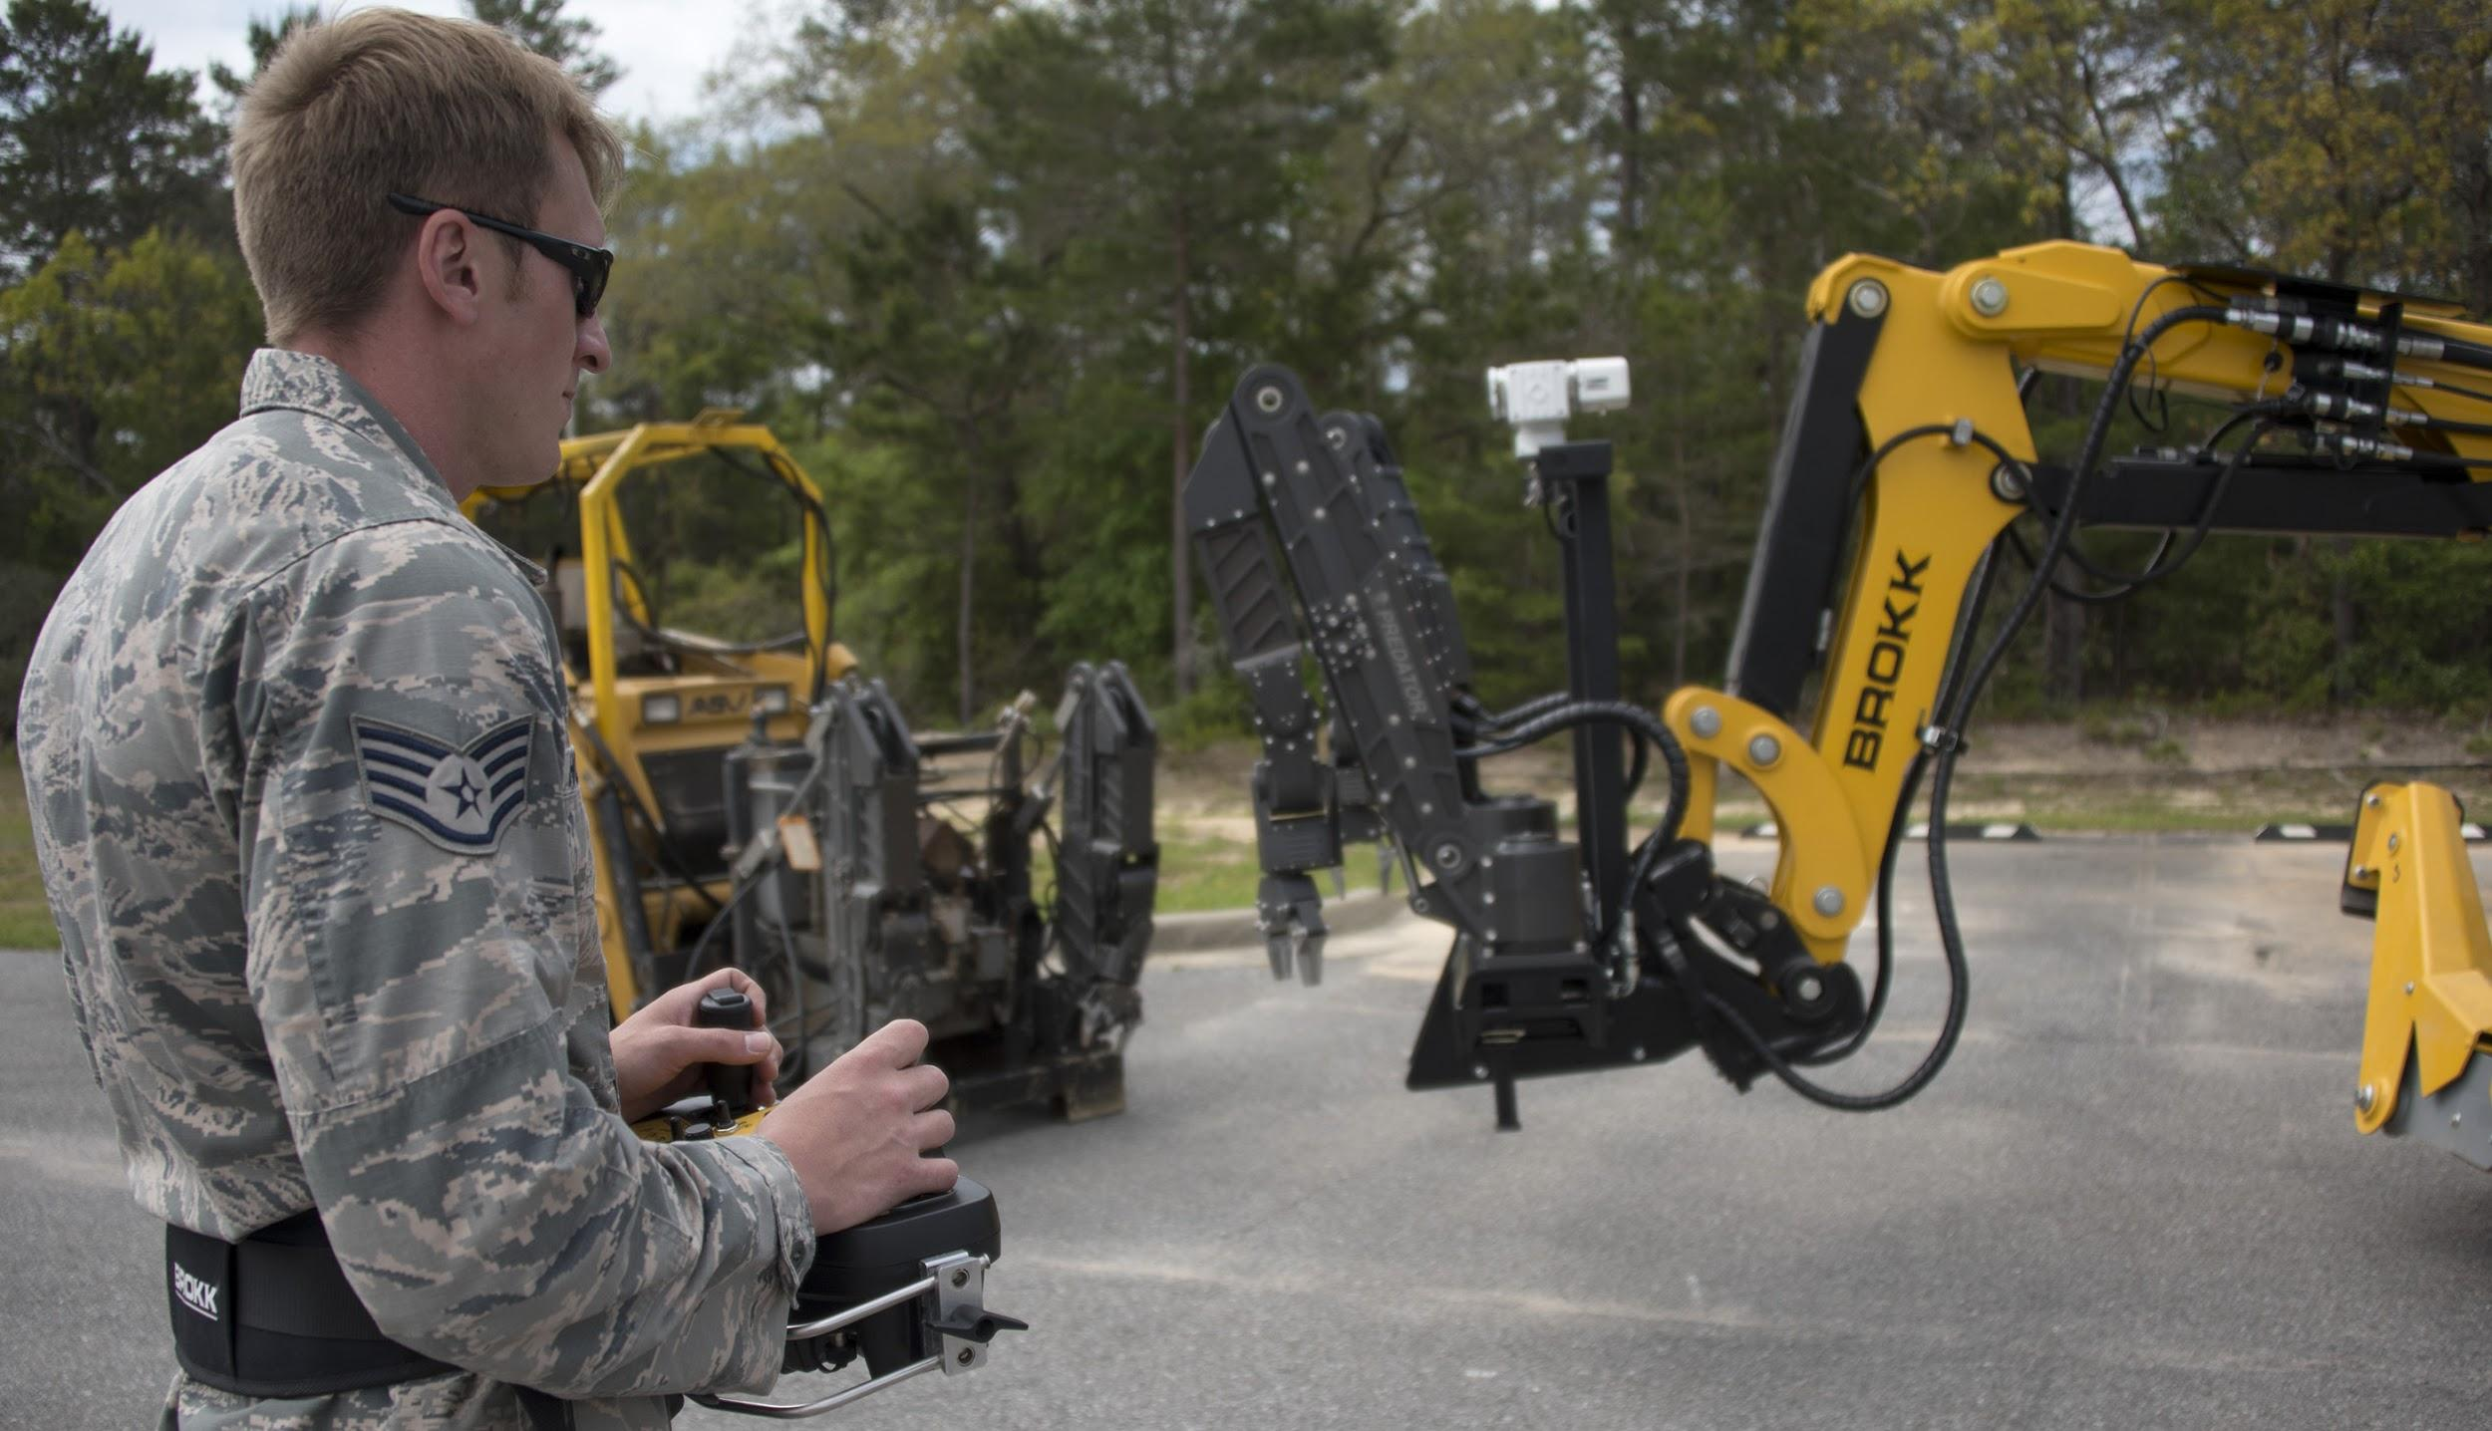
Technology is Changing the World.
Internet + widespread mobile devices = instant access to information
Robotic arms 🡪 assembly lines – reduced need for factory workers
Computerization 🡪 communicate and process info quickly and cheaply – “knowledge workers”

Slide 24
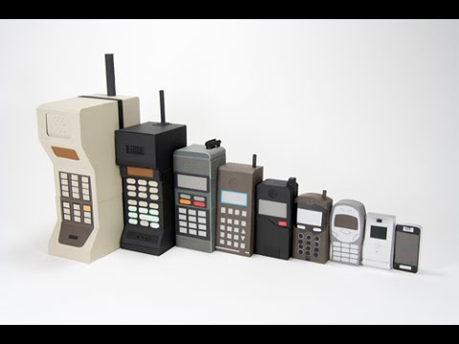
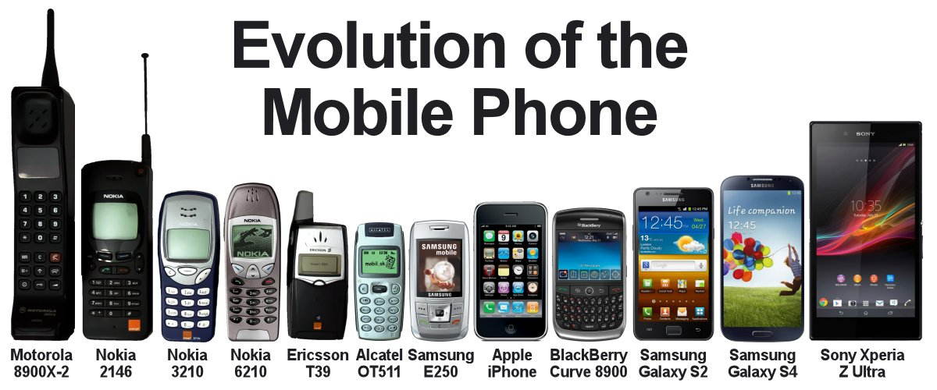

Slide 25
Create a T-Chart on Page 19
Draw a T-Chart on the back of your notes.
Title the Left side Positive Aspects of Globalization and the Right side Negative Aspects of Globalization.
As you watch & listen to the video, fill in both sides of your T-Chart.

Slide 26
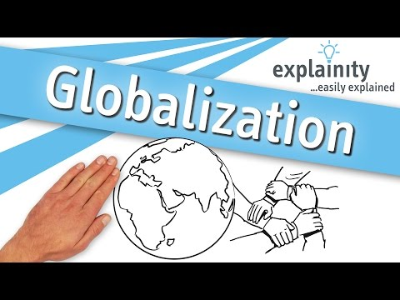
Globalization Explained

Slide 27
Additional aspects of globalization
People exposed to more ideas
Increased interaction among cultures
Cheaper mass-produced goods available
Open-source development of software
Privacy concerns online
Increased free trade
Environmental impacts
Poverty rate dropping
Increased migration
Technology spread to developing nations

Slide 28
Persuasive Paragraph: Globalization
Pick a stance: Globalization is a positive/negative force in the world.
In a well-written, thoughtful paragraph of at least four sentences, persuade any reader that you are right.
Use at least four pieces of evidence from your T-chart.

Slide 29
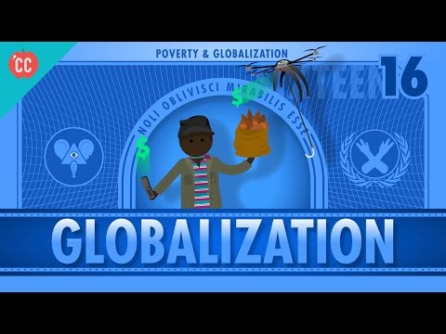
Globalization & Extreme Poverty
Can globalization end extreme poverty?

Slide 30
Exit Ticket
In an academic paragraph, answer the prompt below:
Pick one side: Globalization is primarily positive or globalization is primarily negative.
Support your answer with at least three pieces of evidence information from your T-Chart.

