Slide 1
LG 3: Identify the impact of Hammurabi’s Code of Laws and the Ten Commandments. (TEKS/SEs 20B)

Slide 2
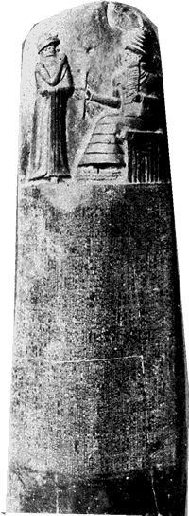
Hammurabi’s Code
Hammurabi = leader of Babylon at its peak
Created world’s first legal code* in 1754 BCE
All Babylonian citizens had the same laws to follow
New idea: government regulated its own people!
Based on the idea of “an eye for an eye & a tooth for a tooth” (retaliation)
Recorded them on tablets & spread across the empire
Different people faced different punishments based on social class & ranking
Examples: fines for wealthier people were higher than for poor
Women & men had different consequences
Notes:
Ask what type of writing they would have been using
Have them write 1 example of different punishments faced by people

Slide 3
Ancient Hebrews
Lived in present-day Israel, Lebanon & Jordan (Mesopotamia)
According to tradition, Abraham, the forefather of the Hebrews, grew up in Ur, Mesopotamia and later moved to Israel
Hebrews (Jews) were extremely unique: they were monotheistic* Not only that, but did not believe god had human or animal characteristics- unusual at this time
Early history of Hebrews & Judaism recorded in the Torah & Old Testament of the Bible

Slide 4
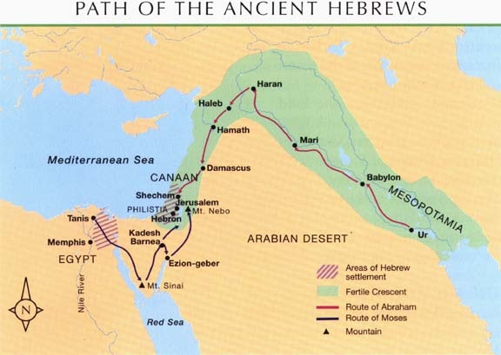
Ancient Hebrews, continued
According to the books, the ancient Hebrews migrated to Egypt to escape food shortages caused by drought in Israel
Enslaved until Moses led them out of slavery
Moses also presented the Hebrews with the Ten Commandments: a moral code for how people should behave
Not a legal code*
Notes:
Map and Egyptian illustration of Hebrews entering Egypt from http://schooltoolbox1.weebly.com/hebrews.html

Slide 5
Influence of Judaism
Idea of monotheism spread in the region
Provided foundation for both Christianity and Islam
Later, the Romans forced Hebrews to far ends of empire
Jewish Diaspora
(diaspora: spread of people around the world)

