Slide 1
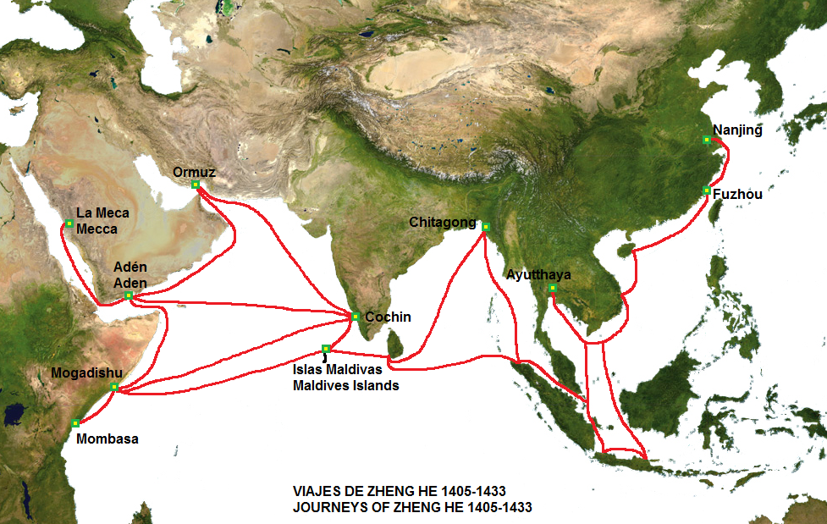
INTERNATIONAL TRADE: MING CHINA & THE INDIAN OCEAN NETWORK
Learning Goal 3: Describe characteristics of global trade after the European discovery of the western hemisphere and explain the role Ming China played in global trade.

Slide 2
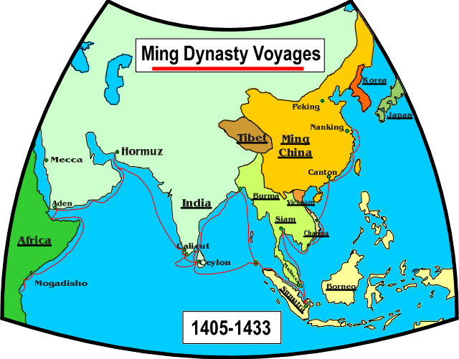
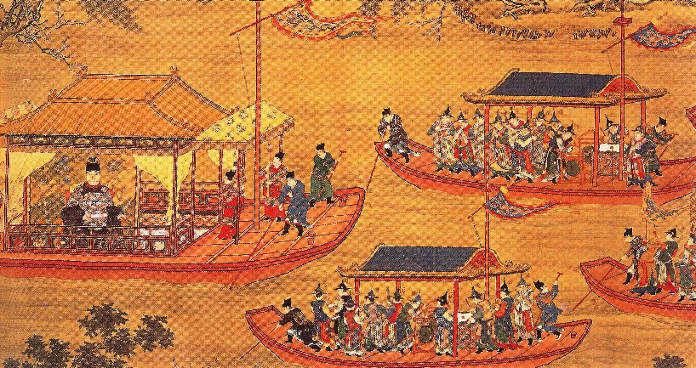
IMPORTANT TERMS TO KNOW
Eunuch
castrated male servants in the Ming dynasty bureaucracy
Tribute
gifts offered to show respect and admiration
Colonialism
Act of one country taking control of another country or region
Ex: USA = colony of Britain in the 1600-1700s,

Slide 3
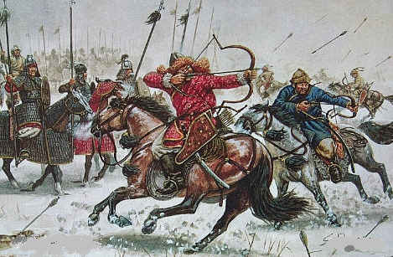
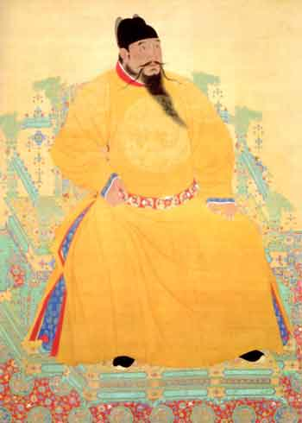
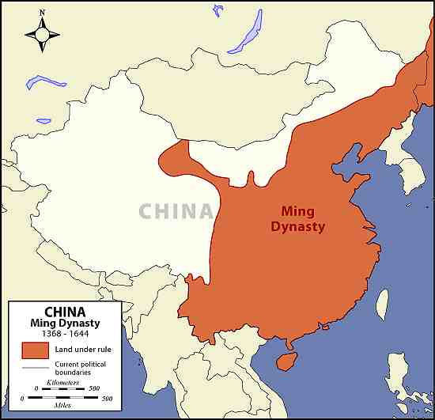
MING DYNASTY
China: 1368 – 1644
Peasant revolt and uprising drove out the Mongols
Ming Dynasty founded by Hong Wu, peasant soldier and Buddhist monk
Reestablished Chinese rule and aimed to prevent future foreign rule
Major economic growth

Slide 4
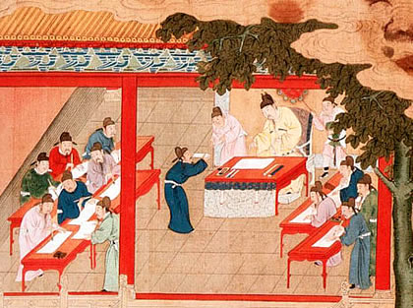
MING GOVERNMENT
Emperor Wu, a Buddhist Monk, brought stability to China
Rebuilt the infrastructure (Bridges, canals, roads, temples, etc.)
Ming Government
Centralized government
Emperors lived at the palace at the
Forbidden City
Eunuchs = powerful
Reinstated the civil service exams
Neo-Confucianism
Notes:
Museum today. 24 emperors lived there.

Slide 5
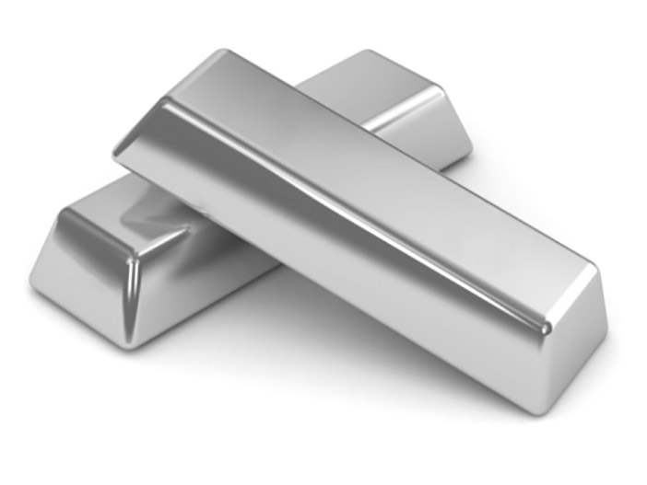
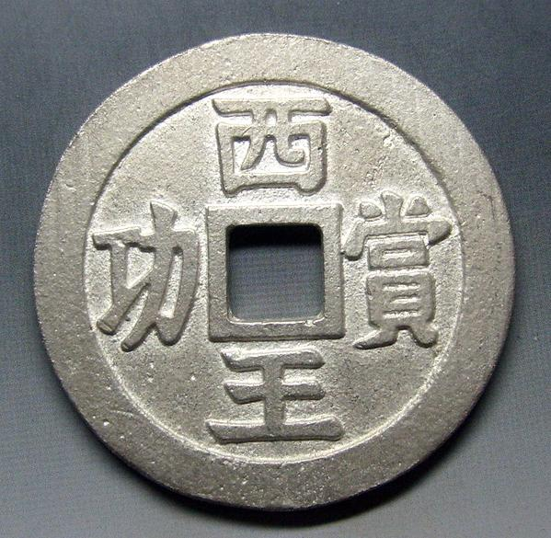
THE MING DYNASTY: SILVER RUSH!
Economics
Chinese leaders highly valued silver
The market value of silver in China was double that any where else
Naturally, everyone wanted to sell silver to China!
Spain had access to silver in Latin America (especially in Mexico & Peru)
Massive silver trade by the Spanish, Portuguese, and Japanese into China
Eventually silver lost its value in China because they had imported so much

Slide 6
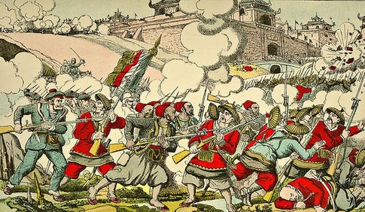
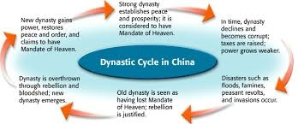
DECLINE OF THE MING DYNASTY
China stopped trading with foreigners
No foreign trade = no market for Chinese goods
No market = no money for producers
No money = widespread poverty
Political corruption
Emperors would waste money on lavish parties
Heavy taxes = Peasants angered!
Famine = Peasants starved
Epidemic = large-scale death
Politically weak = militarily weak = invaded by the Manchus
The last Ming emperor hanged himself on a tree in the imperial garden outside the Forbidden City to avoid facing defeat.

Slide 7
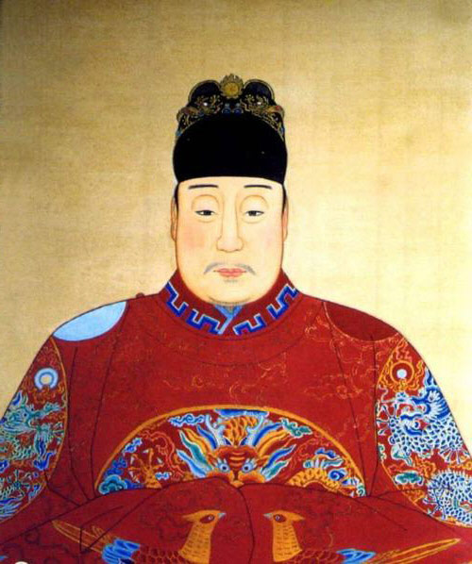
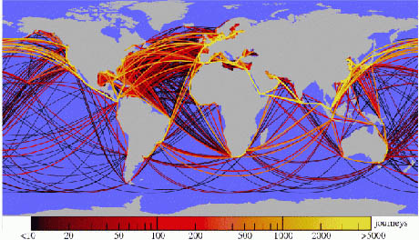
BUT BEFORE THE MING DYNASTY COLLAPSED…

Slide 8
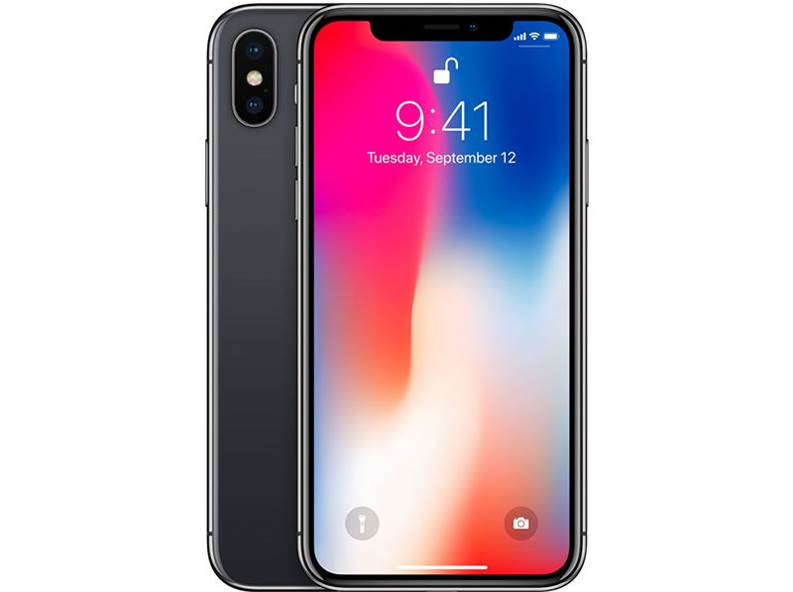
How many miles do you think the combined parts of an iPhone travel before you buy it?
The parts that make up the home button travel 12,000 miles.
The answer? Nearly 500,000 miles (approx. twice the distance to the moon)
Notes:
Source: https://www.wired.com/2016/04/iphones-500000-mile-journey-pocket/

Slide 9
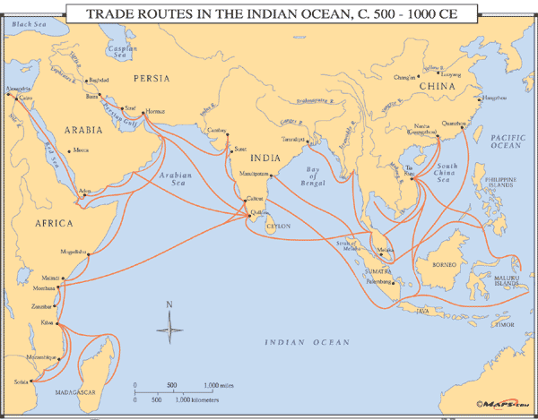
INDIAN OCEAN TRADE NETWORK
Silk Road = continued to be used for trading by land
Indian Ocean = trade via ship
Primary trading nations:
Portugal
Netherlands (the Dutch)
China (until the Ming collapsed)
Spain
East Africa
Islamic Empire (what remained of it after the Mongols)
Philippines
Great Britain
Japan

Slide 10
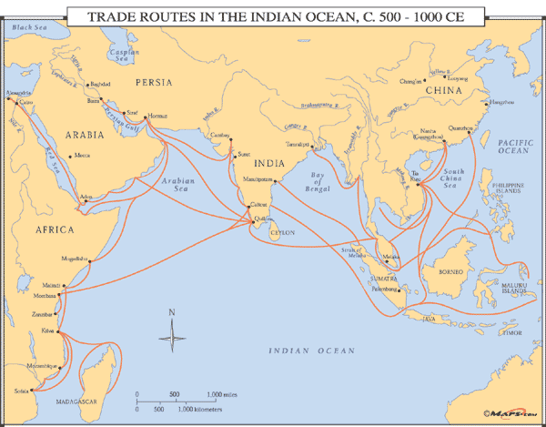
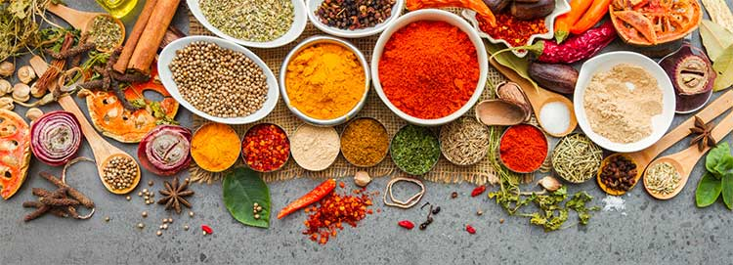
Indian Ocean Trade Network
Remember, Ottomans (Muslims) controlled most of the land trade routes
Europe wanted:
Spices, raw materials, Chinese luxury items: silk, gunpowder, porcelain, etc.
China wanted SILVER!
Imported as much silver as possible from Spain
Individual European countries had their own specific goals…

Slide 11
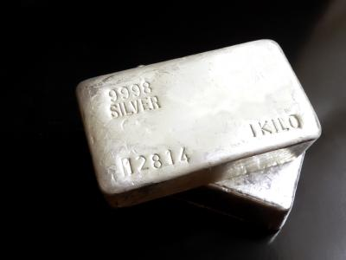
Mercantilism & Silver
At this time, European countries pursued the policy of mercantilism: a nation’s wealth is measured in its gold & silver
China, as we know, was focused on importing silver
Chinese population was even required to pay their taxes in silver!
To afford silver, the Chinese had to sell their own goods
Silver “went round the world and made the world go round
China maintained a favorable balance of trade with Europe becausae silk was still in high demand in Europe

Slide 12
Exit Ticket
What good did China want during this time period?
What item did the Russians trade?
Who is the Chinese explorer known for traveling the Indian Ocean with huge fleets?
True or False: After the Ming dynasty, China stopped trading
List 4 items the Europeans wanted from Asian countries.

Slide 13
Exit Ticket: What are two advantages & two disadvantages of international trade?
Think of both today and the 1500s-1600s. Here are questions to help you think:
Why do we buy cheap goods from China? Fancy shoes from Italy? Electronics from Japan?
How does that help the US?
How does it hurt the US?
How does it help individuals? Hurt them?
How would this help & hurt people/countries in the 16th & 17th centuries?

