Slide 1
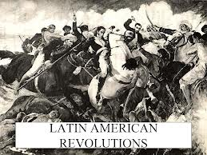
Latin America’s Road to Independence

Slide 2
Basic Recipe
American and French Revolution spread ideas of the Enlightenment
European powers distracted by conflict in Europe (usually caused by Napoleon)
Colonies get sick of repression, see the success of the American and French Revolution and revolt

Slide 3
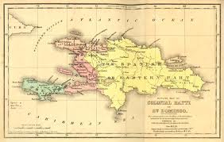
Haiti
The French colonial government in Haiti had sent men to fight in the American Revolution and they returned with ideas about how to change Haitian society.

Slide 4
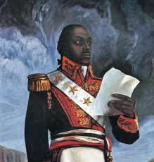
Haitian Revolution
During the French Revolution civil war broke out in the French Colony of Haiti
In that chaos a slave revolt occurred in 1791, and spread throughout colony
British and Spain attempted to seize colony during revolt but troops fell to yellow fever
Slave revolt ended in Haitian independence from France
Lead by Toussaint Louverture
Toussaint Louverture

Slide 5
Nationalist Revolts
Napoleon overthrew monarchies of Spain and Portugal
Put Joseph Bonaparte (brother) on the Spanish throne
Colonists did not feel loyal to France
Revolutionary rulers in Latin America revolt

Slide 6
Spanish Colonial Latin America had a very strict social hierarchy.
Peninsulares, people born in Spain*, were the only ones allowed to have positions in the colonial government.
Creoles, people born in the colonies from Spanish parents, were not allowed to hold government positions.
Independence movements in Latin America were started by creoles because they resented the political dominance of the Peninsulares.*
Colonial Society

Slide 7
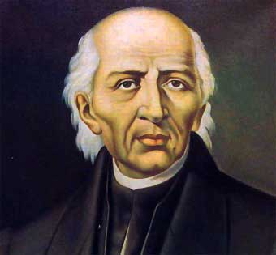
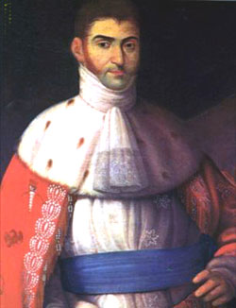
Mexican War of Independence
Revolt led by Mexican born Spaniards and Mestizos who wanted independence from Spain
Miguel Hidalgo
1st hero of Mexican Independence
September 16, 1810
Agustin Iturbide
1st Emperor of Independent Mexico
1822

Slide 8
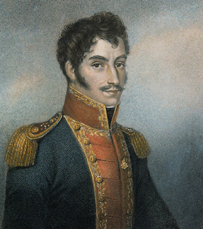
Latin America: Simon Bolivar
(1783-1830), was one of South America's greatest generals. His victories over the Spaniards won independence for Bolivia, Colombia, Ecuador, Peru, and Venezuela. Bolívar is called El Libertador (The Liberator) and the "George Washington of South America."
Revolutionary leaders in Latin America, such as Simon Bolivar were inspired by the ideals of the Enlightenment* and the successes of the American and French revolutions.

Slide 9
Once the person Napoleon had placed in power in Latin America was dismissed Simon Bolivar was appointed governor.
Even though Bolivar was part of the privileged creole upper class he declared independence from Spain.
Bolivar was influenced by the ideas of Rousseau and established a national congress.

Slide 10
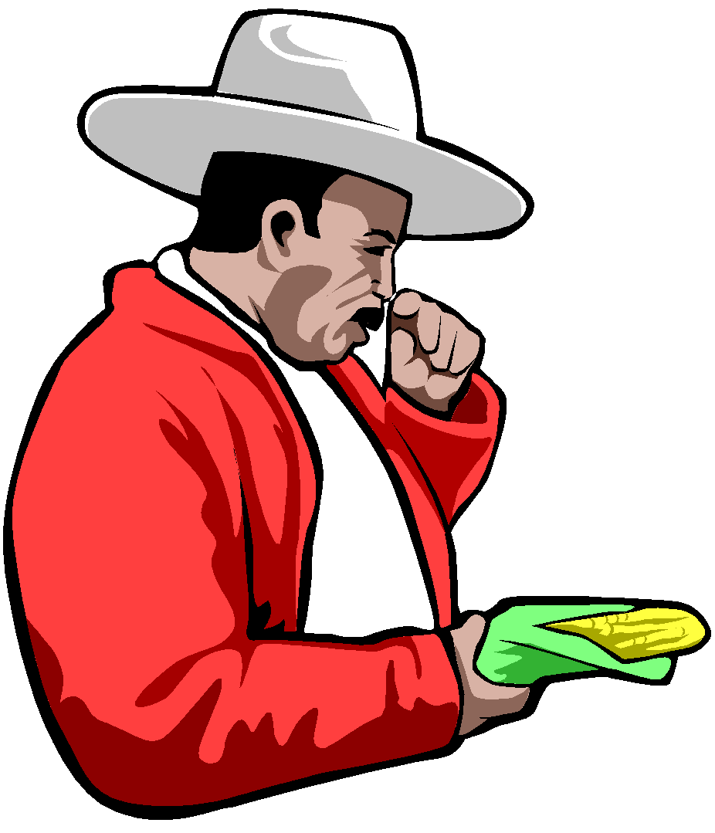
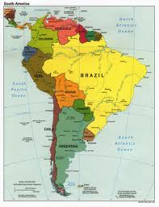
Bolivar realized that the success of the revolt was dependent on the support of the mixed-race classes of Latin Americans.
He promised to fight for rights for the lower classes and to emancipate the slaves.
Bolivar hoped to create a united South America modeled after the United States, but regional animosities and geographic barriers kept this from happening.

Slide 11
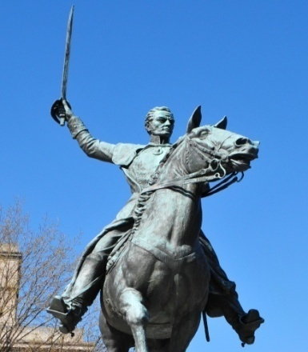
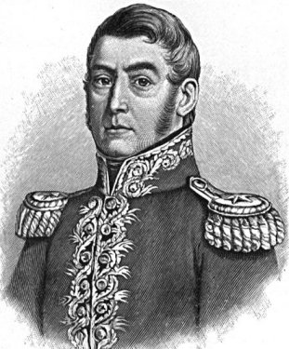
South America
Jose de San Martin
Spaniards should be removed from S. America
Started in Argentina and then Venezuela
Continued on to rest of S. America
Joined with Simon Bolivar in Chile
Monroe Doctrine (1823)
Told European powers to stay
out of the Americas

Slide 12
Posters
With your assigned group you will create a mini poster about on of the leaders of the Latin American Revolutions using your notes and the reading on your desk.
You will only have 15-20 mins, then your group will share your poster with the class.
Include the following:
Name of leader
Country/Countries they fought for/against
Grievances/complaints
Their role
Their impact
As groups share you will fill in your Latin America Chart

