Slide 1
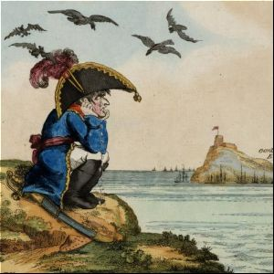
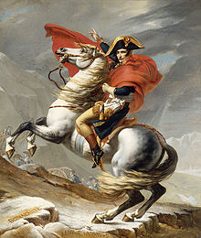
Napoleon: Most successful military leader in Europe’s history?

Slide 2
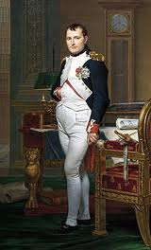
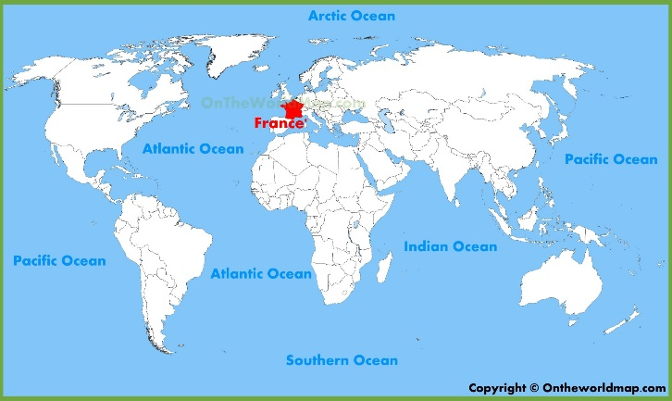
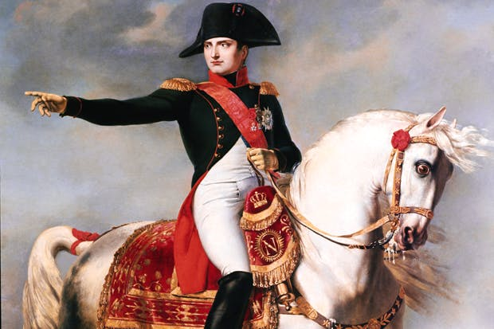
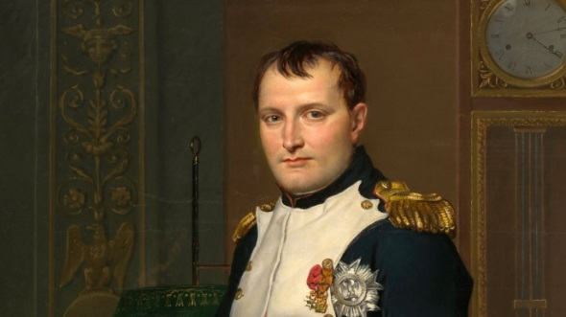
Napoleon: Who Was He?
Attended military school starting at age 9, successful military leader
1799: After the Reign of Terror Napoleon staged a coup d’etat* & took control of the French government
Emperor 1804-1814 (& in 1815 too)
Reduced citizens rights & promised to provide stability after the chaos of the revolution & Reign of Terror and defeat France’s enemies
Recognized as one of the greatest military commanders of all time
Conquered most of Europe through the Napoleonic Wars
Clip

Slide 3
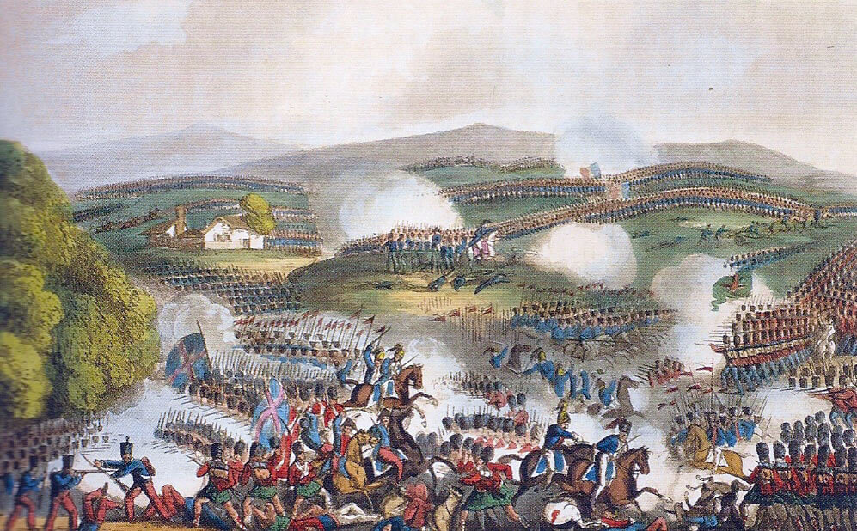

Slide 4
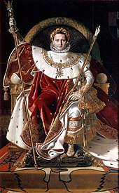
Napoleon’s Accomplishments
In 10 years, Napoleon conquered & ruled much of Europe including Austria, Prussia, Spain, Portugal, and some kingdoms in Italy
He spread revolutionary ideas by writing constitutions for the countries he conquered.
Lost one major battle: Battle of Trafalgar (1805). Unable to defeat the British due to their naval strength
Continental System: blockaded Great Britain – outlawed trade with the British Isles

Slide 5
Napoleon’s Empire

Slide 6
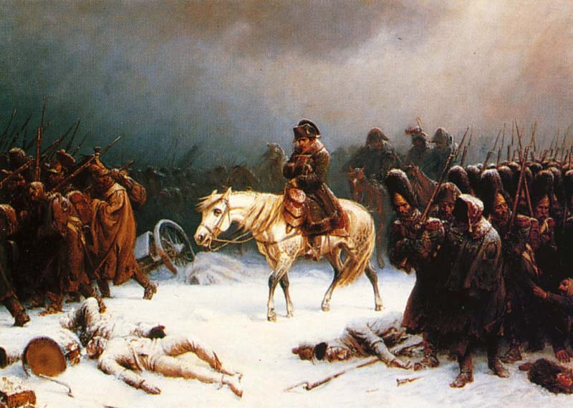

Slide 7
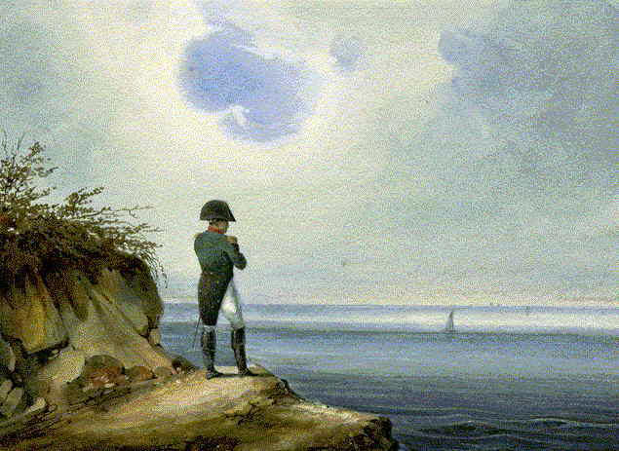
Napoleon’s Demise
Disastrous mistake: Invasion of Russia (1812).
Russian czar Alexander I continued selling grain to Britain so Napoleon & his Grand Army (420,000+ soldiers!) invaded Russia
“Scorched Earth” policy
Defeated again in 1813
French leaders exiled Napoleon to the island of Elba & restored the monarchy (temporarily)
Napoleon escaped from Elba, regained support, and
became emperor again
Final defeat: Battle of Waterloo in June 1815 &
exiled again, dying after 6 years.

Slide 8
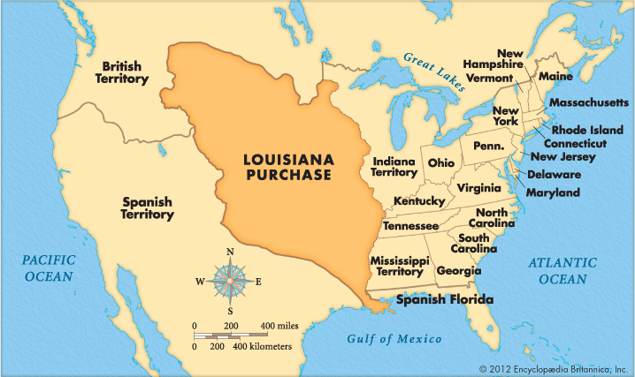
Napoleon’s Legacy
Napoleonic Wars weakened Spain & Portugal
enabled Latin Americans to success revolt & gain independence
Spread Enlightenment influences
Napoleonic Code: abolished privileges based on birth, promoted religious tolerance, and stated government jobs should go to the most qualified in France
Continued rivalry between British and French
Sale of Louisiana Purchase to the US
Far more land to USA!

Slide 9
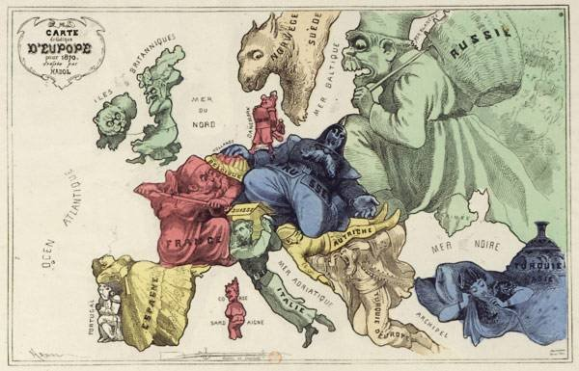
Comedic map of Europe (1870) where each country was represented by a caricature of its national ‘persona’.

Slide 10
Congress of Vienna (1815)
Meeting to restore the balance of power between European countries after Napoleon
Goals: Restore monarchies to power, no more imperialism in Europe

