Slide 1
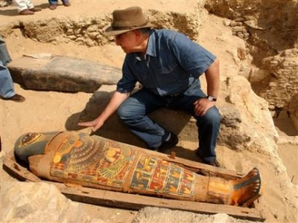
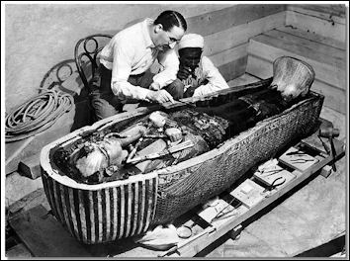
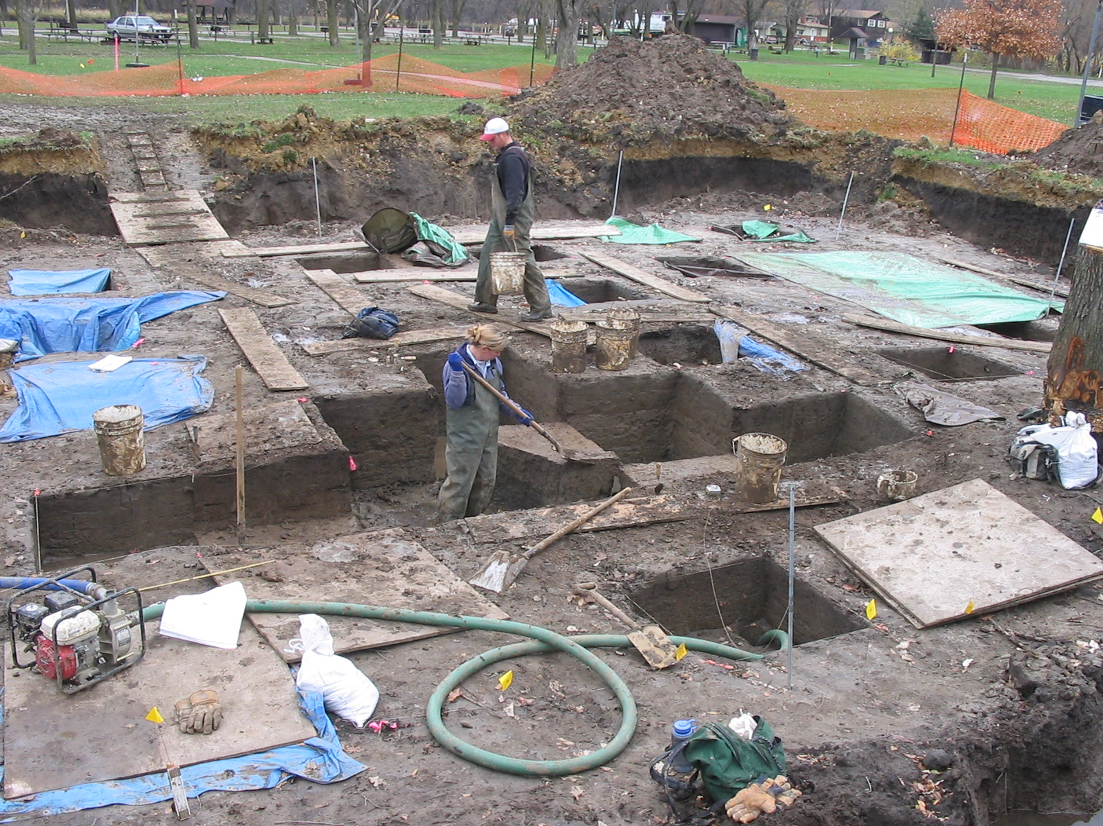
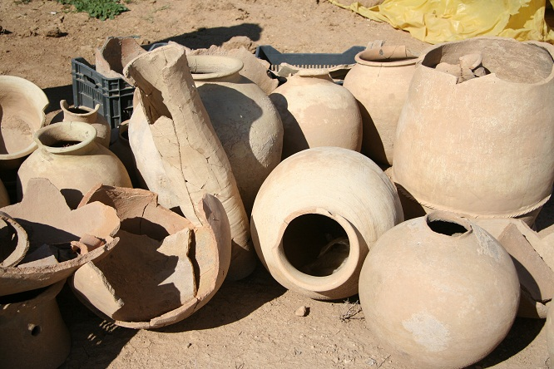
How Do We Know About Ancient Civilizations?
Archaeology-study of civilizations through their artifacts
Search for artifacts left behind (cities, buildings, garbage, paintings, bodies, anything left behind)
Try to understand what they are and how they were used

Slide 2
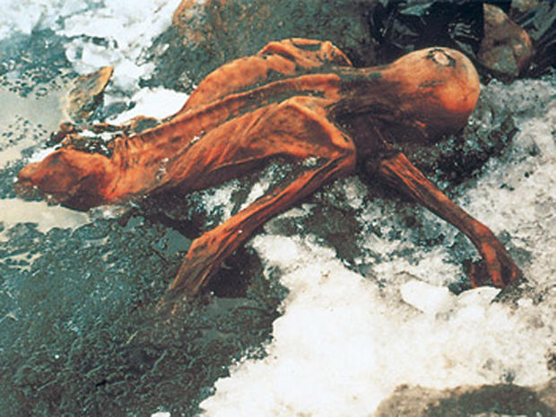
How do we know about these? Example: Otzi the Ice Man
In 1991, 2 German hikers accidentally discovered the preserved body of a man who lived 5,000 years ago
found a tool kit with him that included a six-foot longbow and a deerskin case with 14 arrows, an antler tip for sharpening flint blades, a small flint dagger in a woven sheath, a copper ax, and a medicine bag.
If you ever travel to Bolzano, Italy, you can view the ice man in a museum!
http://news.nationalgeographic.com/news/2013/10/131016-otzi-ice-man-mummy-five-facts/
Notes:
Source: textbook

Slide 3
The First Civilizations: The River Valley Civilizations
Learning Goal 2: Analyze how geography affected the development of the River Valley Civilizations and
describe the political and technological advances made in the River Valley Civilizations. (TEKS/SE’s 15B,16A,B,
19A,27A)

Slide 4
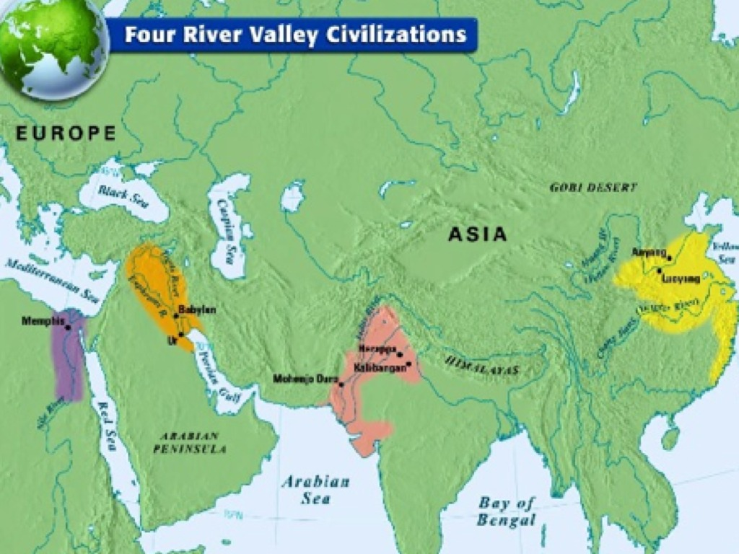
The earliest civilizations formed in the areas above. Why do you think they developed in these locations?

Slide 5
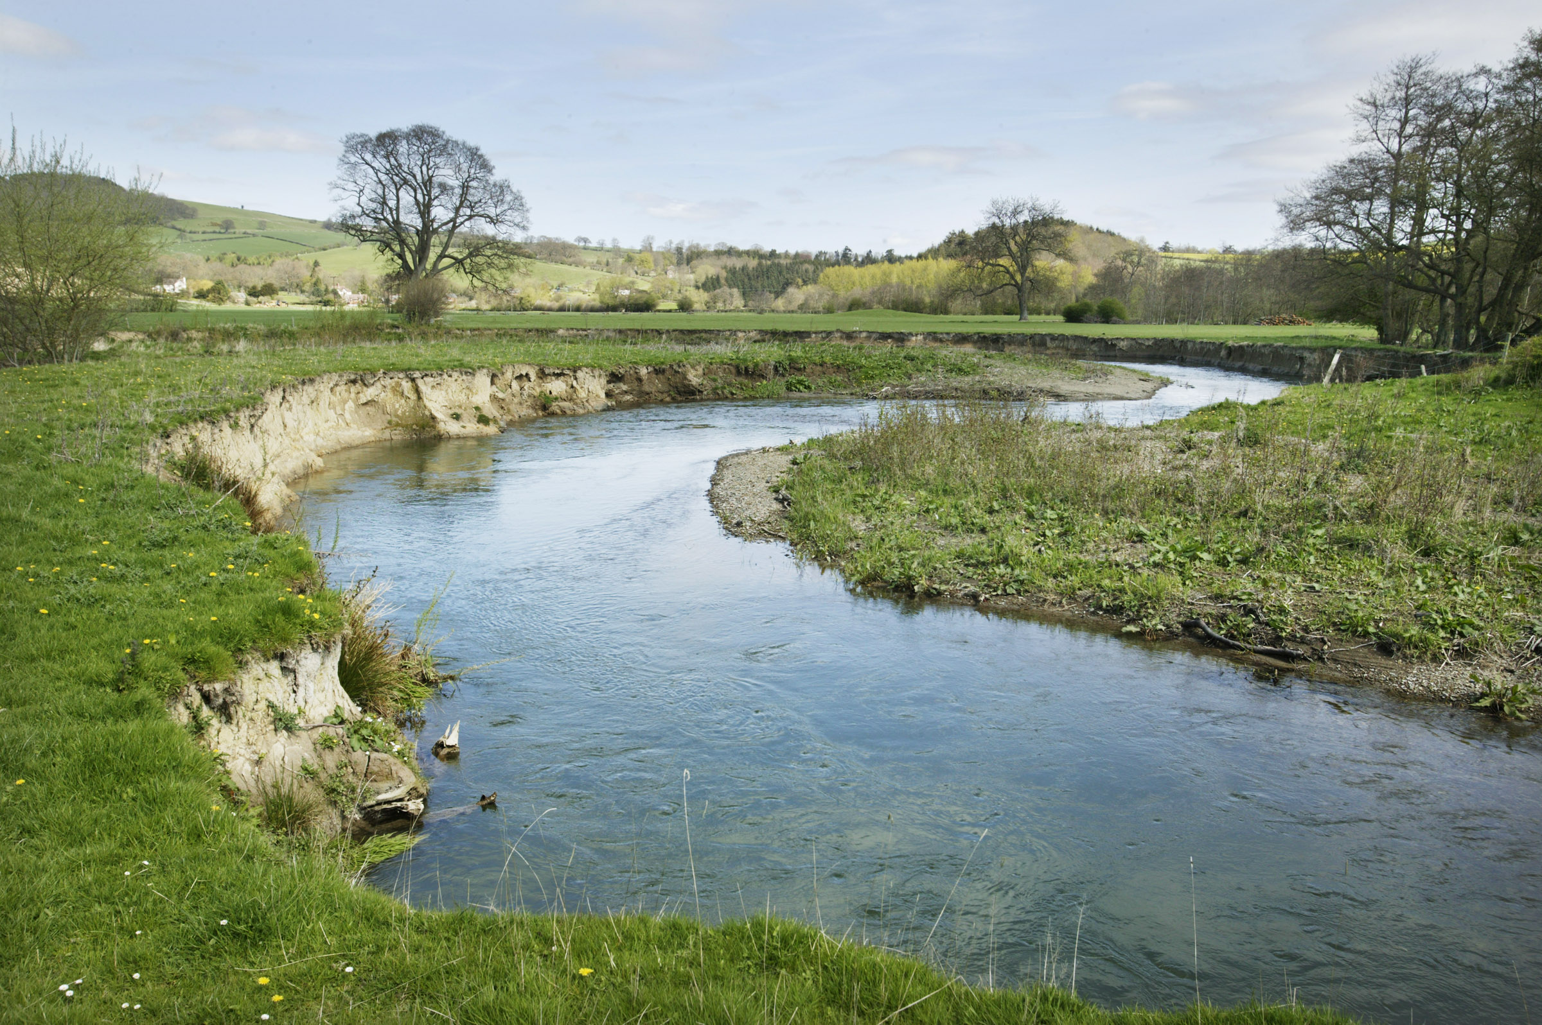
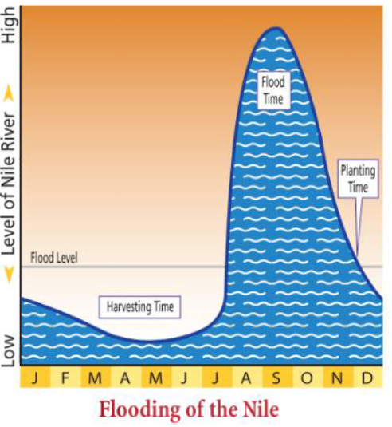
Why did people settle by rivers?
Access to water for irrigation & transportation
Seasonal flooding provided fertile soil
Some locations had predictable flooding, others were not so lucky…

Slide 6
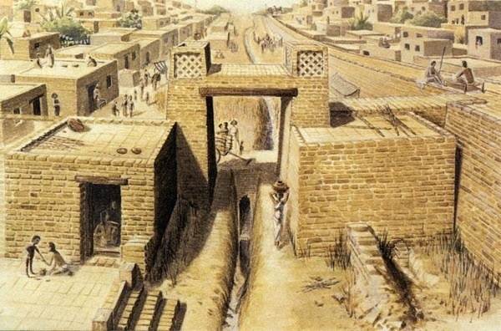
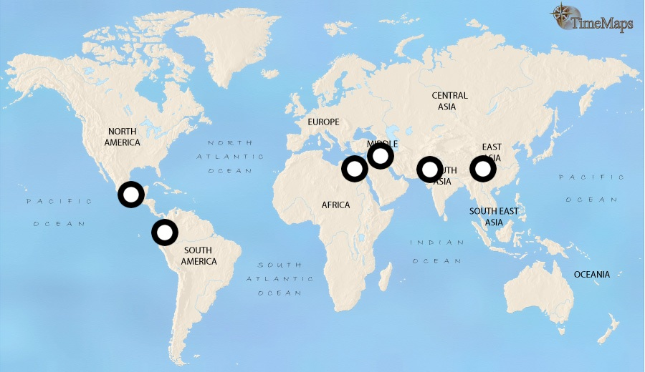
All around the world, city-states* and civilizations developed near fresh water sources.
Result: crop surplus!
Allowed people to specialize in other areas & trade economies to grow
Settled communities evolved & innovated
Notes:
City drawing: Sumer

Slide 7
Step 1: Independently use the textbook to find out all the answers to the questions for your civilization.
Mesopotamia: pg. 29-34
Egypt (Nile River Valley): pg. 35-41
Indus Valley: pg. 44-49
Huang He (Yellow) River/China: pg. 50-55

Slide 8
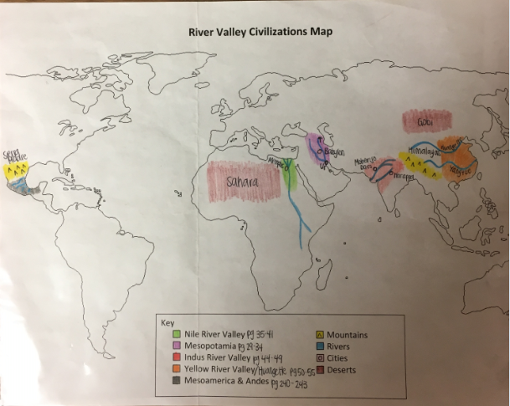

Slide 9
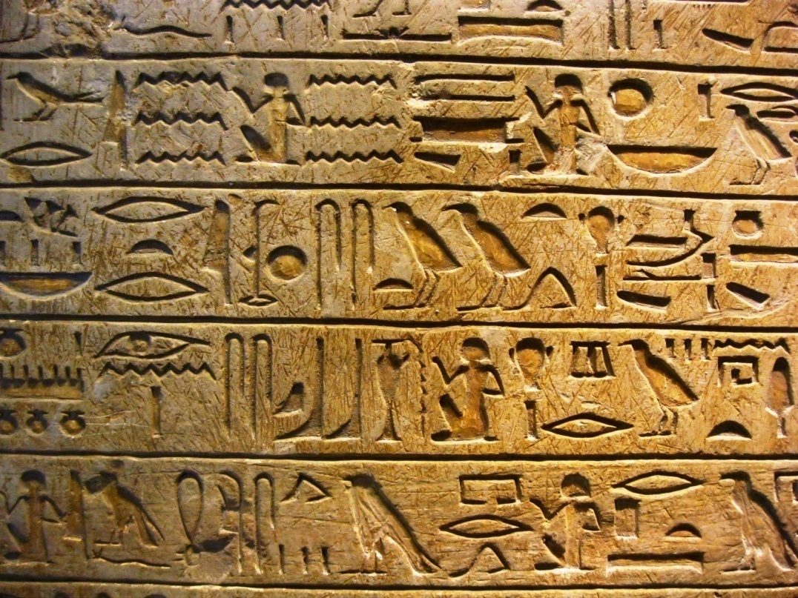
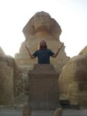
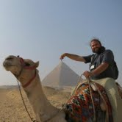
Pyramids at Giza
Hieroglyphic Writing
http://www.google.com/imgres?um=1&hl=en&rls=com.microsoft:en-us:IE-SearchBox&biw=1280&bih=627&tbm=isch&tbnid=ftC2UmzLtEARCM:&imgrefurl=http://www.english-online.at/history/ancient-egypt/life-in-ancient-egypt.htm&imgurl=http://www.english-online.at/history/ancient-egypt/ancient-egypt-pyramids.jpg&w=560&h=373&ei=7yVAUN_hH6WI2gWb1YH4Dg&zoom=1&iact=hc&vpx=747&vpy=306&dur=3182&hovh=183&hovw=275&tx=111&ty=130&sig=114288088232264669172&page=2&tbnh=136&tbnw=199&start=21&ndsp=24&ved=1t:429,r:10,s:21,i:239
http://ritournelleblog.files.wordpress.com/2010/12/louvre-hieroglyph.jpg
Notes:
NILE Side note of interest: both men and women wore eye makeup and lipstick in Egypt

Slide 10
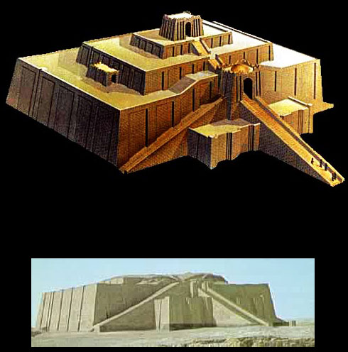
Ziggurat of Ur
Cuneiform
http://fact-o-tron.com/wp-content/uploads/2010/03/CuneiformTablet1.jpg
http://www.wayfaring.info/2006/12/05/ziggurats-and-the-greatest-of-them-sumerian-ziggurat-of-ur/
Notes:
MESOPOTAMIAThe last 4 slides can be used as a guessing activity if you take out the name of the civilization. It goes Mesopotamia, Nile/Egypt, Huang He, Indus

Slide 11
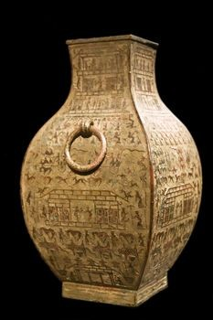
Bronze Ware
Pictograms
http://www.art-virtue.com/introduction/GiaGuWen.gif
http://www.buzzle.com/articles/shang-dynasty-china.html
Notes:
HUANG HE

Slide 12
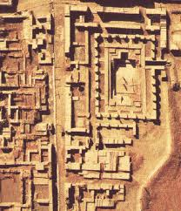
Mohenjo Daro
Harappan Clay Seals
http://www.bibliotecapleyades.net/arqueologia/worldwonders/md.htm
http://www.google.com/imgres?um=1&hl=en&sa=X&rls=com.microsoft:en-us:IE-SearchBox&biw=1280&bih=627&tbm=isch&tbnid=DSOS8wpszo5aMM:&imgrefurl=http://rolfgross.dreamhosters.com/India-ArchitectureWeb/IndusValley.htm&imgurl=http://www.harappa.com/indus/gif2/indusseals.jpg&w=550&h=374&ei=-CtAUKjyEOSJ2AWan4DQDA&zoom=1&iact=hc&vpx=952&vpy=30&dur=8471&hovh=185&hovw=272&tx=135&ty=105&sig=114288088232264669172&page=3&tbnh=139&tbnw=170&start=46&ndsp=24&ved=1t:429,r:23,s:46,i:360
Notes:
INDUS

Slide 13
Exit Ticket
If you were to live in one of the four early river valley civilizations, which one would you select? Provide two reasons why you chose this one.

