Slide 1
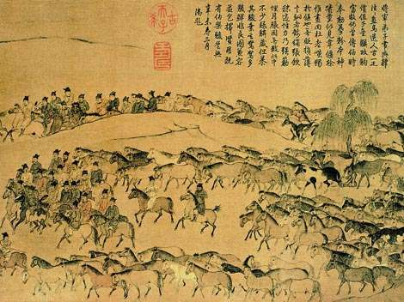
The golden age of CHINA: the Tang & song dynasties
“The world’s most advanced country”
TEKS 4H, 15A, 27A

Slide 2
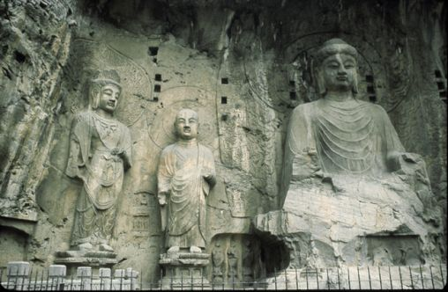
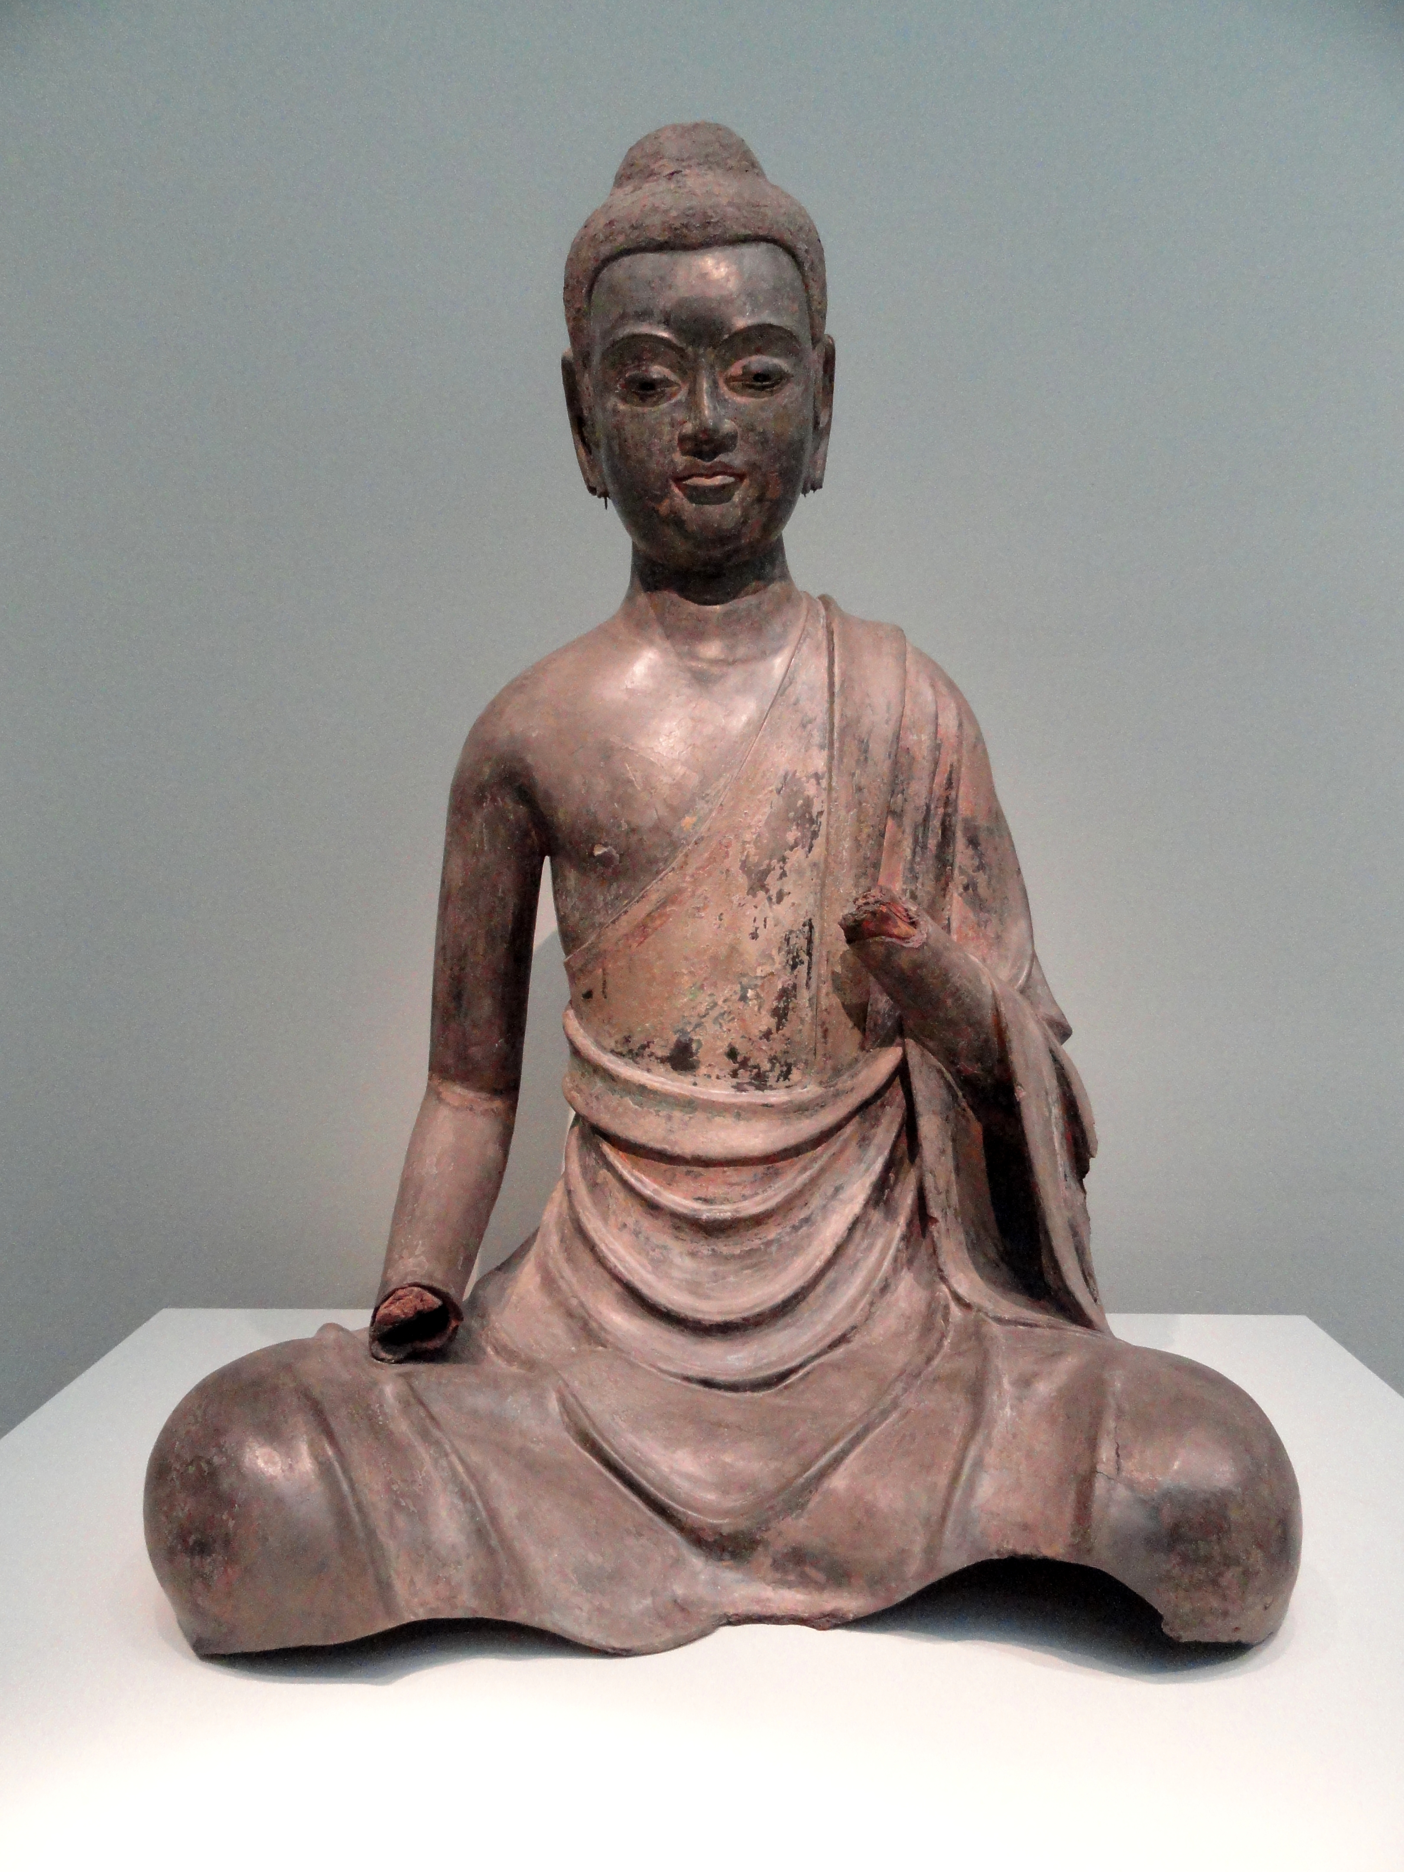
The tang dynasty (introduction)
Remember the Han dynasty?
Collapsed 220 AD
Over the next 350 years more than 30 local dynasties rose & fell!
Buddhism gained political influence during this time
This continued until the emergence of the Tang dynasty (618-907)

Slide 3
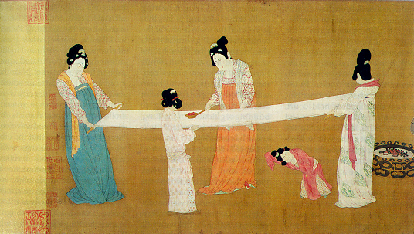
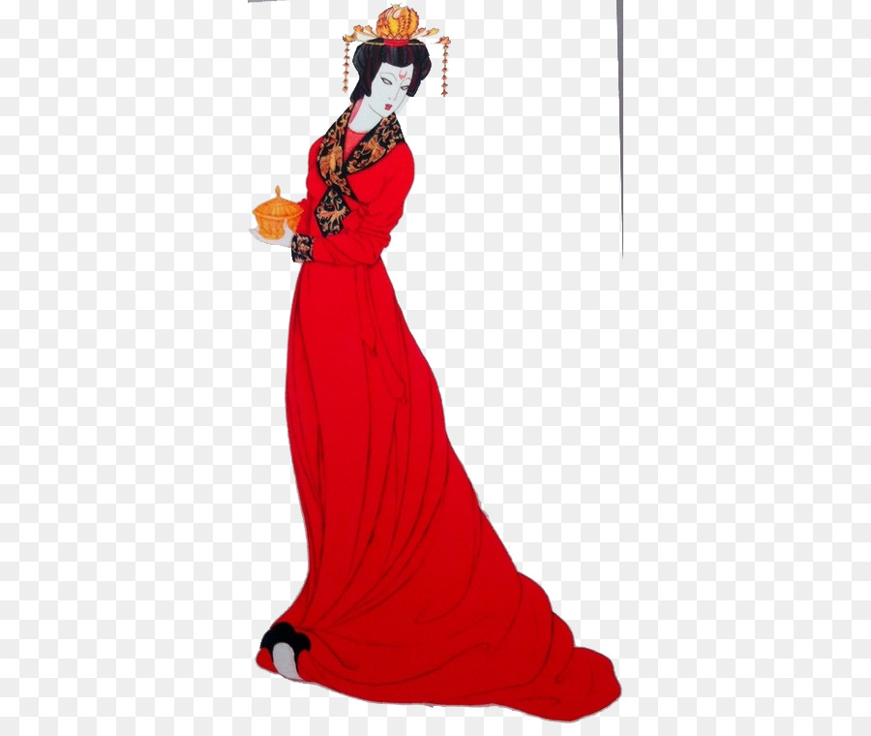
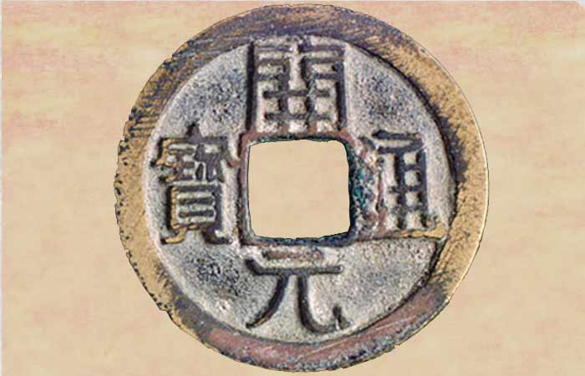
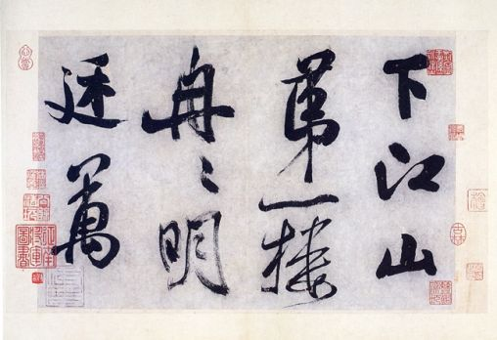
The tang dynasty
Expanded empire
Extended influence over Korea
Empress Wu
Strong central government to control the huge empire
2 capitals: Cha’ng-an and Luoyang
Revived Confucianism, ending the political influence of Buddhism
Also revived the civil service exam
Nobility dominated the government
Education became more valued
Central Asia defeated by Muslim armies in 751 (Battle of Talas)
907: Chinese rebels sacked & burned the capital of Chang-an & murdered the last Tang emperor (a child!)
Notes:
Ladies preparing newly woven silk. Bottom R is Tang era poetry

Slide 4
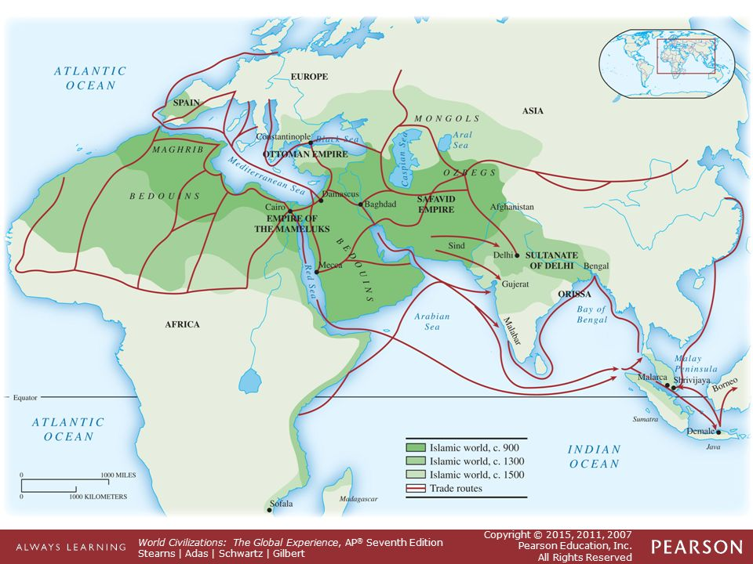
Notes:
Talk about how close the Muslim Empire gets to China

Slide 5
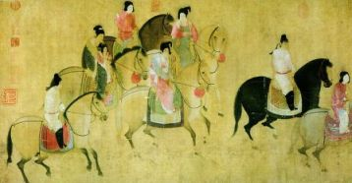
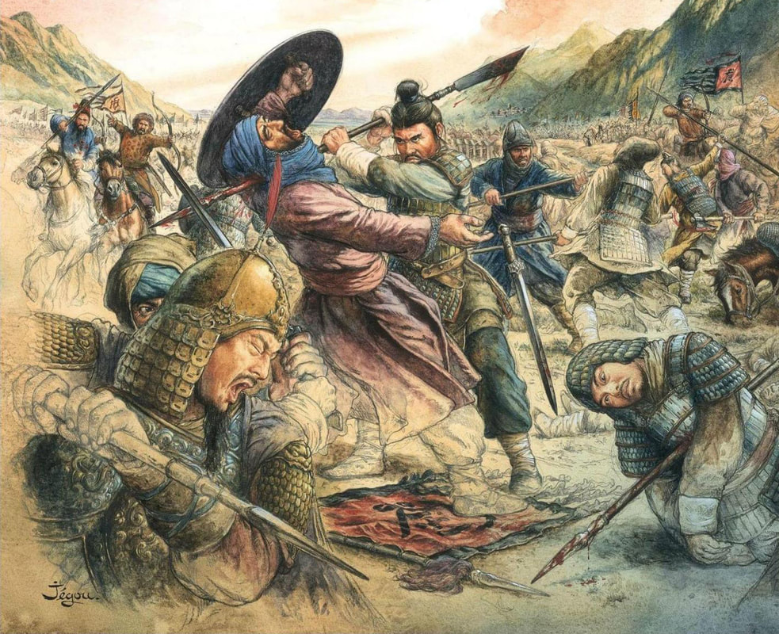
The in-between years…
Rival warlords divided China into kingdoms
Families fought for the Mandate of Heaven until…

Slide 6
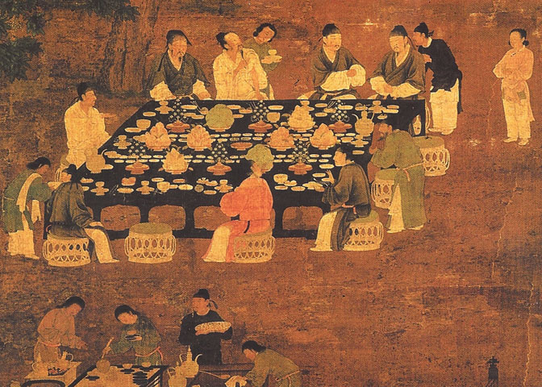
The Song dynasty (aka sung dynasty)
Never regained territory lost after the Tang
Tried to buy peace with northern enemies- annual
tributes of silver, tea, silk
New capital established at Hangzhou
Weak military
Confucian government
Strong economic development
Southern cities prospered from trade with Chinese in the north, nomads in Central Asia, and people in Western Asia & Europe
Population reached 100 million (double what it was prior to the Tang!)
Marco Polo
The Song scroll

Slide 7
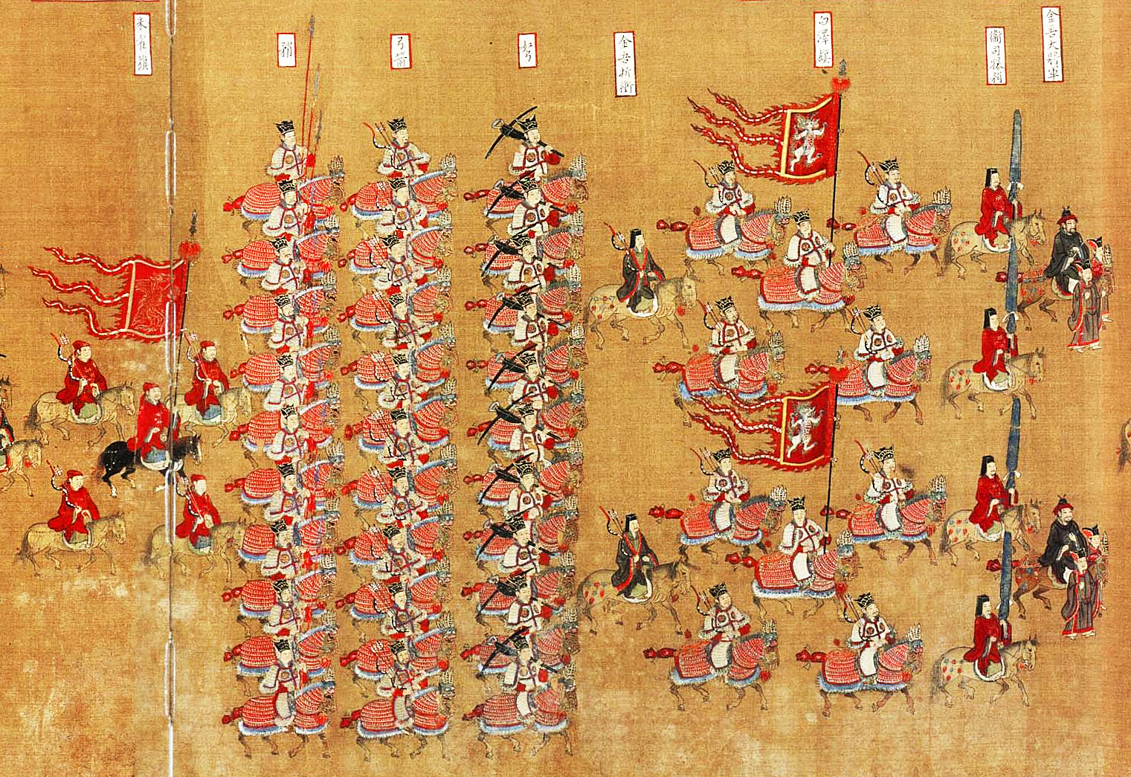

Slide 8
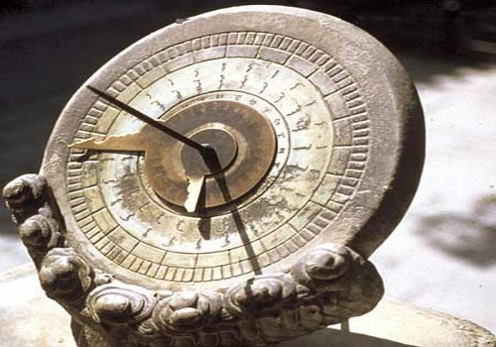
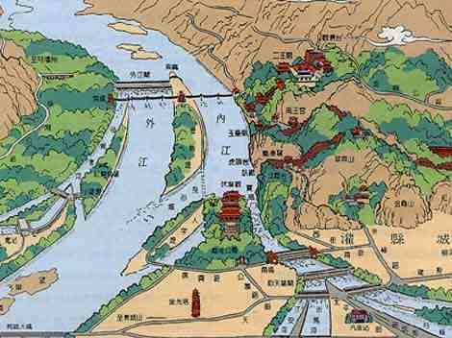
Accomplishments of the tang & song
Grand Canal extended- could ship goods across China by boat
Use of paper money & letters of credit – improved economy!
Mechanical clock, acupuncture
Advances in math and algebra
Land reform- parceled out land to peasant farmers
Imported faster ripening rice, doubling the rice crop
Population increased
Foreign trade flourished
Major port cities boomed
Poetry, painting blossomed
Spread of Buddhism (gained popularity in China, then lost popularity)

