Slide 1
The English Civil War and the Glorious Revolution

Slide 2
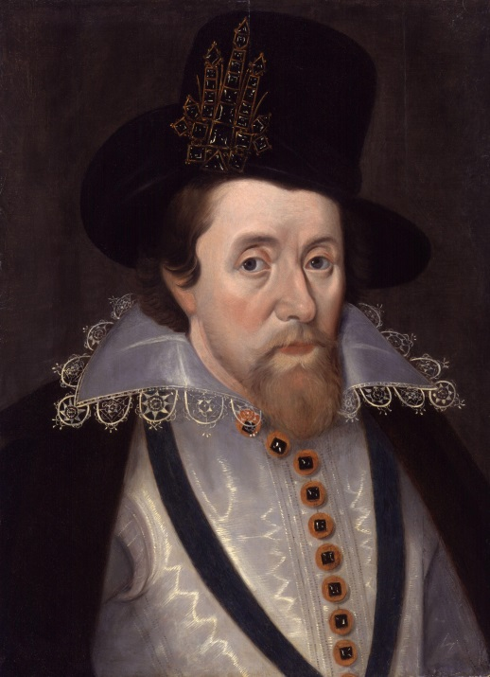
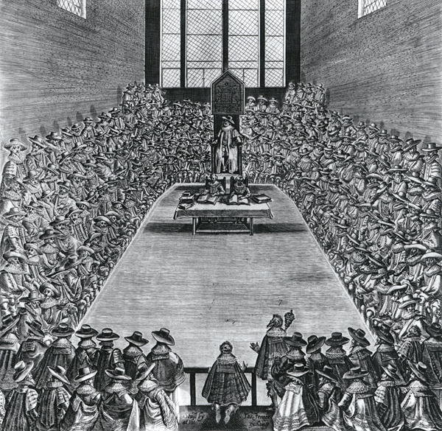
1603 – King James I
After Queen Elizabeth’s death, her cousin the King of Scotland, becomes the King of England
Enter King James I
King James Raises taxes and this make Parliament very angry…

Slide 3
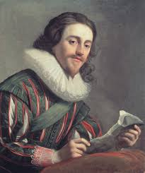
1625 – King Charles I
When James dies, his son Charles I became king.
Charles dissolves (breaks up) Parliament but later has to call them back because he needs money.

Slide 4
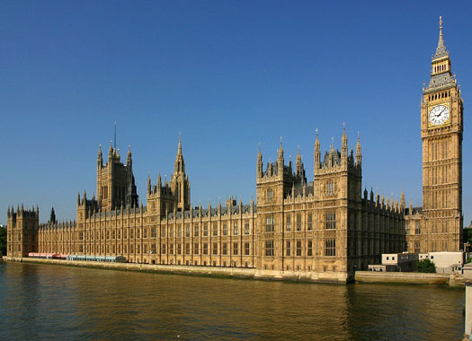
Quick recap
Basically at this point, Parliament has had it with the King of England.

Slide 5
1642 – Civil War Begins
They give the King one last chance!
Parliament agrees to help Charles if they can control the army.
Charles doesn't agree and instead decides to invade Parliament.

Slide 6
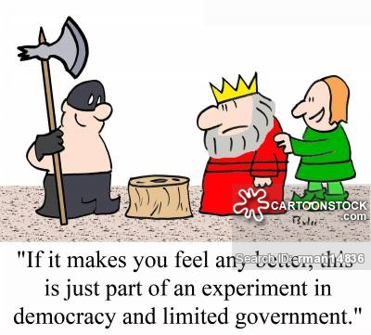
1646 – Abolish Monarchy
The Cavaliers (King’s troops) are successful at first but eventually, the Roundheads (led by Oliver Cromwell) win.
Charles I was beheaded in public 3 years later.
“If it makes you feel any better, this is just part of an experiment in democracy and limited government.”

Slide 7
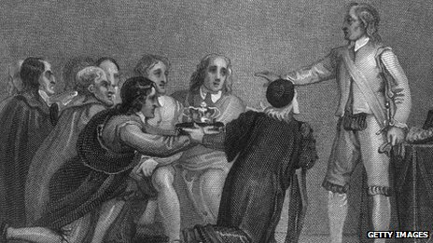
1653 – Lord Protector
Oliver Cromwell declares himself “Lord Protector” (which is really just a nice way to say military dictator)

Slide 8
1660 - Restoration
After Oliver Cromwell dies, his son tries to keep power but is unsuccessful.
Many of Cromwell’s policies were very unpopular (who doesn’t want to celebrate Christmas??)
England decides to bring back the king and they ask King Charles in Scotland to be king.
Sorry for beheading you dad Charles, but will you be king please??
Sure!!

Slide 9
1685 – James II King
Charles II dies without a legitimate heir so his brother, James, becomes king.
The only problem with James is that he has done the unforgivable…. He has married… a CATHOLIC!
Why is this important? (think back to King Henry VIII)

Slide 10
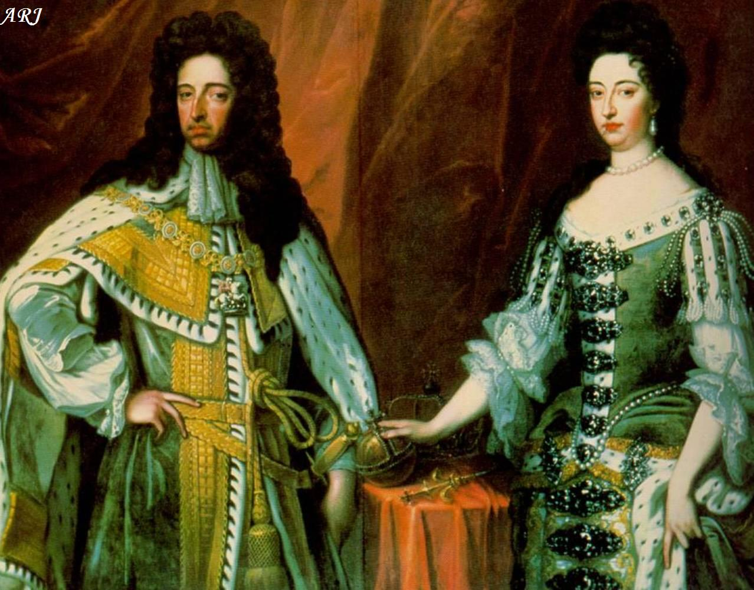
1688 - Glorious Revolution
To avoid the issues they had during the civil war, the English decided to invite James’ older daughter, Mary, and her husband, William, (both protestant) to be the queen and king of England.
They accepted (it was glorious) and James fled to France.

Slide 11
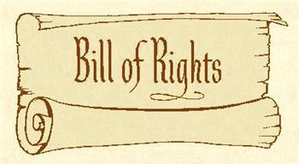
1689 – English Bill of Rights
Parliament was finally in charge and to make sure that the monarch in England never tried to over power them again, they had William and Mary sign the English Bill of Rights
Power was transferred to Parliament and English will from here on remain a Constitutional Monarchy.

