Slide 1
The Korean & Vietnam Wars
LG 1: explain how the Korean War & Vietnam War were associated with the Cold War.

Slide 2
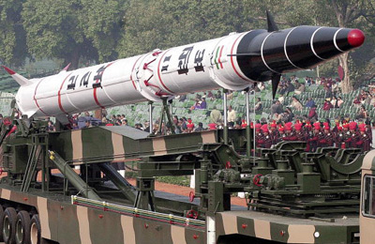
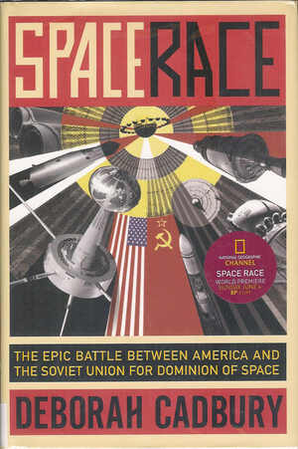
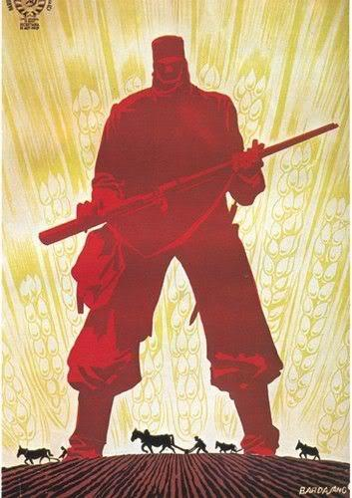
CONTAINMENT
United States policy to prevent spread of Communism
US would not overturn Communism where it existed, but it would try to prevent it from spreading any further
Led to:
Nuclear arms race
Space Race
Korean War
Vietnam War

Slide 3
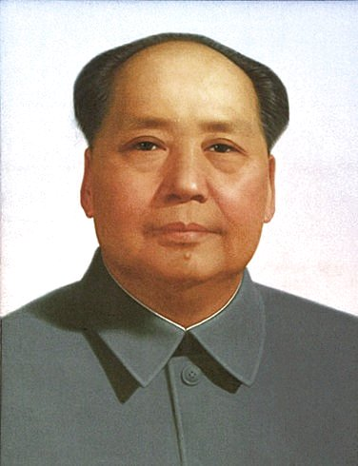
COMMUNISM IN CHINA
End of WWII
Chinese Communist revolution
Mao Zedong
Communist leader
Mao gained total control in 1949 – People’s Republic of China
Worked to expand China’s influence (Mongolia, India, Tibet, etc.)
US fears “Domino Theory”
(if one country in a region came under the influence of communism, then the surrounding countries would follow in a domino effect.)

Slide 4
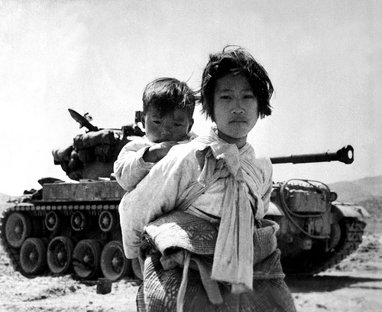
KOREAN WAR 1950 - 1953
Korea was split (like Germany) between Communist North and Democratic South
Split along 38th Parallel
After WWII, Soviets supplied North Korea with military aid/supplies hoping to take control of South Korea as well
USA involved to prevent spread of communism
Containment!
Cease fire signed 1953
Boundaries still on 38th parallel = NO CHANGE FROM THE WAR
Korean War Synopsis

Slide 5
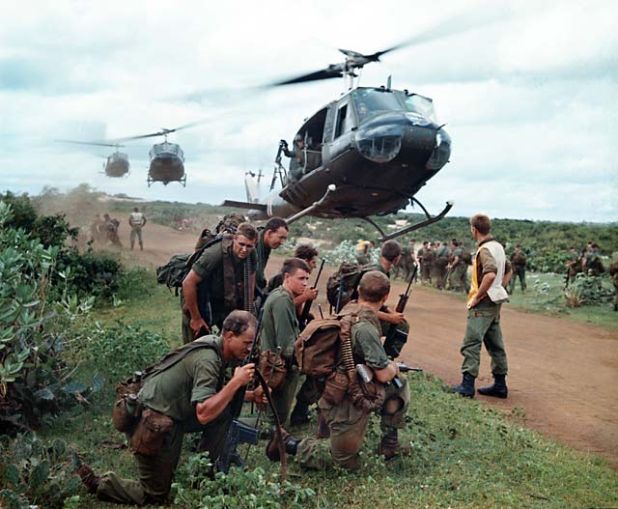
VIETNAM WAR 1954 – 1975
Vietnam Intro Video
Ho Chi Minh led the Vietminh (communist party) -> North
Democratic South (supported by the US)
USA involved to prevent spread of communism
Containment!
Pulled US troops out of war because of how unpopular the movement was at home.
Vietnam War Synopsis

