Slide 1
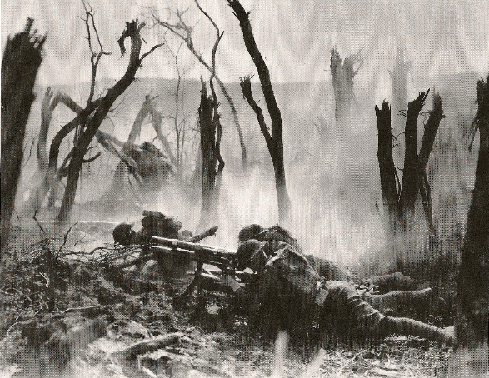
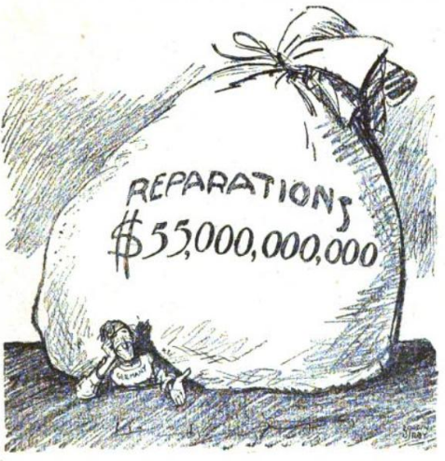
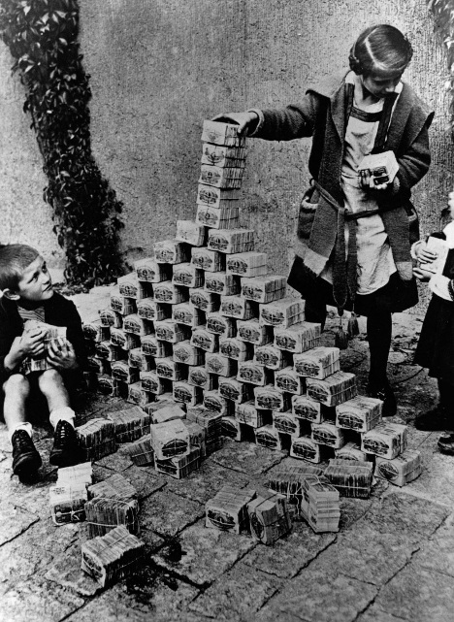
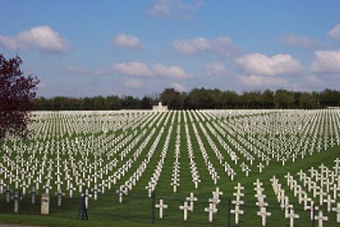
Pre-World War II Timeline
1914-1918: World War I
Trench warfare, millions killed, new technology
1919: Treaty of Versailles
Germany takes blame for WWI, has to pay millions in reparations…
1920s & 1930s: Global Depression
impacts various regions harder than others & at different times, allows Hitler to rise to power

Slide 2
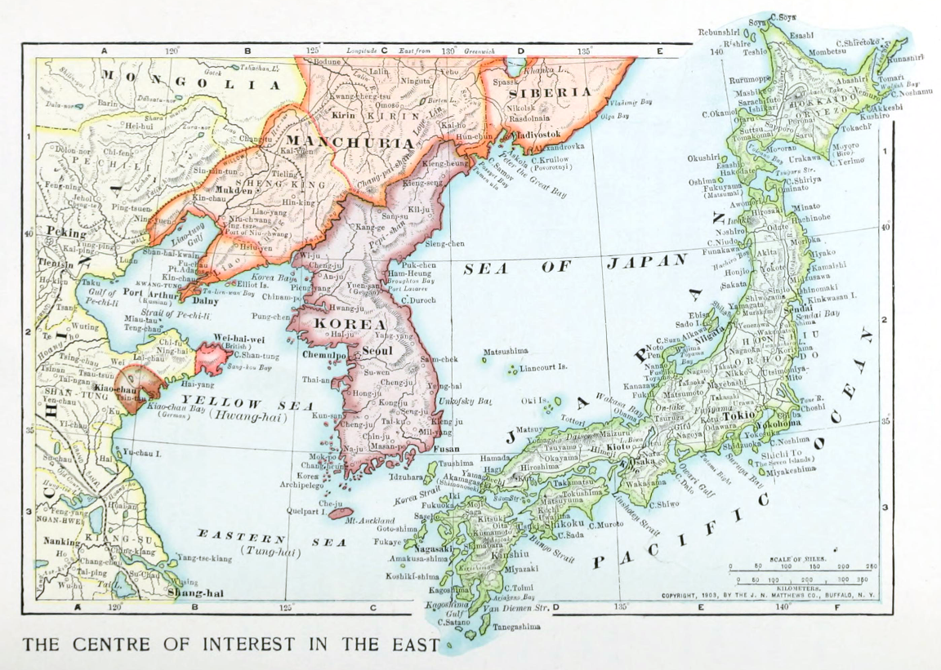
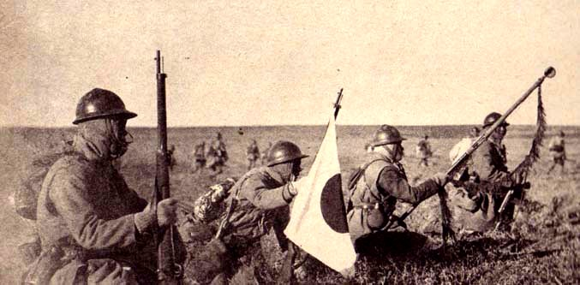
Pre-World War II Timeline, Asia
1931: Japan invades Manchuria & in 1937 Japan invades mainland China
Japan wants to develop an empire
Needs more natural resources
Commits heinous crimes at Nanjing

Slide 3
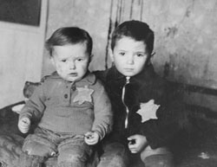
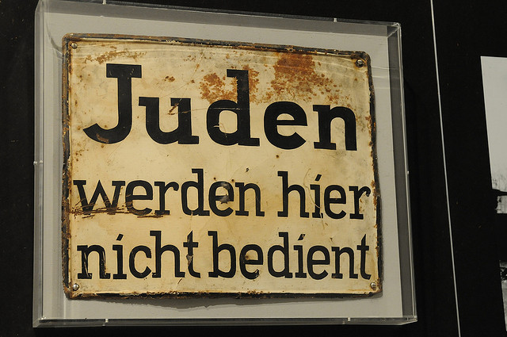
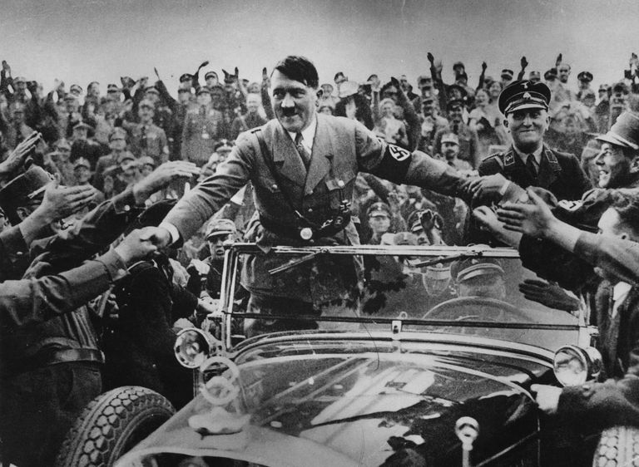
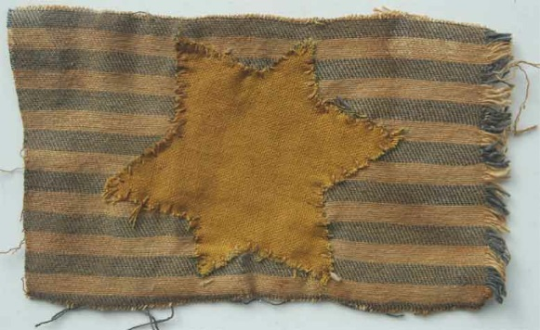
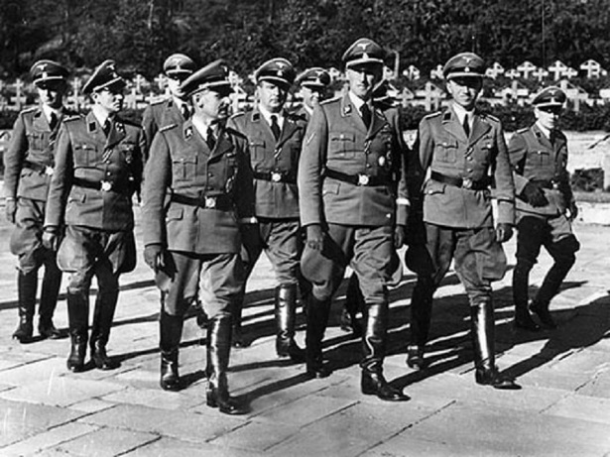
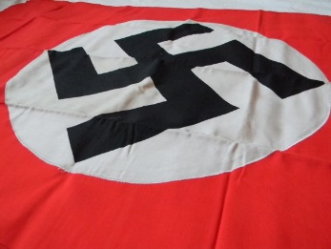
1930s: The Rise of the Nazis
Hitler becomes chancellor of Germany
Nationalism- restore pride in German heritage
Germany began rearmament; developed a strong army
Broke the Treaty of Versailles
First concentration camps open
Discrimination against Jews, Communists, the disabled, LGBTQ, and other minority groups begins
Anti-Semitic laws created in Germany
Increased in severity over time

Slide 4
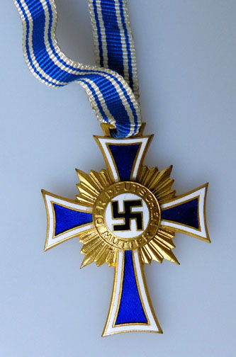
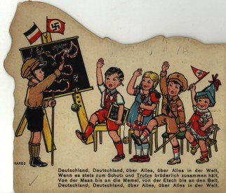
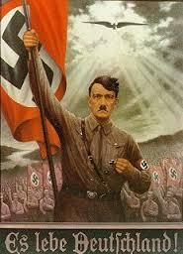
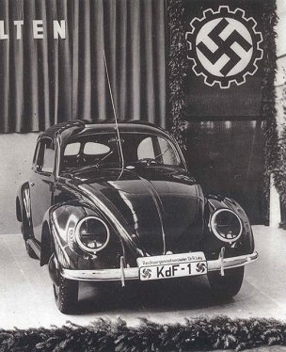
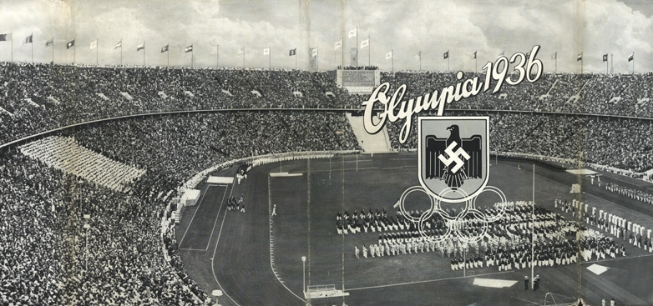
Notes:
Motherhood cross

Slide 5
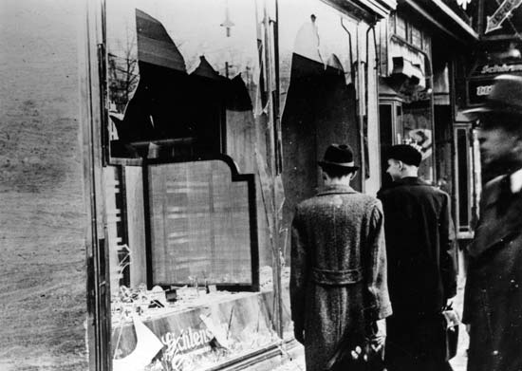
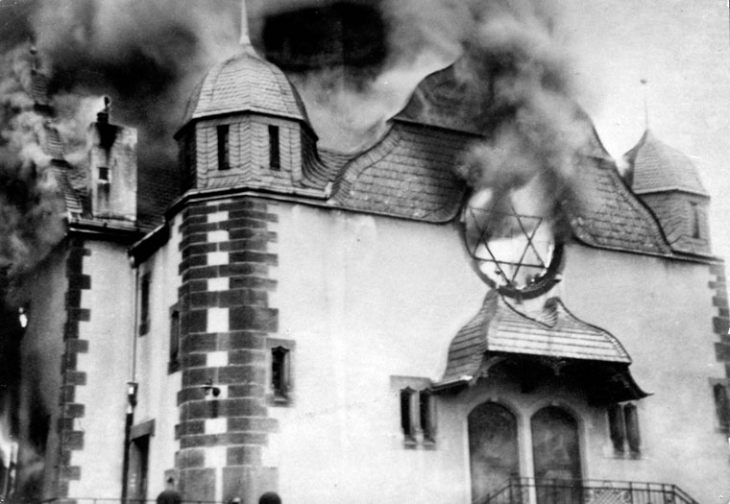
Use of propaganda to convince Germans they, the Aryans, were racially superior to all others
Indoctrination of children (Hitlerjugend, at school, at the cinema…)
Anti-Semitic propaganda
1938: Kristallnacht in which Jewish shops were vandalized and Jewish men sent to camps

Slide 6
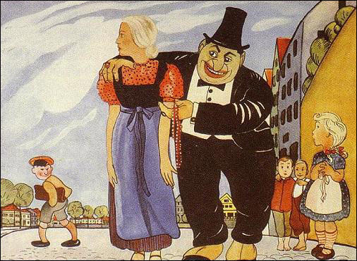
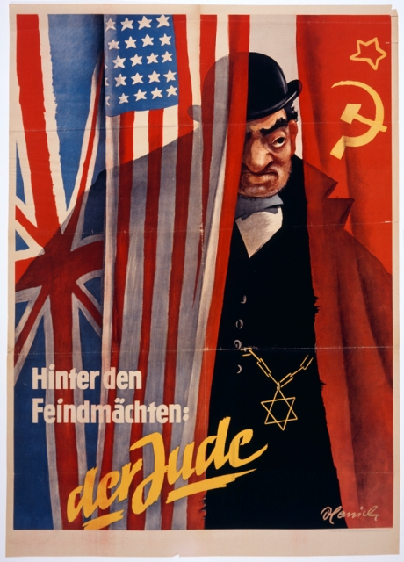
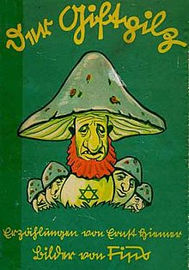
Anti-Semitic propaganda

Slide 7
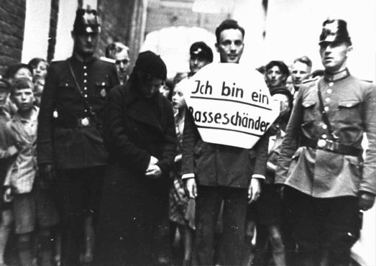
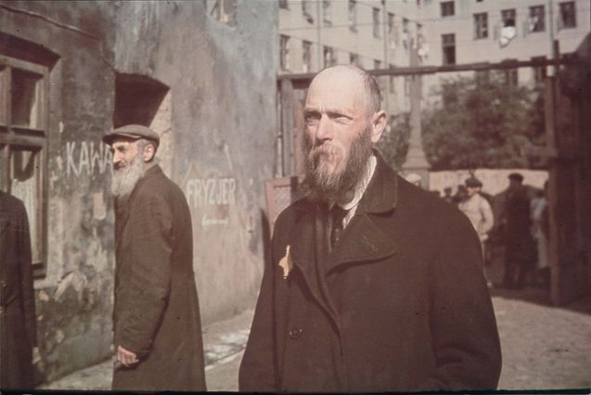
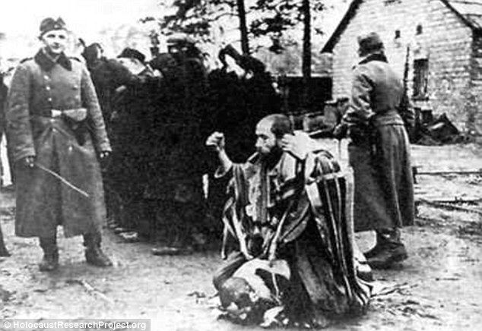
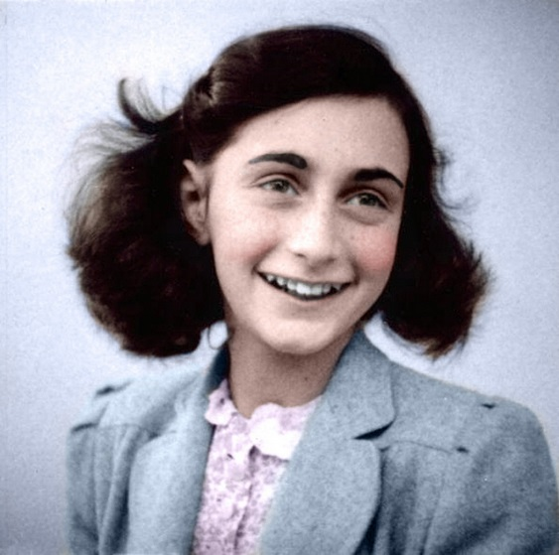

Slide 8
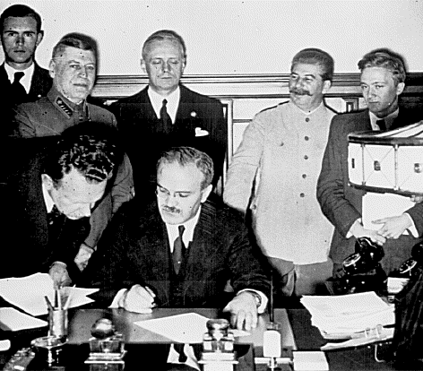
1930s: Appeasement
In order to avoid a second World War, Britain and France choose to handle Nazi Germany with a policy of appeasement
Nazi Germany invaded Austria in 1938– the Anschluss
Broke the Treaty of Versailles
Munich Agreement- Meeting of Britain, France, Italy & Germany in which they decide Germany can invade & take over the Sudetenland part of Czechoslovakia
1939- Non-Aggression Pact: the Soviet Union (now communist & under Stalin’s dictatorial rule) & Germany sign an agreement that they will not attack each other

Slide 9
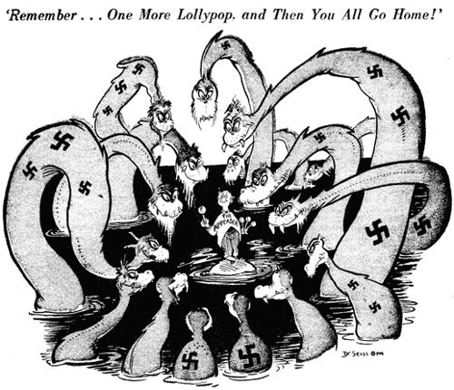
Dr. Seuss- Appeasement cartoon

Slide 10
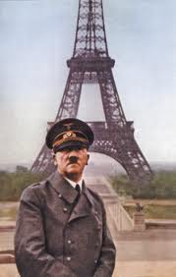
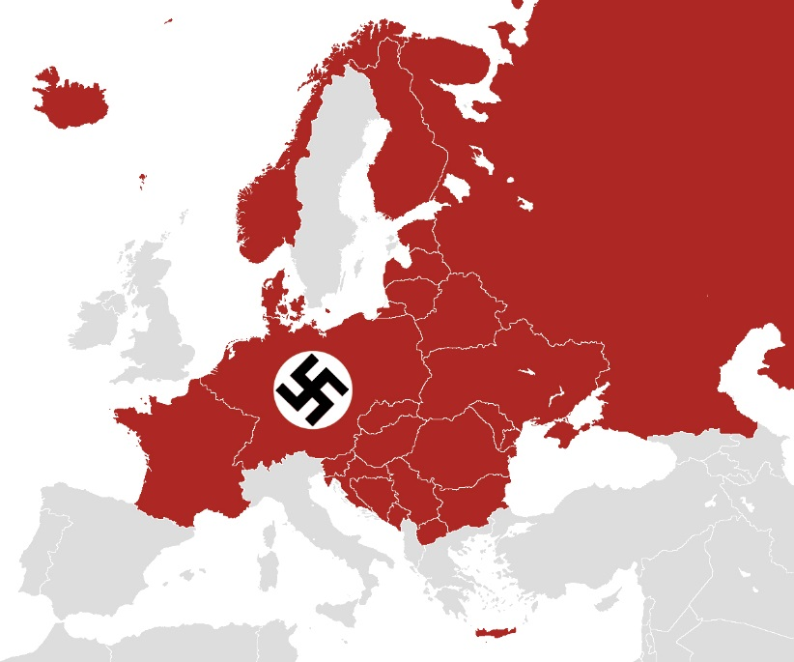
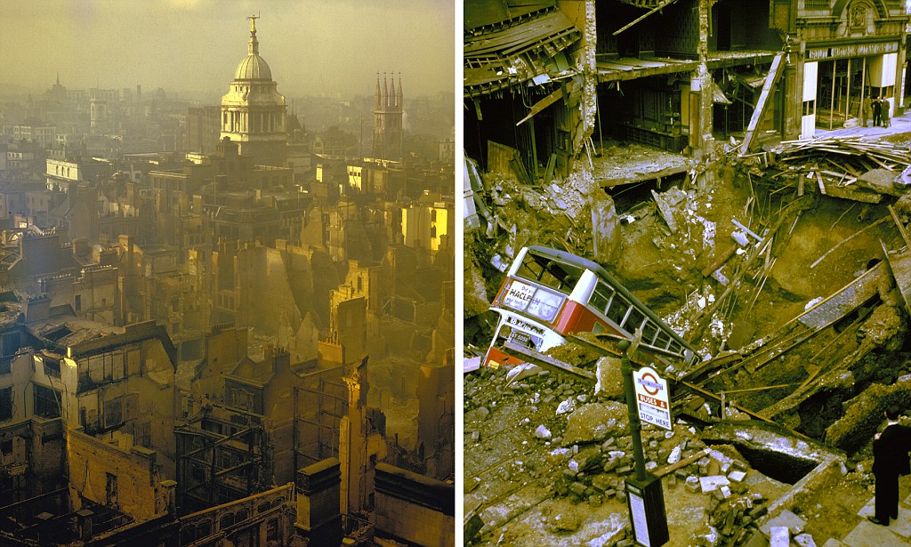
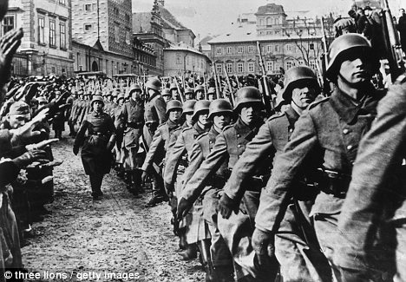
1939: The War Starts
Video clip
September 1, 1939: Nazi Germany invades Poland
successfully used the blitzkrieg strategy
Germany then invaded and occupied numerous European nations
Many fought back but could not defeat the powerful Nazi armed forces
Attempted to force Great Britain to surrender through air bombing but failed after a year (Battle of Britain, Blitz of London)

Slide 11
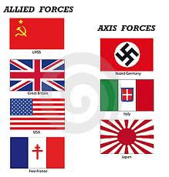
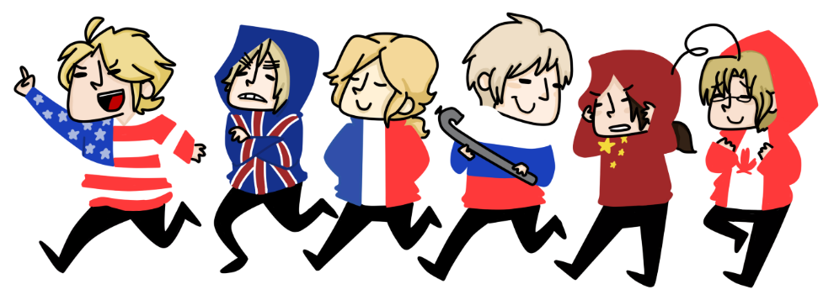
The Two Sides: Who fought who?
Allies
Great Britain (Churchill)
Soviet Union (Stalin)
USA (Roosevelt, Truman)
France
Australia, Canada, New Zealand, and many more
Axis
Germany (Hitler)
Japan (Hirohito)
Italy (Mussolini)

Slide 12
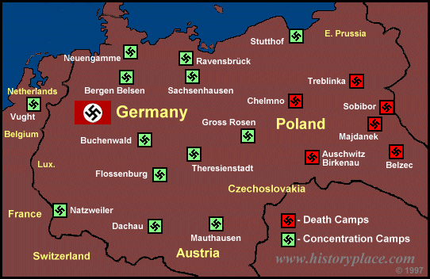
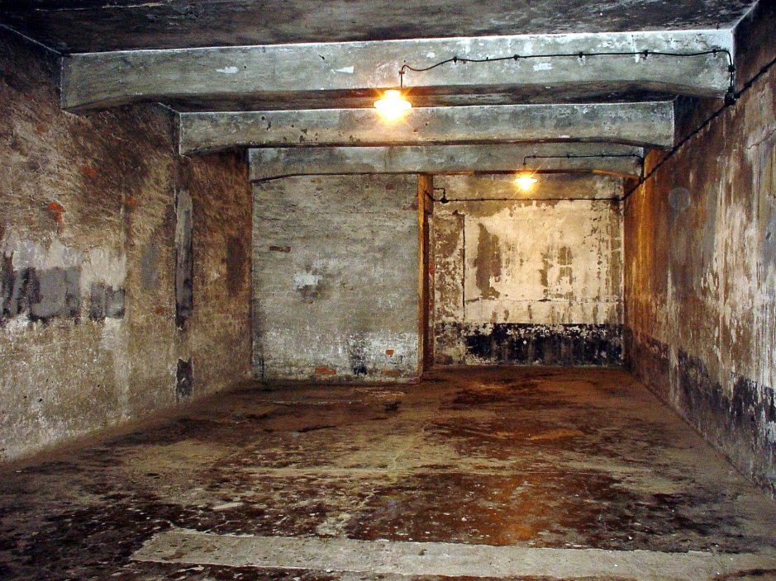
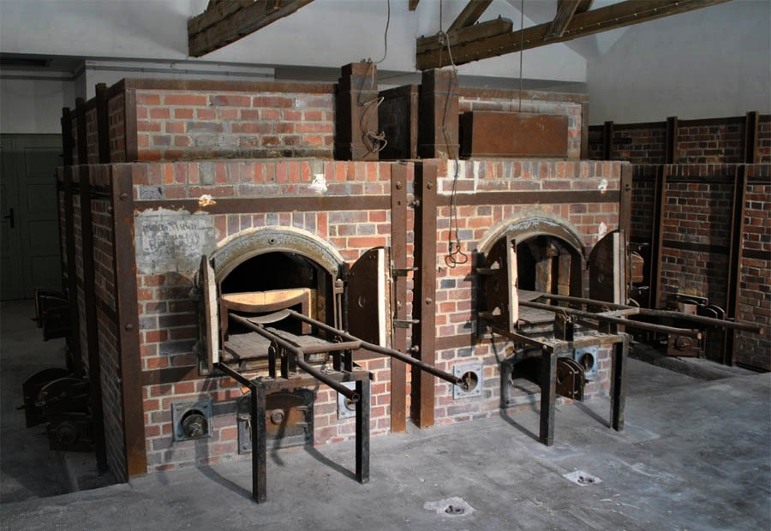
1941: “The Final Solution” is decided upon
The “Final Solution” to the “Jewish Problem”: exterminate the Jews
Formal plan of enslavement & mass murder of European Jews
In all occupied German territories, Jews were required to report for deportation to the “East”
Told they would be sent to work
The Nazis set up an extensive network of concentration camps & death camps created across much of Germany & Eastern Europe

Slide 13
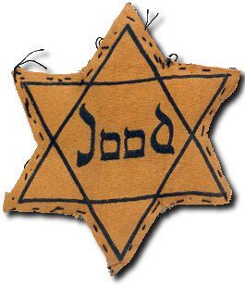
1941-1945: The Holocaust
Jews, Communists, and other “undesirables” or resisters were transported by train to camps
Upon arrival, they underwent a “selection” process by a doctor
Children, the sick, and elderly were sent to the left for death
Healthy adults 16+ typically were sent to the right for enslavement
Those who worked in the camps had a variety of jobs, approx. 500 calories per day, one set of clothes & shoes, and horrific conditions
Torture, beatings, little/no medical care (remember what happens to the sick…), overcrowded, unsanitary, medical experiments…
Gas chambers were used to efficiently execute humans at death camps
Survivor’s clip

Slide 14
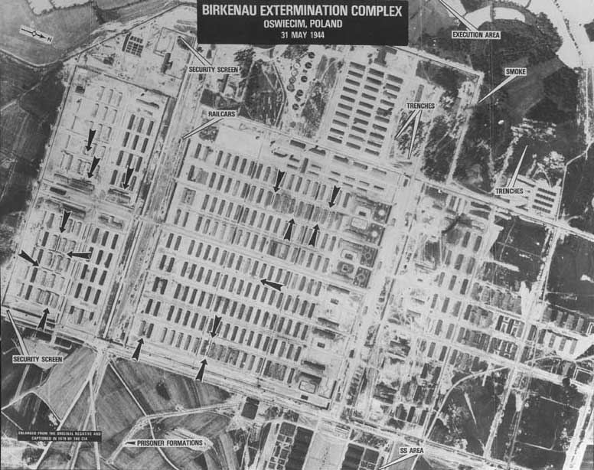
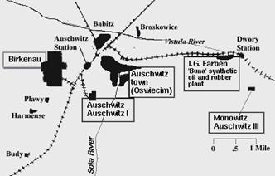
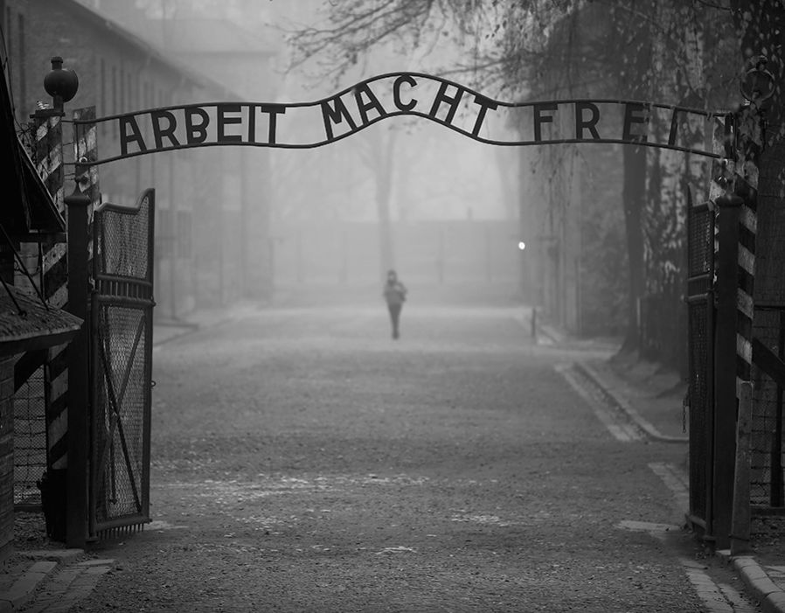
Auschwitz
Drone video clip

Slide 15
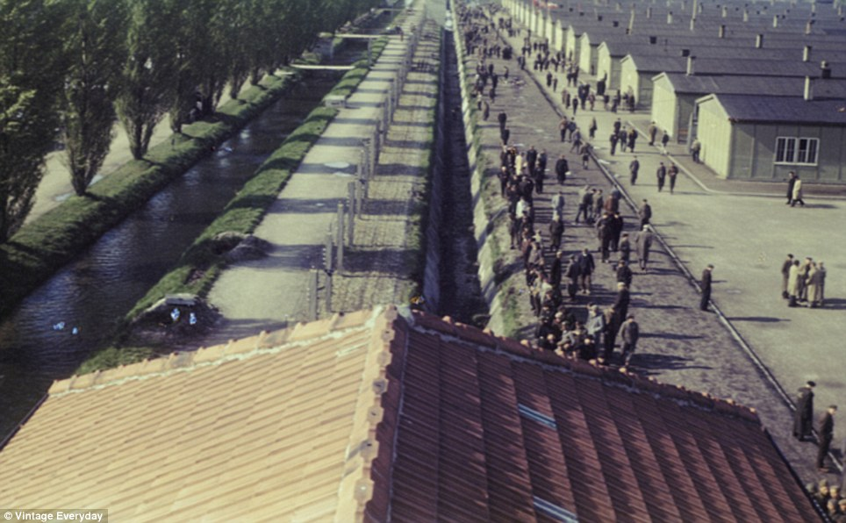
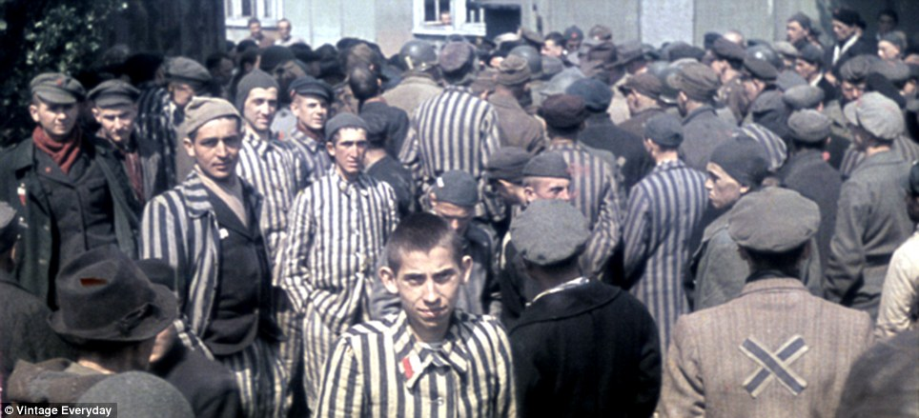
Dachau images
Notes:
Dachau

Slide 16
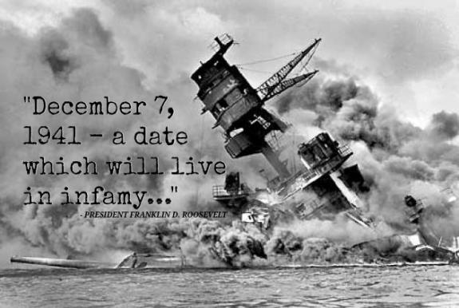

Slide 17
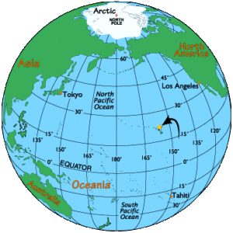
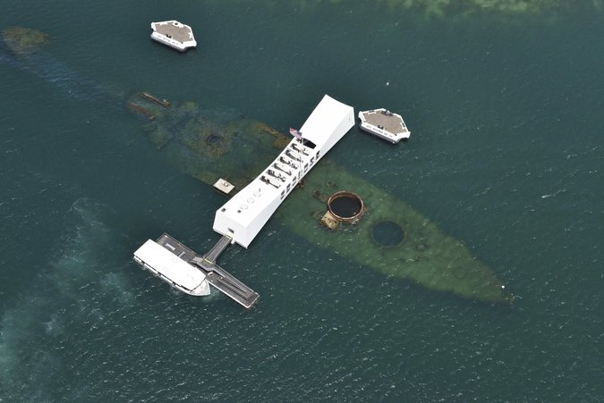
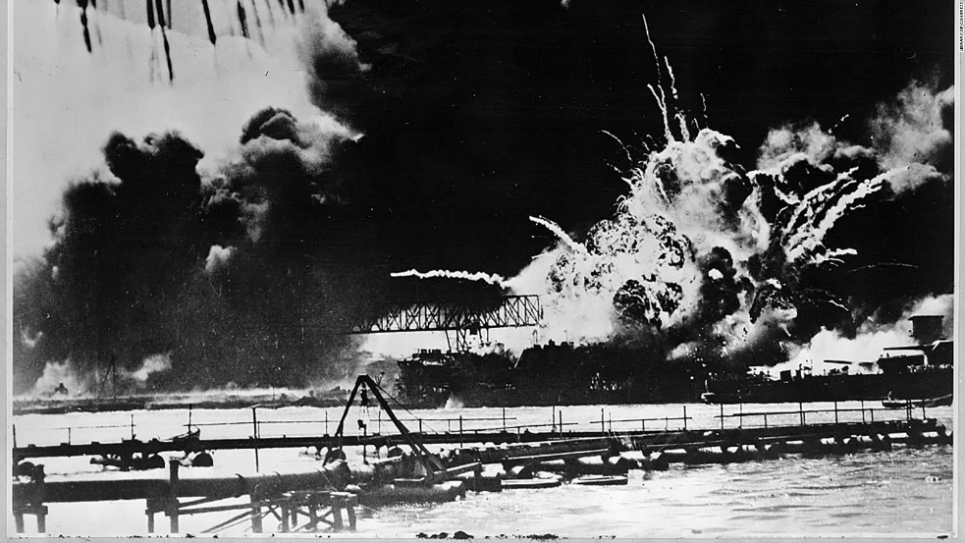
1941: The US joins the War
Dec. 7, 1941: Japan attacked the US naval base at Pearl Harbor
Surprise attack
Heavily damaged the US Pacific fleet
Killed 2,335 American servicemen & 68 civilians
“A day that will live in infamy”- American president Roosevelt’s famous words from the speech in which he asked Congress to declare war on Japan

Slide 18
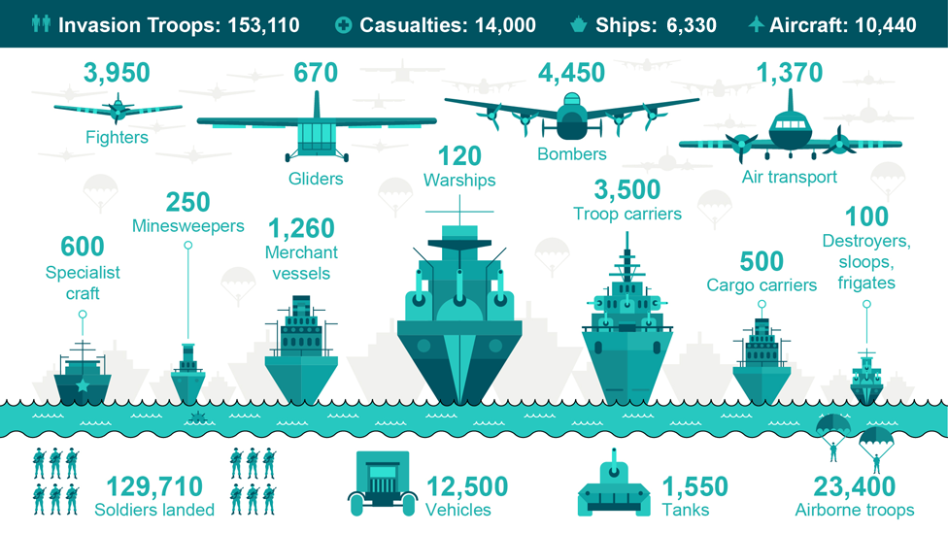
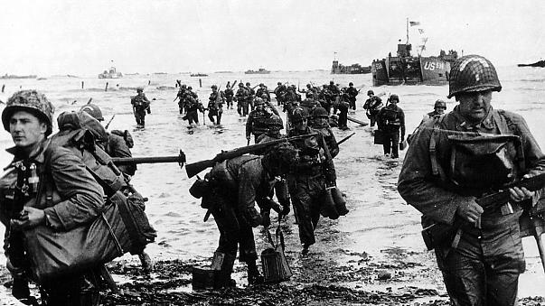
June 6, 1944: D-Day
Allied invasion of Europe
Launched by boat & air on the northern coast of Normandy, France
TURNING POINT IN THE WAR! Allies began to invade & free much of Nazi-occupied Europe

Slide 19
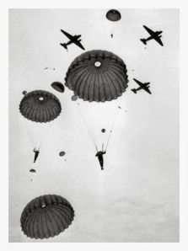

Slide 20
Notes:
To divert the Nazi attention… pas d’calais

Slide 21
Spring 1945
Allies clearly heading toward victory
Land invasion by Allies from both the West and the East
Hitler commits suicide in April
May 7, 1945: Germany surrenders (VE Day)
The European front of World War II is over!

Slide 22
U.S. Army propaganda poster prepares the public for the invasion of Japan after ending war on Germany and Italy

Slide 23
August 1945: The Atomic Bombing & End of the War
July- US secretly tests first atomic bomb
President Truman made the decision to drop the recently tested atomic bomb
Aug. 6- Atomic bomb dropped on Hiroshima, immediately killing 70,000
US warned Japan to surrender or face a second atomic bomb
Japan did not surrender
Aug. 9- Atomic bomb dropped on Nagasaki, killing 37,500 immediately
Aug. 15- Japan surrenders, ending fighting in WWII (VJ Day)
Video clip

